Slide 1
CS247: Advanced Data Mining
08: Graph and Network: Spectral Clustering and Label Propagation
Instructor: Yizhou Sun
yzsun@cs.ucla.edu
February 12, 2024

Slide 2
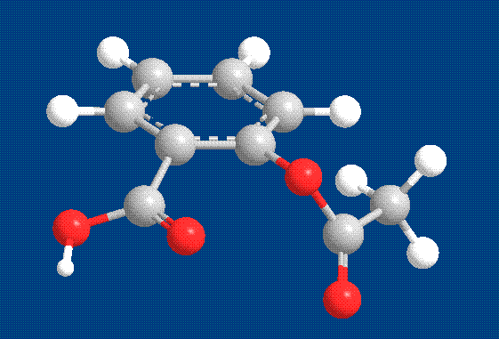
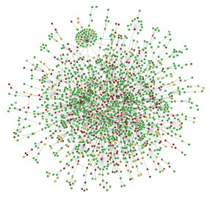
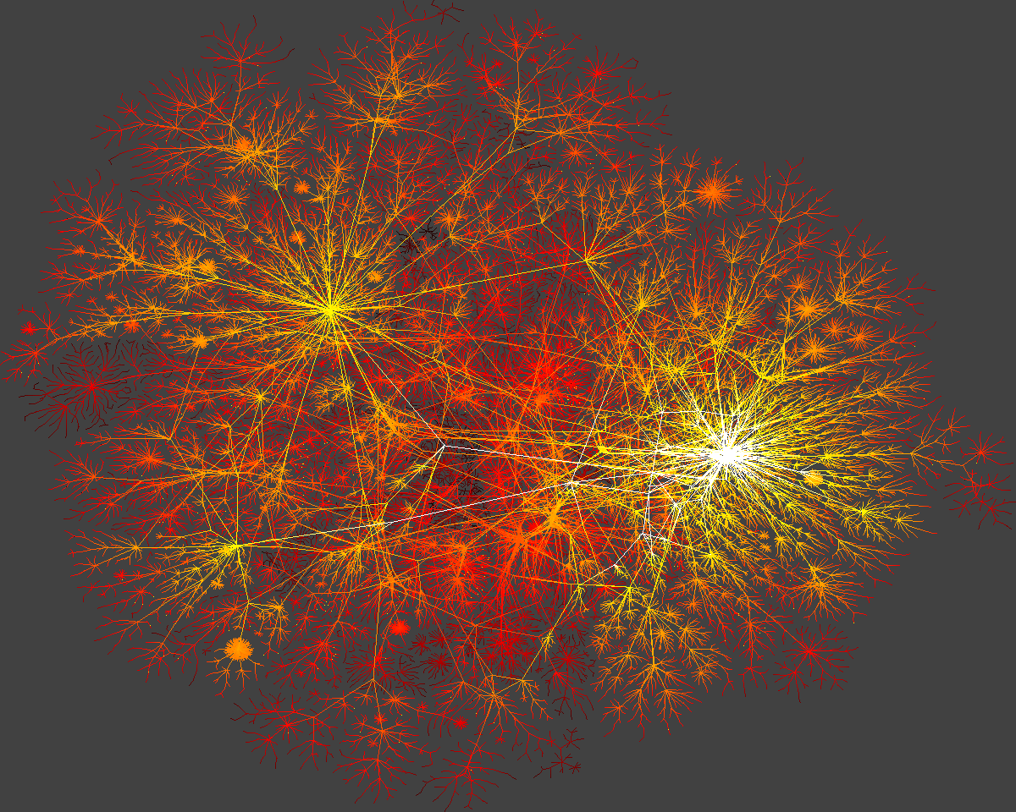
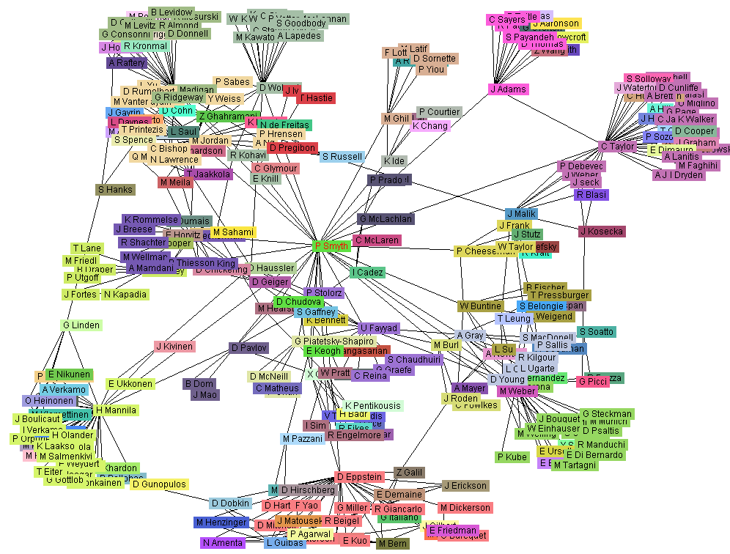
Graph, Graph, Everywhere
from H. Jeong et al Nature 411, 41 (2001)
Aspirin
Yeast protein interaction network
Internet
Co-author network

Slide 3
Why Graph Mining?
Graphs are ubiquitous
Chemical compounds (Cheminformatics)
Protein structures, biological pathways/networks (Bioinformactics)
Program control flow, traffic flow, and workflow analysis
XML databases, Web, and social network analysis
Graph is a general model
Trees, lattices, sequences, and items are degenerated graphs
Diversity of graphs
Directed vs. undirected, labeled vs. unlabeled (edges & vertices), weighted vs. unweighted, homogeneous vs. heterogeneous
Complexity of algorithms: many problems are of high complexity

Slide 4
Graph Tasks
Node Level
Node classification
Node clustering
Link prediction
Ranking and similarity search
…
Graph Level
Graph classification
Graph clustering
Graph similarity search
…

Slide 5
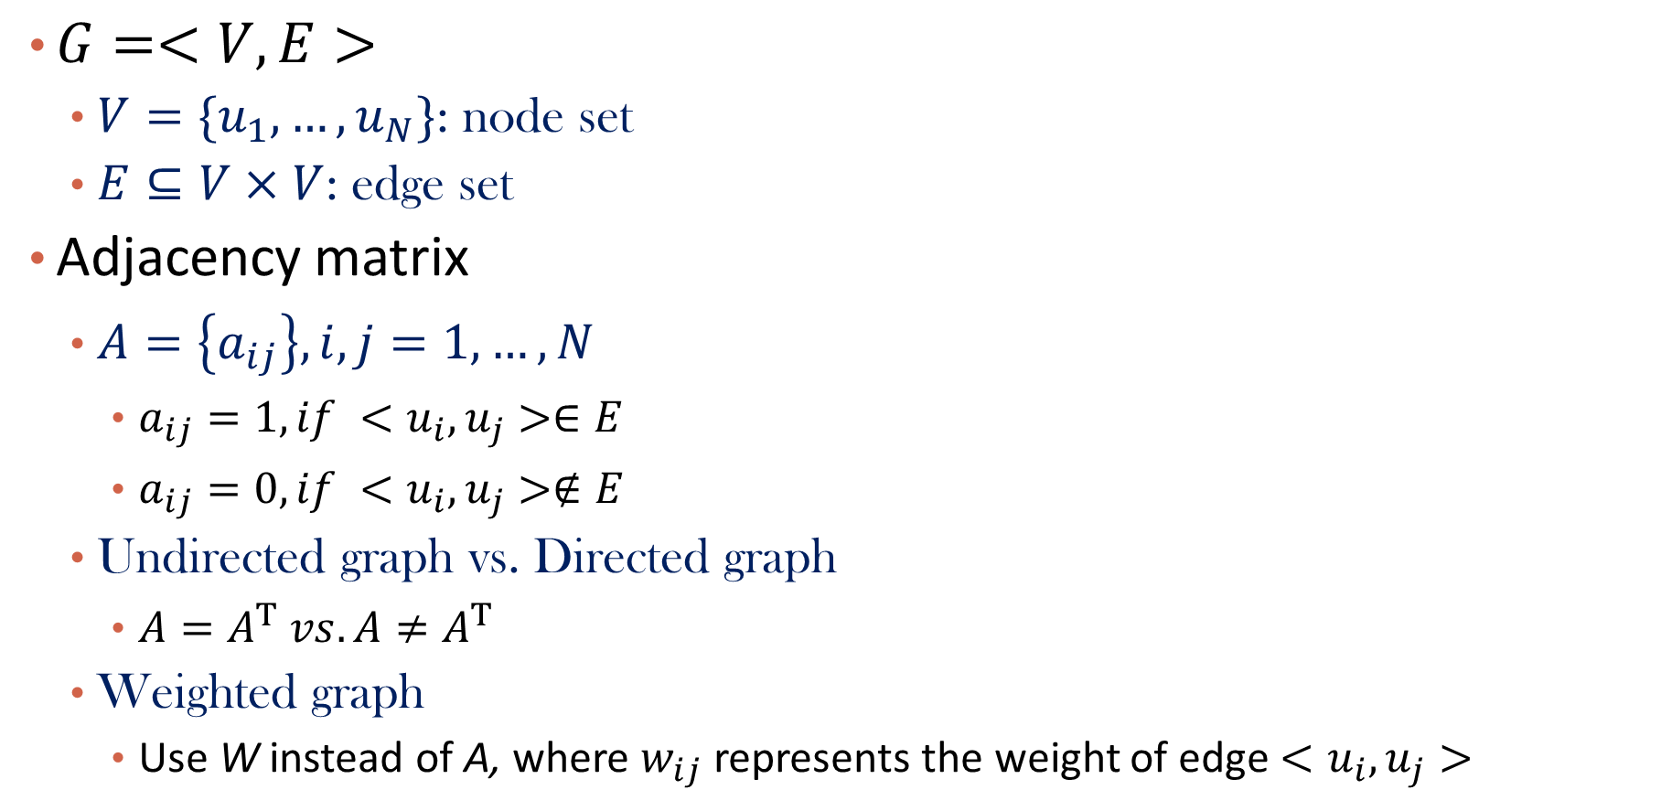
Representation of a Graph
$G=<V,E>$
$V=\{u_{1},…,u_{N}\}$: node set
$E⊆V×V$: edge set
Adjacency matrix
$A=\left\{a_{ij}\right\}, i,j=1,…,N$
$a_{ij}=1, if {<u}_{i},u_{j}>∈E$
$a_{ij}=0, if {<u}_{i},u_{j}>∉E$
Undirected graph vs. Directed graph
$A=A^{T} vs. A≠A^{T}$
Weighted graph
Use W instead of A, where $w_{ij}$ represents the weight of edge ${<u}_{i},u_{j}>$

Slide 6
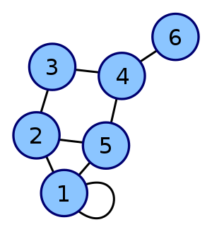
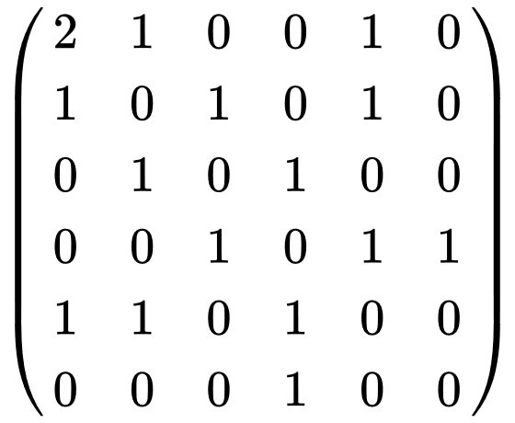
Examples
Yahoo
y a m
y 1 0 0
a 1 0 1
m 0 1 0
Amazon
M’soft
Adjacency matrix A

Slide 7
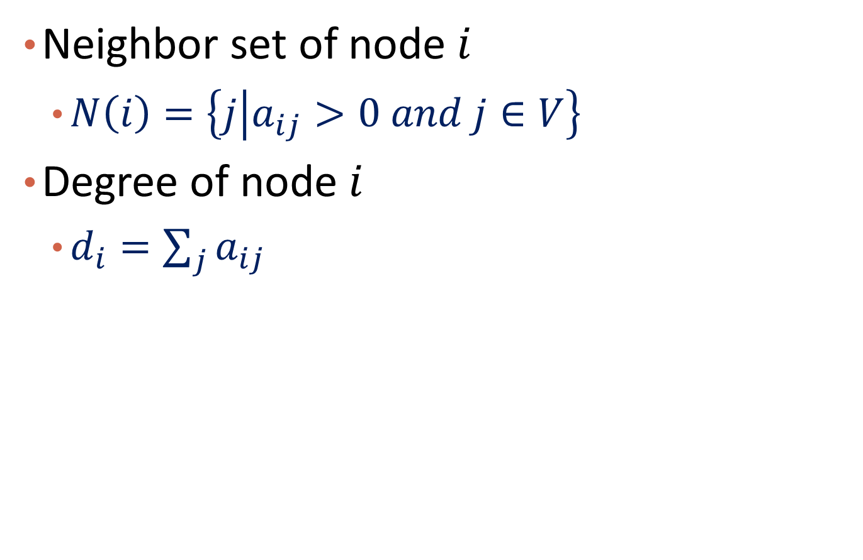
Neighbors and Degree
Neighbor set of node $i$
$N\left(i\right)=\left\{j | a_{ij}>0 and j∈V\right\}$
Degree of node $i$
$d_{i}=\sum_{j}{a_{ij}}$

Slide 8
Graph: Clustering and Classification
Graph Laplacians
Spectral Clustering
Label Propagation
Summary

Slide 9
What are Graph Laplacian Matrices?
They are matrices defined as functions of graph adjacency or weight matrix
A tool to study graphs
There is a field called spectral graph theory studying those matrices

Slide 10
Why do we need them?
Better understand the graph
Important in modeling, loss function and regularization term design

Slide 11
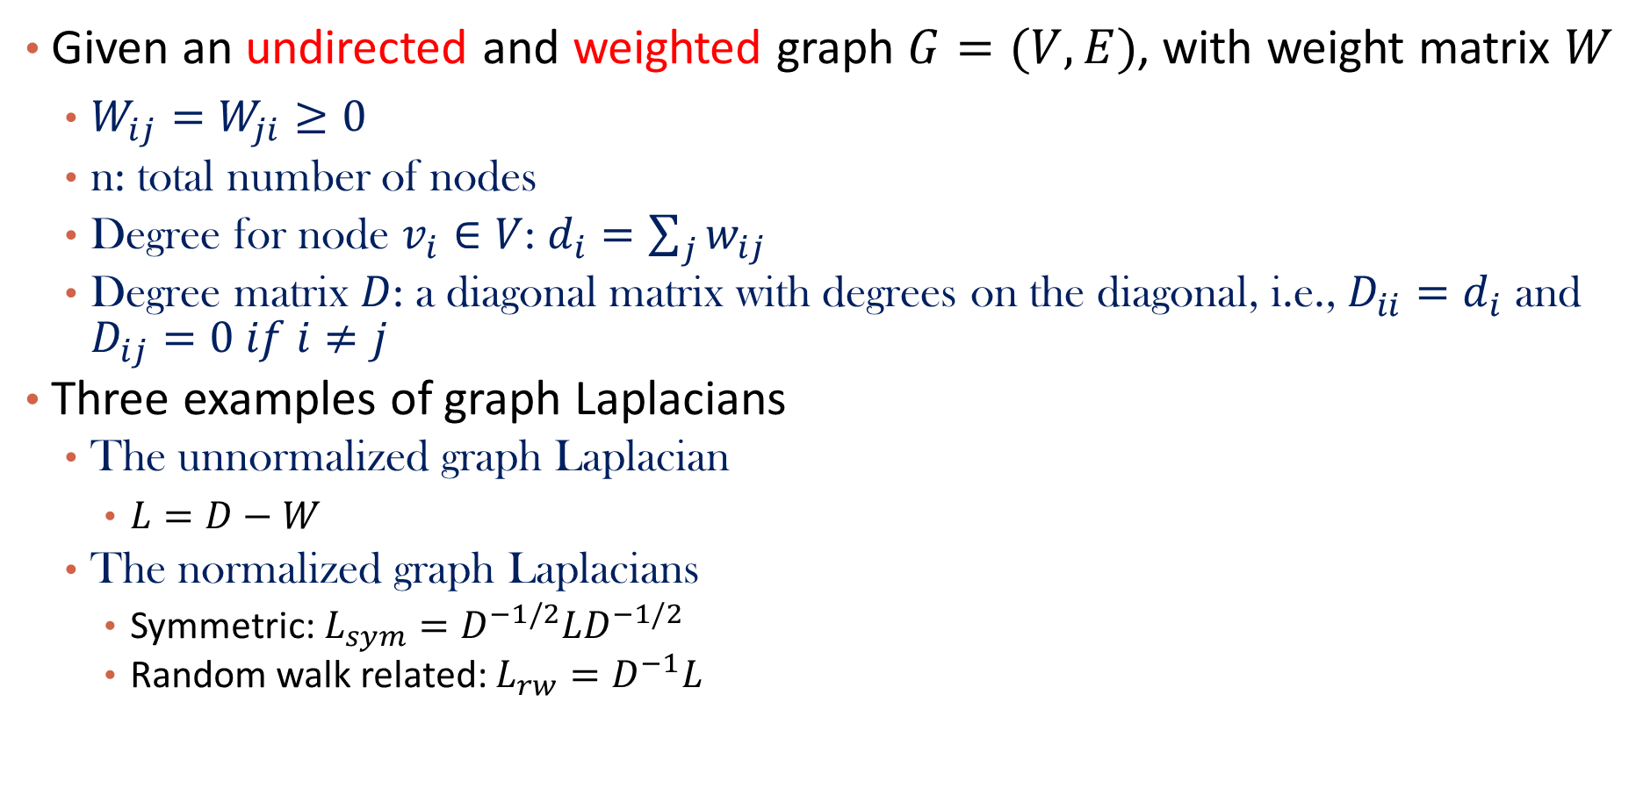
Examples of Graph Laplacians
Given an undirected and weighted graph $G=(V,E)$, with weight matrix $W$
$W_{ij}=W_{ji}≥0$
n: total number of nodes
Degree for node $v_{i}∈V$: $d_{i}=\sum_{j}{w_{ij}}$
Degree matrix $D$: a diagonal matrix with degrees on the diagonal, i.e., $D_{ii}=d_{i}$ and $D_{ij}=0 if i≠j$
Three examples of graph Laplacians
The unnormalized graph Laplacian
$L=D−W$
The normalized graph Laplacians
Symmetric: $L_{sym}=D^{−1/2}LD^{−1/2}$
Random walk related: $L_{rw}=D^{−1}L$

Slide 12
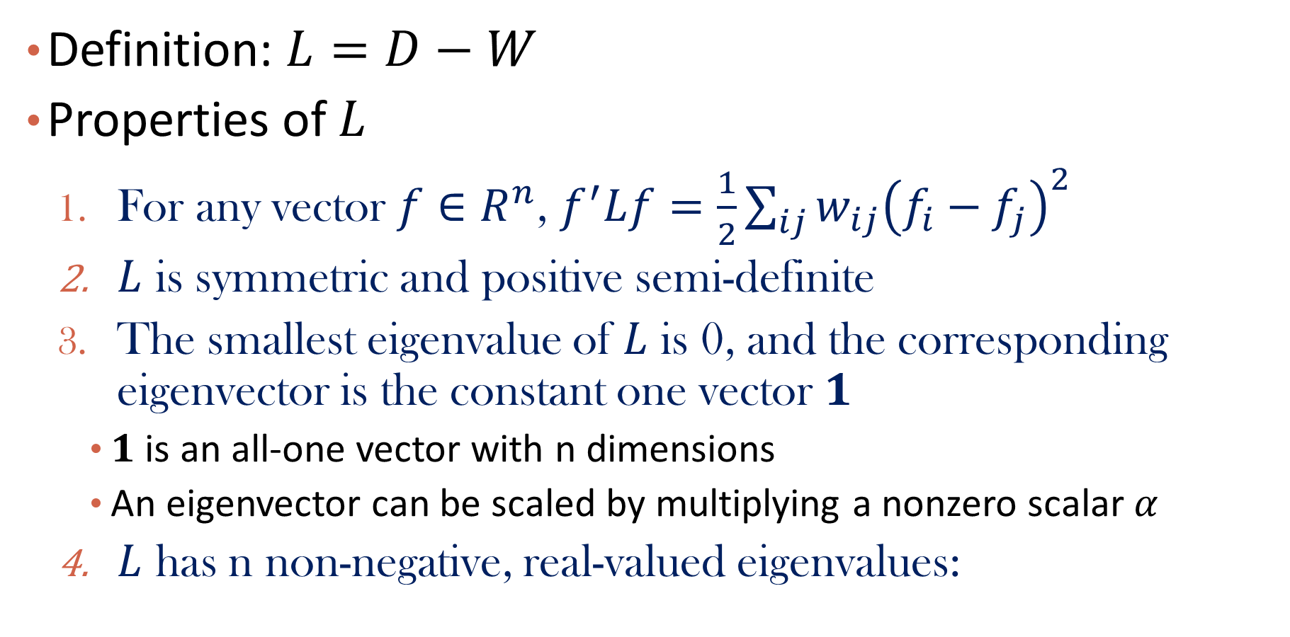
The Unnormalized Graph Laplacian
Definition: $L=D−W$
Properties of $L$
For any vector $f∈R^{n}$, $f^{′}Lf=\frac{1}{2}\sum_{ij}{w_{ij}{\left(f_{i}−f_{j}\right)}^{2}}$
$L$ is symmetric and positive semi-definite
The smallest eigenvalue of $L$ is 0, and the corresponding eigenvector is the constant one vector $1$
$1$ is an all-one vector with n dimensions
An eigenvector can be scaled by multiplying a nonzero scalar $α$
$L$ has n non-negative, real-valued eigenvalues:

Slide 13

Proof of Property 1
For any vector $f∈R^{n}$, $f^{′}Lf=\frac{1}{2}\sum_{ij}{w_{ij}{\left(f_{i}−f_{j}\right)}^{2}}$

Slide 14

Proof of Property 2
$L$ is symmetric and positive semi-definite
Undirected graph => symmetric
Property 1 => $f^{′}Lf≥0$ => positive semi-definite, by definition

Slide 15

Proof of Property 3
The smallest eigenvalue of $L$ is 0, and the corresponding eigenvector is the constant one vector $1$

Slide 16

Proof of Property 4
$L$ has n non-negative, real-valued eigenvalues:

Slide 17

Question
Will adding self loops in graph change $L$?

Slide 18
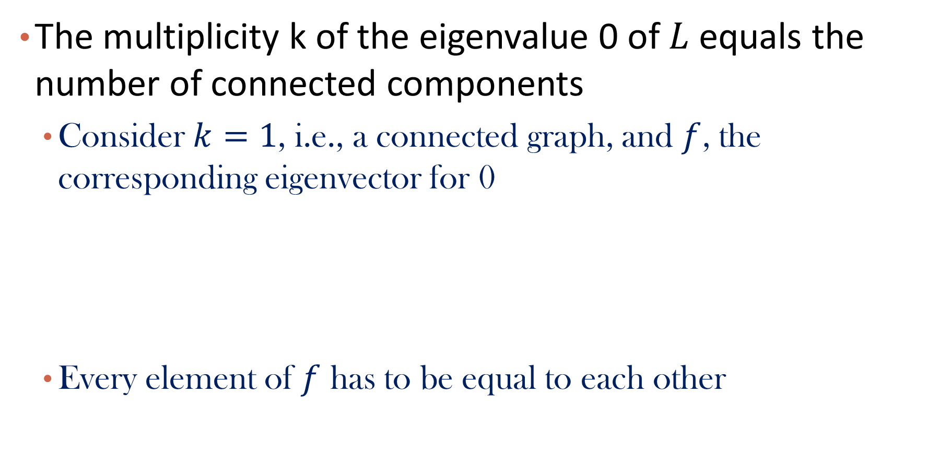
Number of Connected Components
The multiplicity k of the eigenvalue 0 of $L$ equals the number of connected components
Consider $k=1$, i.e., a connected graph, and $f$, the corresponding eigenvector for 0
Every element of $f$ has to be equal to each other

Slide 19
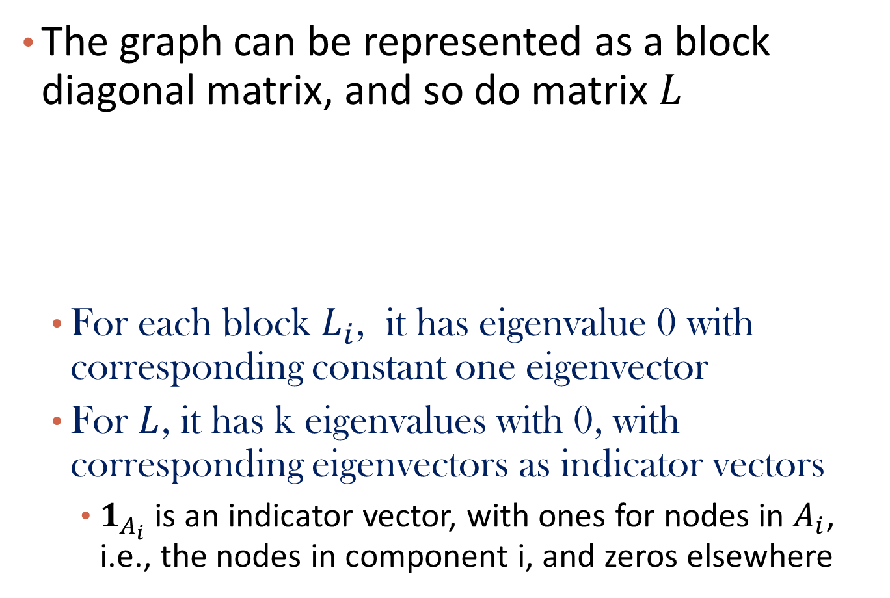
K connected components
The graph can be represented as a block diagonal matrix, and so do matrix $L$
For each block $L_{i}$, it has eigenvalue 0 with corresponding constant one eigenvector
For $L$, it has k eigenvalues with 0, with corresponding eigenvectors as indicator vectors
$1_{A_{i}}$ is an indicator vector, with ones for nodes in $A_{i}$, i.e., the nodes in component i, and zeros elsewhere

Slide 20
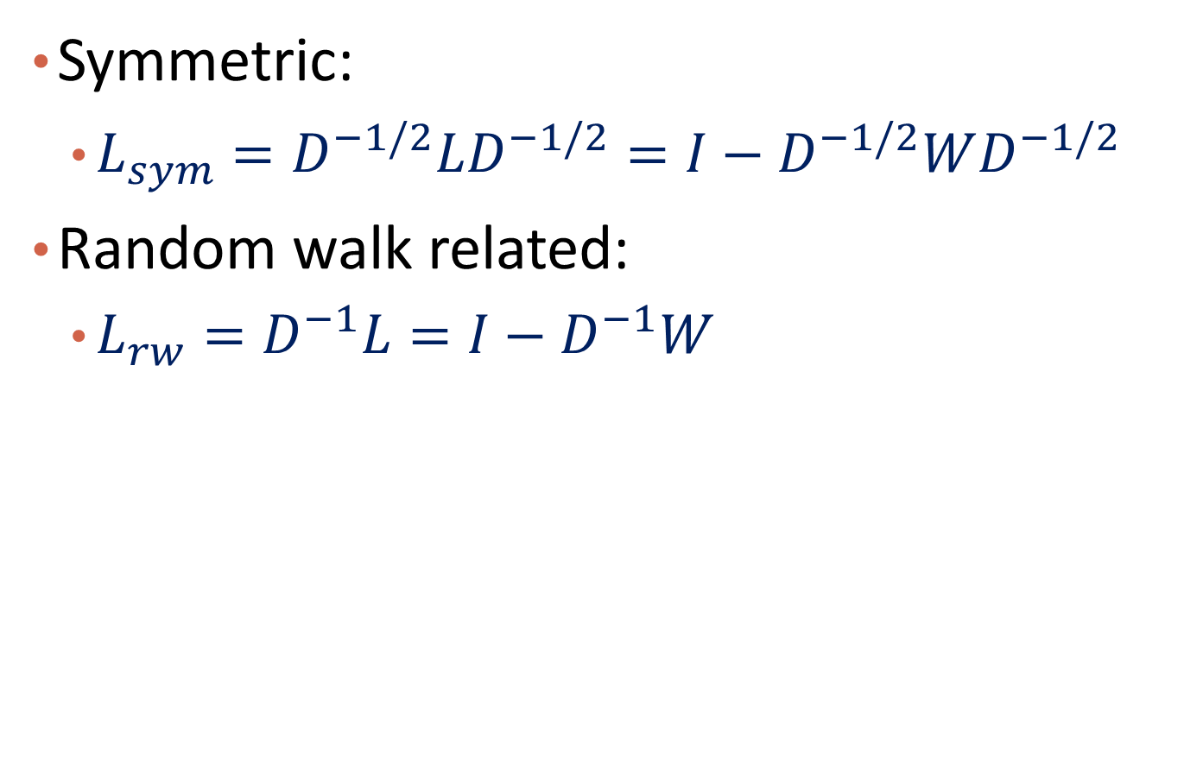
The normalized graph Laplacians
Symmetric:
$L_{sym}=D^{−1/2}LD^{−1/2}=I−D^{−1/2}WD^{−1/2}$
Random walk related:
$L_{rw}=D^{−1}L=I−D^{−1}W$

Slide 21
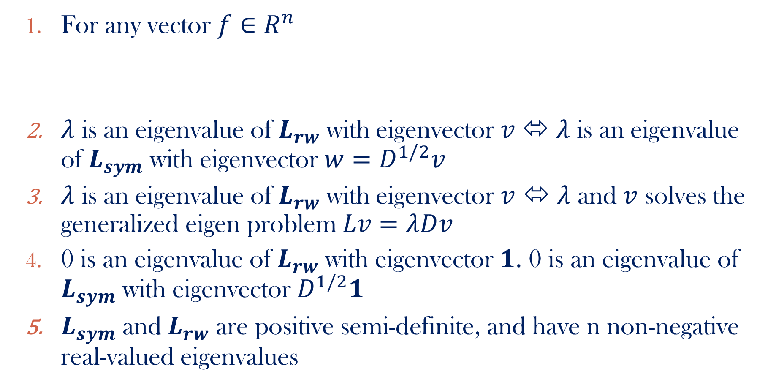

Properties of $L_{sym}$ and $L_{rw}$
For any vector $f∈R^{n}$
$λ$ is an eigenvalue of $L_{rw}$ with eigenvector $v$⬄ $λ$ is an eigenvalue of $L_{sym}$ with eigenvector $w=D^{1/2}v$
$λ$ is an eigenvalue of $L_{rw}$ with eigenvector $v$ ⬄ $λ$ and $v$ solves the generalized eigen problem $Lv=λDv$
0 is an eigenvalue of $L_{rw}$ with eigenvector 𝟏. 0 is an eigenvalue of $L_{sym}$ with eigenvector $D^{1/2}\text{1}$
$L_{sym}$ and $L_{rw}$ are positive semi-definite, and have n non-negative real-valued eigenvalues

Slide 22

Proof of Property 1
For any vector $f∈R^{n},$

Slide 23

Proof of Property 2
$λ$ is an eigenvalue of $L_{rw}$ with eigenvector $v$⬄ $λ$ is an eigenvalue of $L_{sym}$ with eigenvector $w=D^{1/2}v$

Slide 24

Proof of Property 3
$λ$ is an eigenvalue of $L_{rw}$ with eigenvector $v$ ⬄ $λ$ and $v$ solves the generalized eigen problem $Lv=λDv$

Slide 25

Proof of Property 4
0 is an eigenvalue of $L_{rw}$ with eigenvector 𝟏. 0 is an eigenvalue of $L_{sym}$ with eigenvector $D^{1/2}\text{1}$

Slide 26
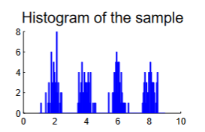
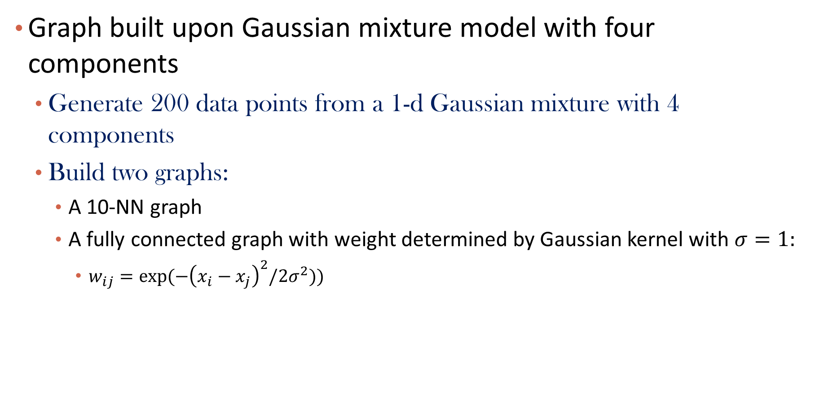
Example
Graph built upon Gaussian mixture model with four components
Generate 200 data points from a 1-d Gaussian mixture with 4 components
Build two graphs:
A 10-NN graph
A fully connected graph with weight determined by Gaussian kernel with $σ=1:$
$w_{ij}=exp⁡(−{\left(x_{i}−x_{j}\right)}^{2}/2σ^{2}))$
https://arxiv.org/pdf/0711.0189.pdf

Slide 27
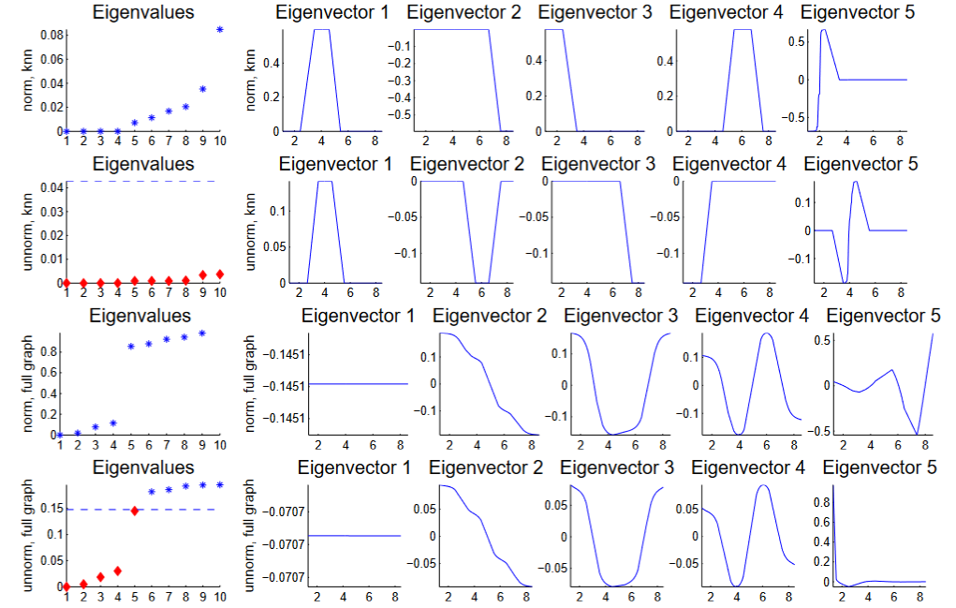


Example Cont.
$$λ_{i} vs. i$$
Eigenvector value $vs. x$

Slide 28
Graph: Clustering and Classification
Graph Laplacians
Spectral Clustering
Label Propagation
Summary

Slide 29
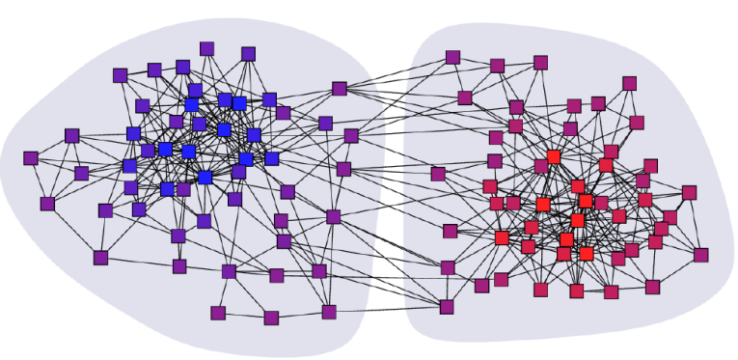
Clustering Graphs and Network Data
Applications
Bi-partite graphs, e.g., customers and products, authors and conferences
Web search engines, e.g., click through graphs and Web graphs
Social networks, friendship/coauthor graphs
Clustering books about politics [Newman, 2006]
29

Slide 30
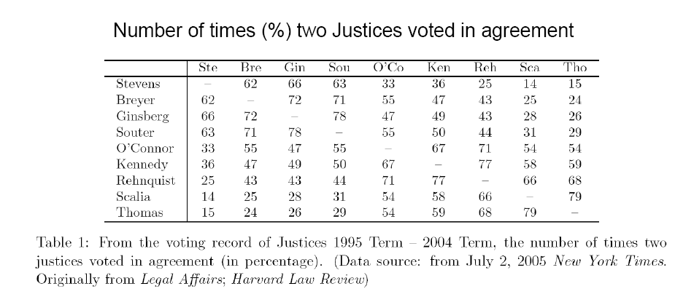
Example of Graph Clustering
Reference: ICDM’09 Tutorial by Chris Ding
Example:
Clustering supreme court justices according to their voting behavior
W =

Slide 31
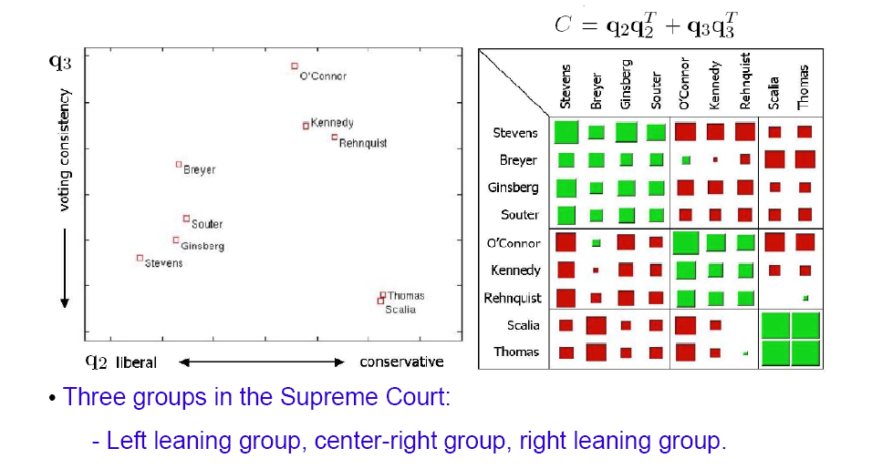
Example: Continue

Slide 32
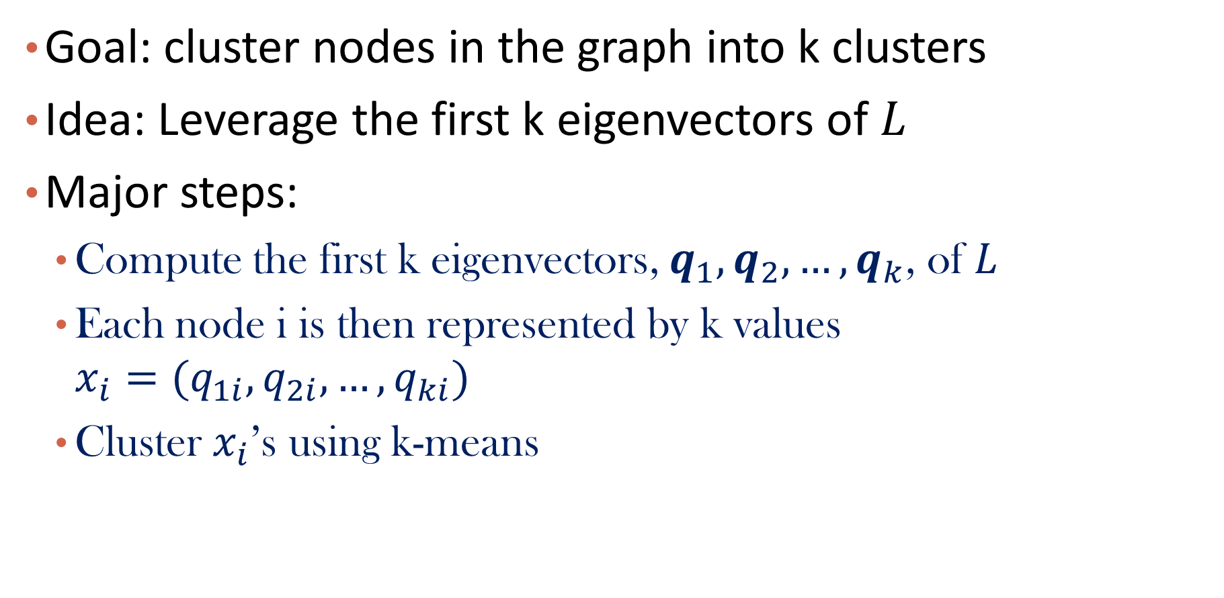
Spectral Clustering Algorithms
Goal: cluster nodes in the graph into k clusters
Idea: Leverage the first k eigenvectors of $L$
Major steps:
Compute the first k eigenvectors, $q_{1},q_{2},…,q_{k}$, of $L$
Each node i is then represented by k values ${x_{i}=(q}_{1i},q_{2i},…,q_{ki})$
Cluster $x_{i}$’s using k-means

Slide 33
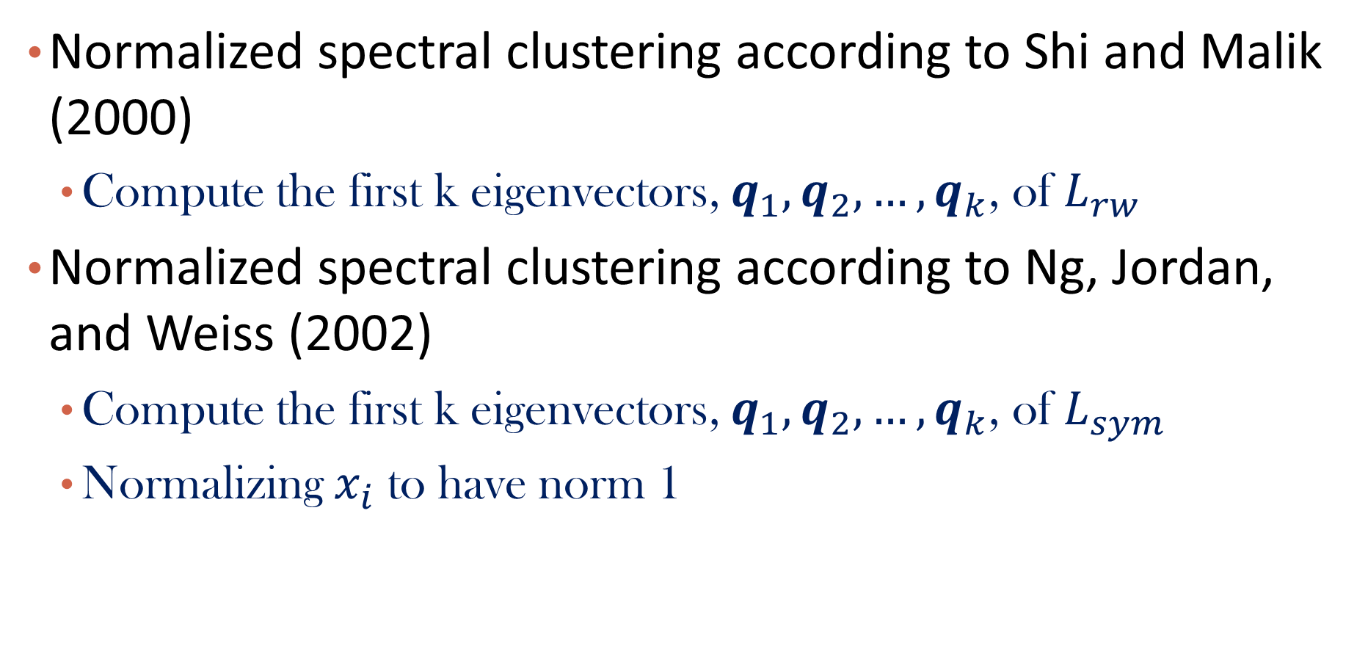
Variants of Spectral Clustering Algorithms
Normalized spectral clustering according to Shi and Malik (2000)
Compute the first k eigenvectors, $q_{1},q_{2},…,q_{k}$, of $L_{rw}$
Normalized spectral clustering according to Ng, Jordan, and Weiss (2002)
Compute the first k eigenvectors, $q_{1},q_{2},…,q_{k}$, of $L_{sym}$
Normalizing $x_{i}$ to have norm 1

Slide 34
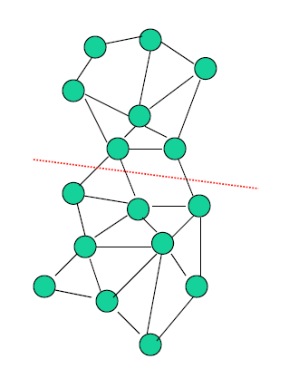
Connections to Graph Cuts
Min-Cut
Minimize the # of cut of edges to partition a graph into 2 disconnected components

Slide 35
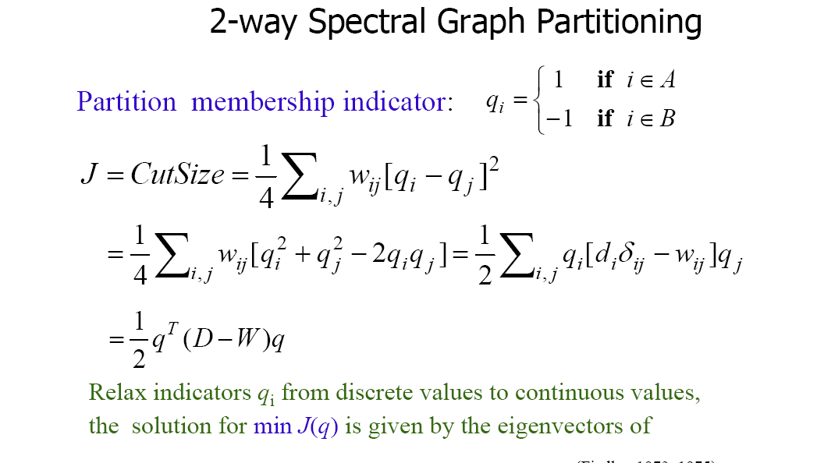


Objective Function of Min-Cut
The optimization problem:
$$\min{J(q)}$$
$$s.t. q^{T}q=n$$

Slide 36
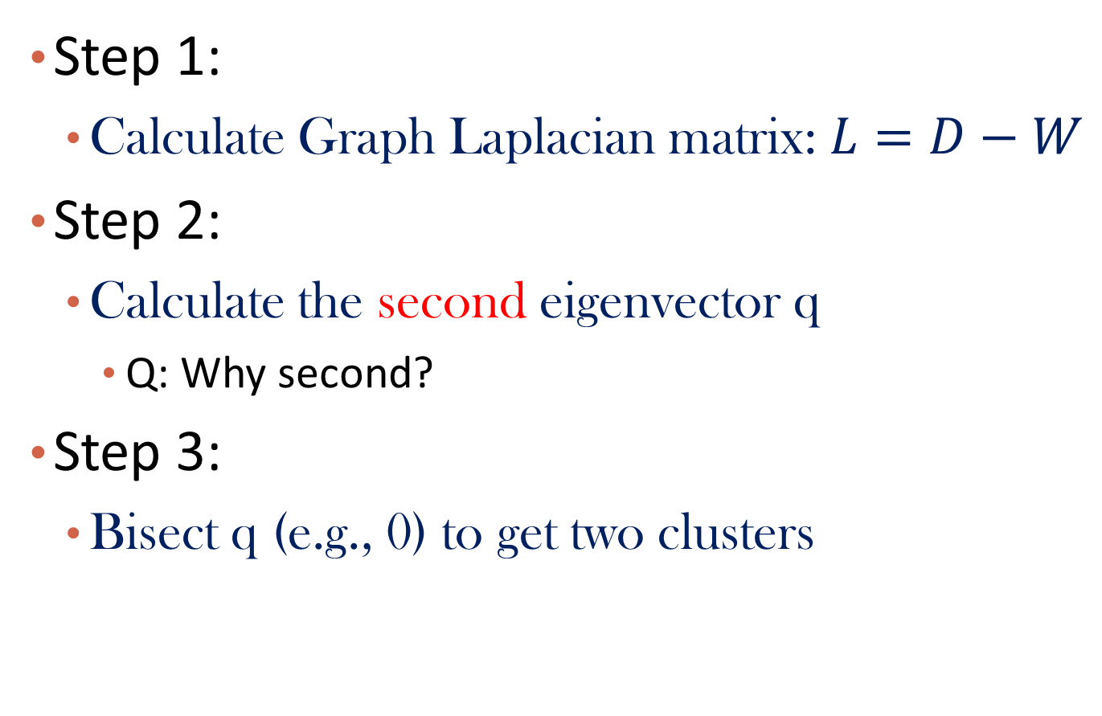
Algorithm
Step 1:
Calculate Graph Laplacian matrix: $L=D−W$
Step 2:
Calculate the second eigenvector q
Q: Why second?
Step 3:
Bisect q (e.g., 0) to get two clusters

Slide 37
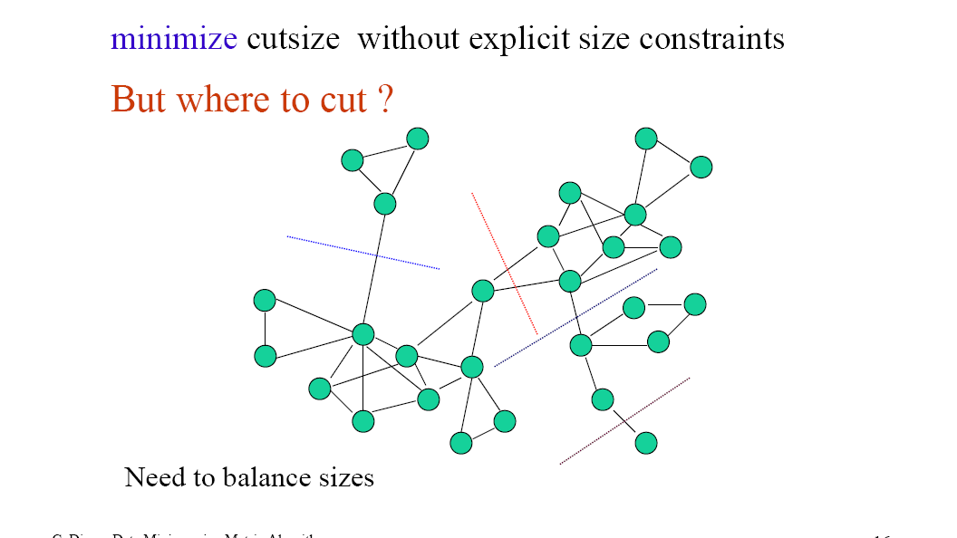
Minimum Cut with Constraints

Slide 38
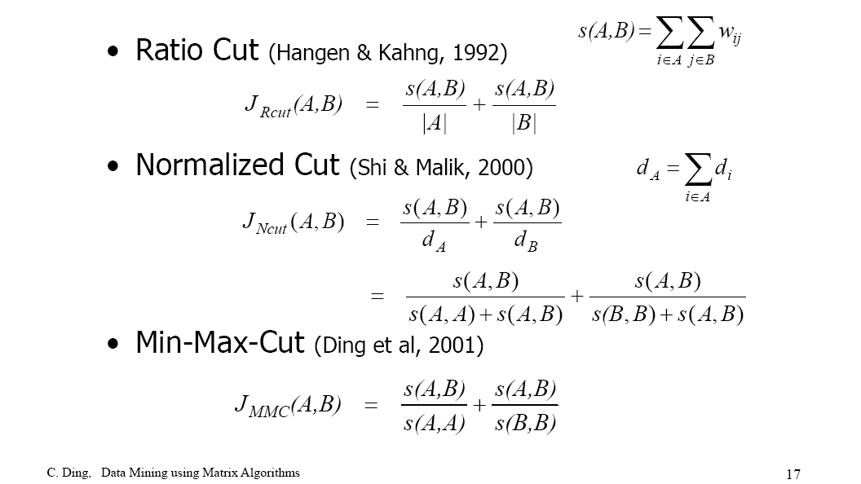
Other Objective Functions

Slide 39
Graph: Clustering and Classification
Graph Laplacians
Spectral Clustering
Label Propagation
Summary

Slide 40
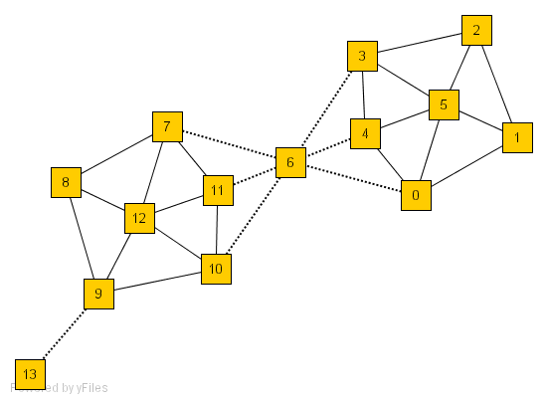
Label Propagation in the Network
Given a network, some nodes are given labels, can we classify the unlabeled nodes by using link information?
E.g., Node 12 belongs to Class 1, Node 5 Belongs to Class 2
5
12

Slide 41
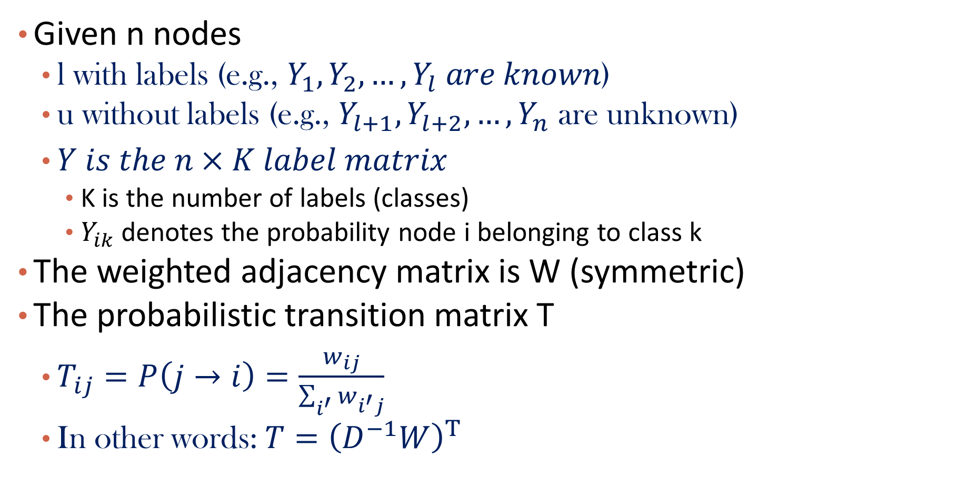
Problem Formalization for Label Propagation
Given n nodes
l with labels (e.g., $Y_{1},Y_{2},…,Y_{l} are known$)
u without labels (e.g., $Y_{l+1},Y_{l+2}, …,Y_{n}$ are unknown)
$Y is the n×K label matrix$
K is the number of labels (classes)
$Y_{ik}$ denotes the probability node i belonging to class k
The weighted adjacency matrix is W (symmetric)
The probabilistic transition matrix T
$T_{ij}=P\left(j→i\right)=\frac{w_{ij}}{\sum_{i^{′}}{w_{i^{′}j}}}$
In other words: $T={\left(D^{−1}W\right)}^{T}$

Slide 42
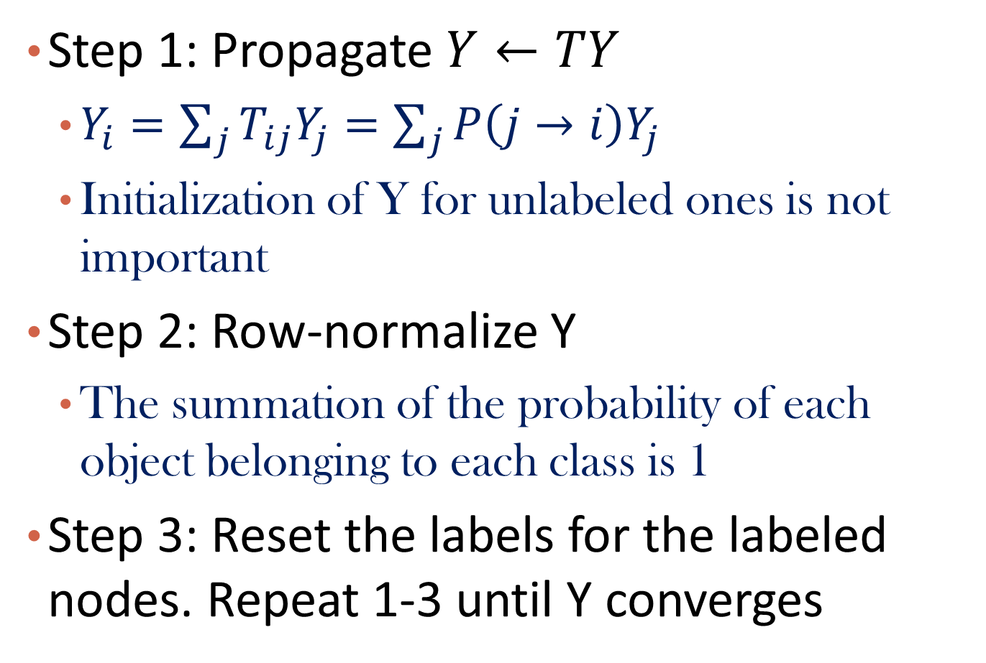
The Label Propagation Algorithm
Step 1: Propagate $Y←TY$
$Y_{i}=\sum_{j}{T_{ij}Y_{j}=\sum_{j}{P\left(j→i\right)Y_{j}}}$
Initialization of Y for unlabeled ones is not important
Step 2: Row-normalize Y
The summation of the probability of each object belonging to each class is 1
Step 3: Reset the labels for the labeled nodes. Repeat 1-3 until Y converges

Slide 43
Example: Iter = 0
5
12

Slide 44
Example: Iter = 1
2
3
5
7
4
1
8
11
0
12
10
9

Slide 45
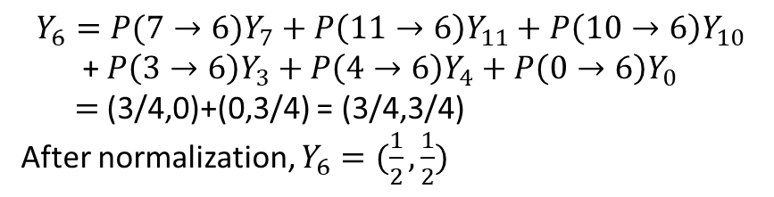
Example: Iter = 2
2
3
5
7
4
1
6
8
11
0
12
10
9
$$Y_{6}={P(7→6)Y}_{7}+P\left(11→6\right)Y_{11}+P\left(10→6\right)Y_{10}$$
+ $P\left(3→6\right)Y_{3}+P\left(4→6\right)Y_{4}+P\left(0→6\right)Y_{0}$
$=$(3/4,0)+(0,3/4) = (3/4,3/4)
After normalization, $Y_{6}=(\frac{1}{2},\frac{1}{2})$
13

Slide 46
Other Label Propagation Algorithms
Energy minimizing and harmonic function
Semi-Supervised Learning Using Gaussian Fields and Harmonic Functions
By Xiaojin Zhu et al., ICML’03
https://www.aaai.org/Papers/ICML/2003/ICML03-118.pdf
Graph regularization
Learning with Local and Global Consistency
By Denny Zhou et al., NIPS’03
http://papers.nips.cc/paper/2506-learning-with-local-and-global-consistency.pdf

Slide 47
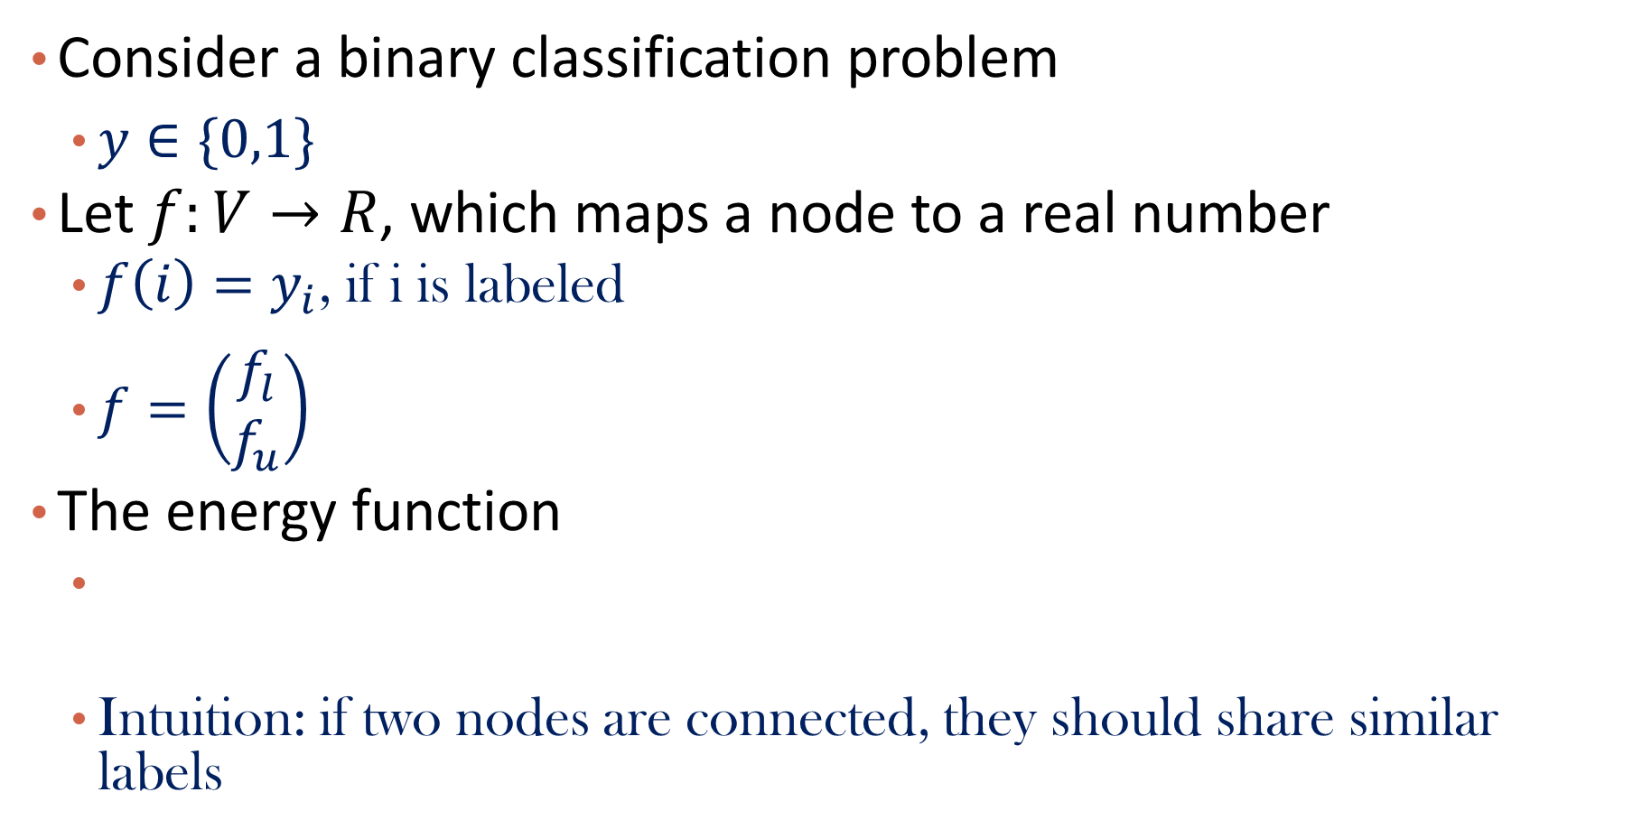
From Energy Minimizing Perspective
Consider a binary classification problem
$y∈\{0,1\}$
Let $f:V→R$, which maps a node to a real number
$f\left(i\right)=y_{i}$, if i is labeled
$f=\left(\begin{matrix}f_{l} \\ f_{u}\end{matrix}\right)$
The energy function
Intuition: if two nodes are connected, they should share similar labels

Slide 48

Minimizing Energy Function Results in Harmonic Function
Note $E\left(f\right)=f^{′}\left(D−W\right)f=f^{′}Lf!$
Goal: find f such that $E\left(f\right)$ is minimized, and $f_{l}$ is fixed
Solution: $\frac{dE(f)}{df_{u}}=0$
Notes:
$$\left(D−W\right)f=0$$

Slide 49


Solve $f_{u}$
Consider W as a block matrix
Closed form solution of $f_{u}$:
Where $P=D^{−1}W$
Q: Which graph Laplacian is this?

Slide 50


Iterative solution of $f_{u}$:
$f_{u}=(\sum_{t=0}{P_{uu}^{t})P_{ul}f_{l}}⇒$
$f_{u}^{0}=P_{ul}f_{l}, f_{u}^{t}=P_{uu}f_{u}^{t−1}+P_{ul}f_{l}, f_{u}=\lim_{t→∞}{f_{u}^{t}}$
As ${{(I−P}_{uu})}^{−1}=I+P_{uu}+P_{uu}^{2}+…$

Slide 51
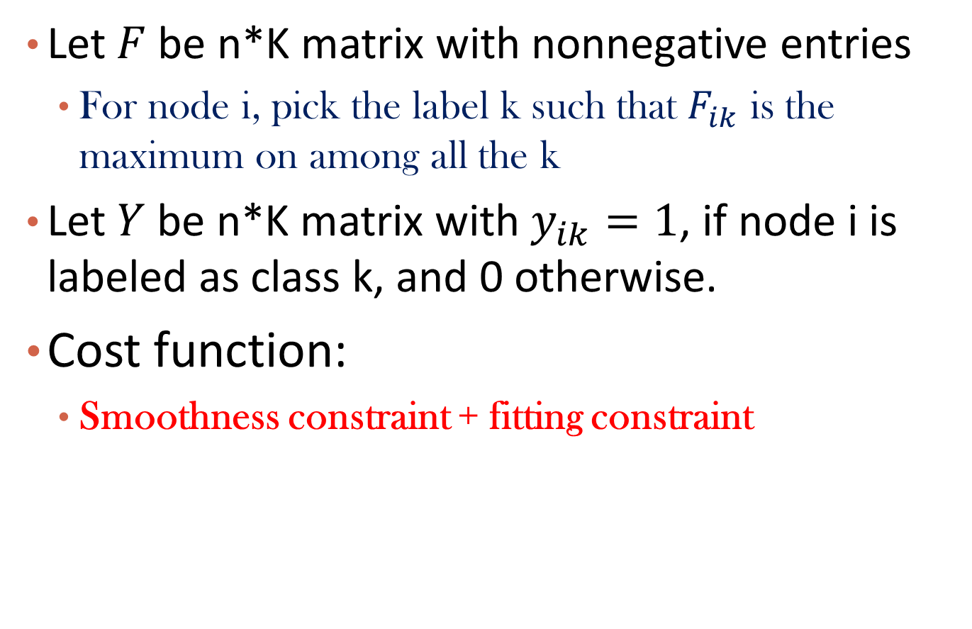
From Graph Regularization Perspective
Let $F$ be n*K matrix with nonnegative entries
For node i, pick the label k such that $F_{ik}$ is the maximum on among all the k
Let $Y$ be n*K matrix with $y_{ik}=1$, if node i is labeled as class k, and 0 otherwise.
Cost function:
Smoothness constraint + fitting constraint

Slide 52
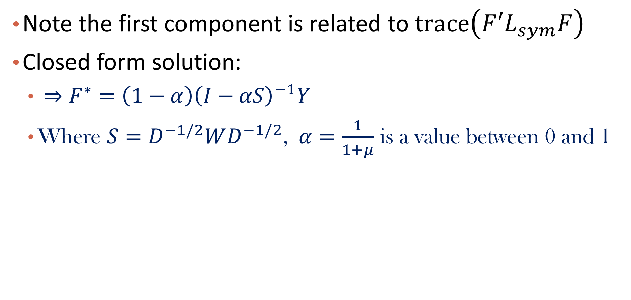
Solve F
Note the first component is related to $trace\left(F{′L}_{sym}F\right)$
Closed form solution:
$⇒F^{∗}=\left(1−α\right){\left(I−αS\right)}^{−1}Y$
Where $S=D^{−1/2}WD^{−1/2}$, $α=\frac{1}{1+μ}$ is a value between 0 and 1

Slide 53

Iterative solution
$F^{∗}=\left(1−α\right){\left(I−αS\right)}^{−1}Y$
$F\left(0\right)=\left(1−α\right)Y$
when $t→∞, F\left(t\right)→F^{∗}$

Slide 54
Graph: Clustering and Classification
Graph Laplacians
Spectral Clustering
Label Propagation
Summary

Slide 55
Summary
Graph Laplacians are keys to understand graphs
Unnormalized graph Laplacians
Normalized graph Laplacians
Spectral clustering
Leverage eigenvectors of graph Laplacians to conduct clustering on graphs
Has close relationship with graph cuts
Label propagation
Semi-supervised node classification on graphs
Also related to graph Laplacians

Slide 56
References
A Tutorial on Spectral Clustering by U. Luxburg http://www.kyb.mpg.de/fileadmin/user_upload/files/publications/attachments/Luxburg07_tutorial_4488%5B0%5D.pdf
Learning from Labeled and Unlabeled Data with Label Propagation
By Xiaojin Zhu and Zoubin Ghahramani
http://www.cs.cmu.edu/~zhuxj/pub/CMU-CALD-02-107.pdf
Semi-Supervised Learning Using Gaussian Fields and Harmonic Functions
By Xiaojin Zhu et al., ICML’03
https://www.aaai.org/Papers/ICML/2003/ICML03-118.pdf
Learning with Local and Global Consistency
By Denny Zhou et al., NIPS’03
http://papers.nips.cc/paper/2506-learning-with-local-and-global-consistency.pdf

