Slide 1
CS247: Advanced Data Mining
09: Graph and Network: Graph Embedding
Instructor: Yizhou Sun
yzsun@ccs.neu.edu
February 25, 2024

Slide 2
Graph Embedding
What is Graph Embedding
Shallow Network Embedding
Knowledge Graph Embedding
Graph Neural Network
Summary

Slide 3
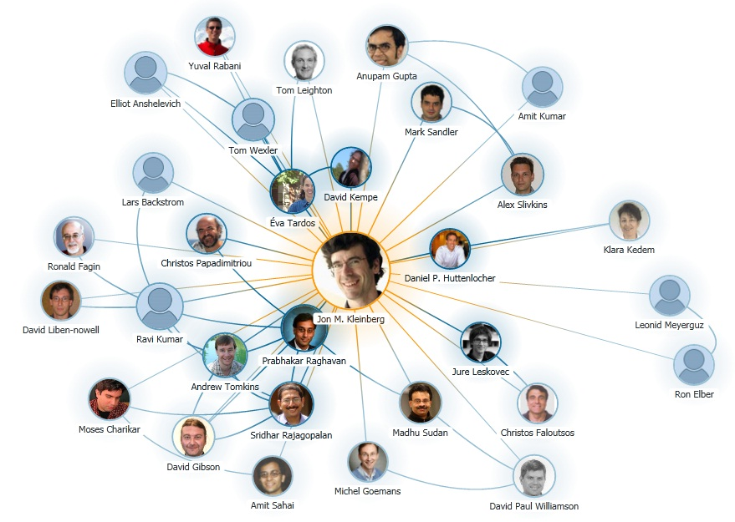
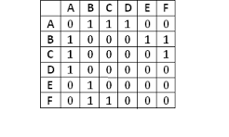
How to represent nodes?
A naïve solution
Limitations:
Extremely High-dimensional
No global structure information integrated
Permutation-variant

Slide 4
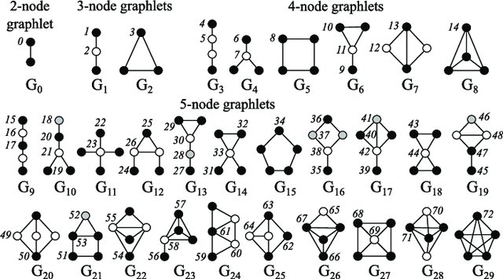
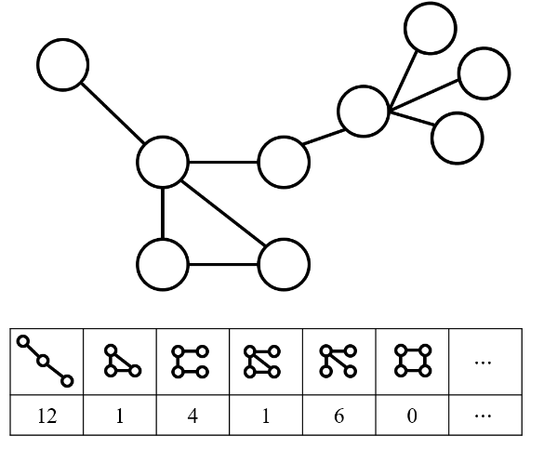
Even more challenging for graph representation
Ex. Graphlet-based feature vector
Source: DOI: 10.1093/bioinformatics/btv130
Source: https://haotang1995.github.io/projects/robust_graph_level_representation_learning_using_graph_based_structural_attentional_learning
Requires subgraph isomorphism test: NP-hard

Slide 5
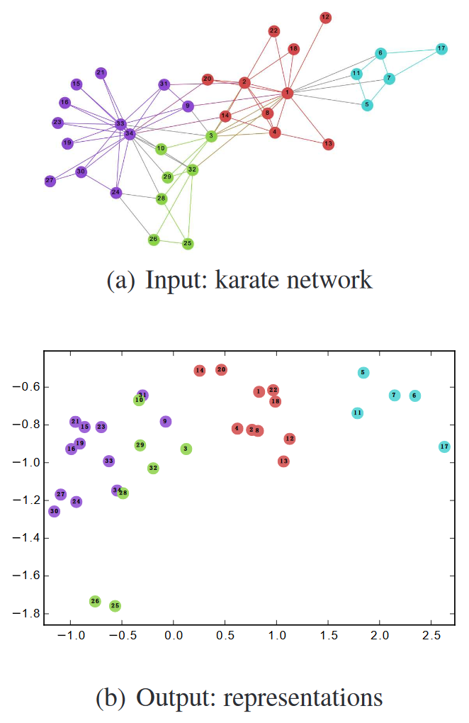
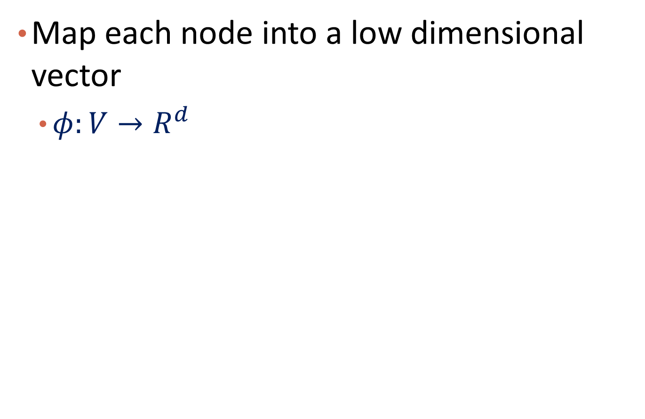
A Better Solution
Map each node into a low dimensional vector
$φ:V→R^{d}$
Source: DeepWalk

Slide 6
Graph Embedding
What is Graph Embedding
Shallow Network Embedding
Knowledge Graph Embedding
Graph Neural Network
Summary

Slide 7
Shallow Network Embedding Approaches
Inspired by word embedding
A node’s embedding is determined by its context
How to define the local context of a node?
DeepWalk [Perozzi, KDD’14]
LINE [Tang, WWW’15]
Node2Vec [Grover, KDD’16]

Slide 8
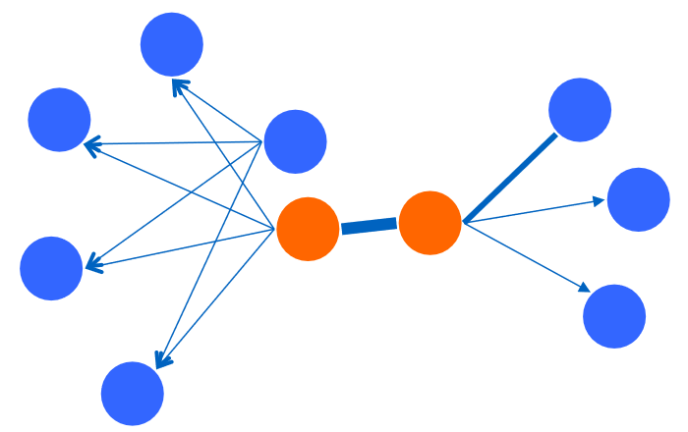
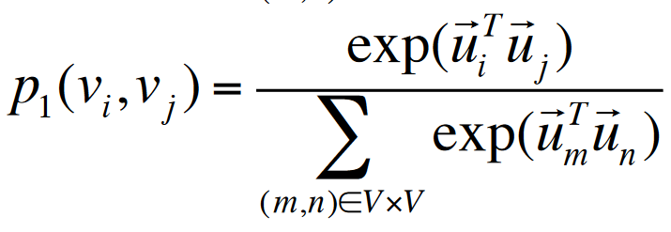

LINE: Large-scale Information Network Embedding
First-order proximity
Assumption: Two nodes are similar if they are connected
Limitation: links are sparse, not sufficient
$$u_{i}:embedding vector for node i$$
Notes:
Tutorial

Slide 9
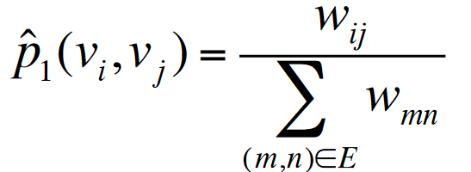
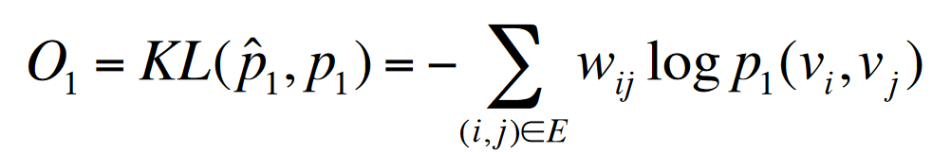

Objective function for first-order proximity
Minimize the KL divergence between empirical link distribution and modeled link distribution
$$w_{ij}:weight over edge(i,j)$$

Slide 10
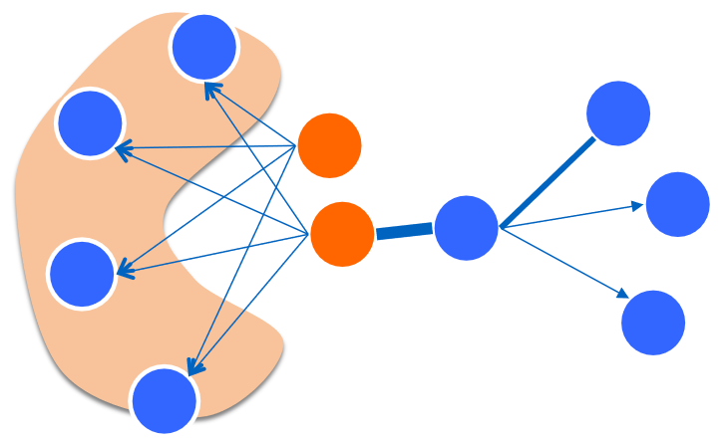
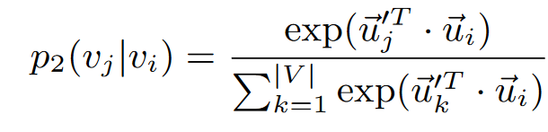
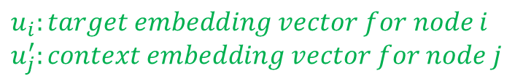
Second-Order Proximity
Assumption:
Two nodes are similar if their neighbors are similar
$$u_{i}:target embedding vector for node i$$
$$u_{j}^{′}:context embedding vector for node j$$

Slide 11
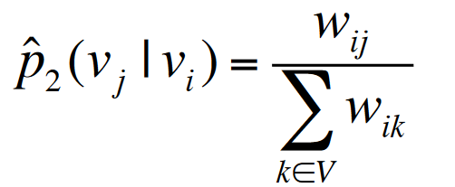
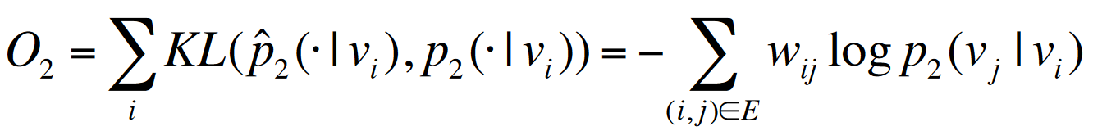


Objective function for second-order proximity
Minimize the KL divergence between empirical link distribution and modeled link distribution
Empirical distribution
Objective function
$$d_{i}$$
$$d_{i}=\sum_{k}{w_{ik}}$$

Slide 12
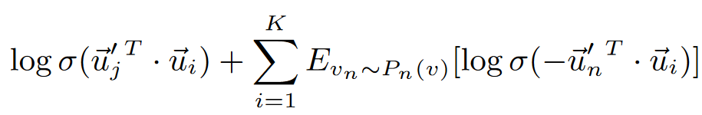
Negative Sampling for Optimization
For second-order proximity derived objective function
For each positive link (i, j), sample K negative links (i, n)
An edge with weight w can be considered as w binary edges
New objective function
$${negative distribution: P}_{n}\left(v\right)∝d_{v}^{3/4}$$

Slide 13
Announcement
Midterm grading is out
Homework grading is out
Course project sign-up is out
Presentation score will be given by audiences
Participation score will be given to audiences who rate the presenting groups

Slide 14
Midterm Statistics
Mean: 78.8 Median: 85 Max: 98
75.6% students receive scores higher than 75

Slide 15
slido
Midterm Feedback
ⓘ Start presenting to display the poll results on this slide.

Slide 16
Graph Embedding
What is Graph Embedding
Shallow Network Embedding
Knowledge Graph Embedding
Graph Neural Networks
Summary

Slide 17
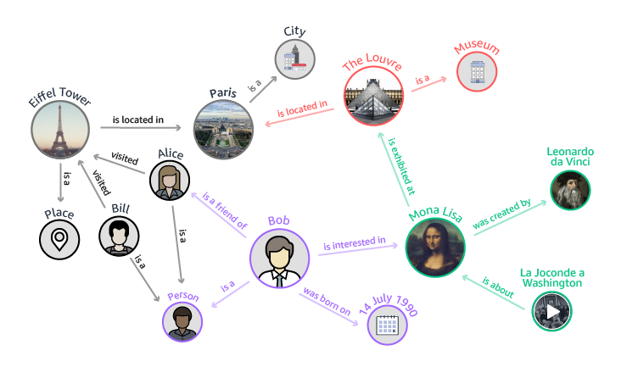
Knowledge Graph
What are knowledge graphs?
Multi-relational graph data
(heterogeneous information network)
Provide structured representation for semantic relationships between real-world entities
A triple (h, r, t) represents a fact, ex:
(Eiffel Tower, is located in, Paris)

Slide 18

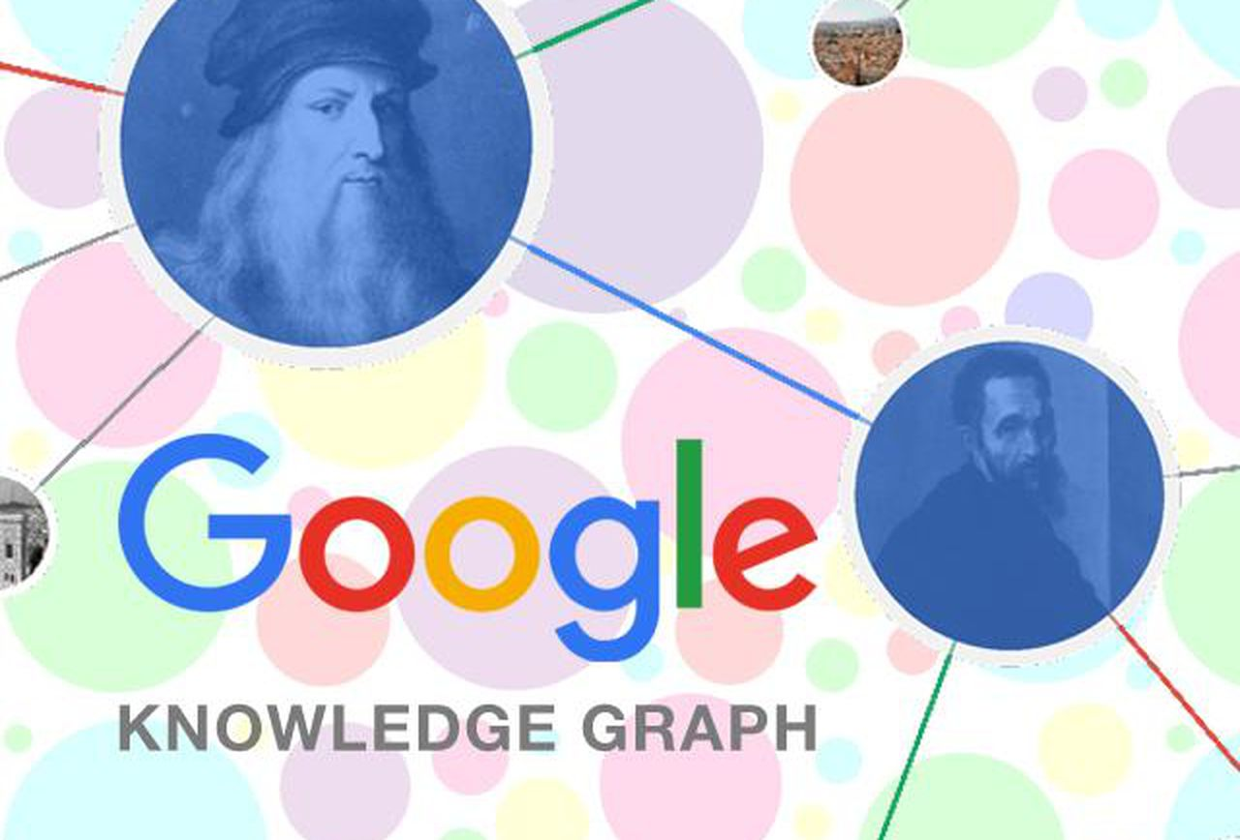















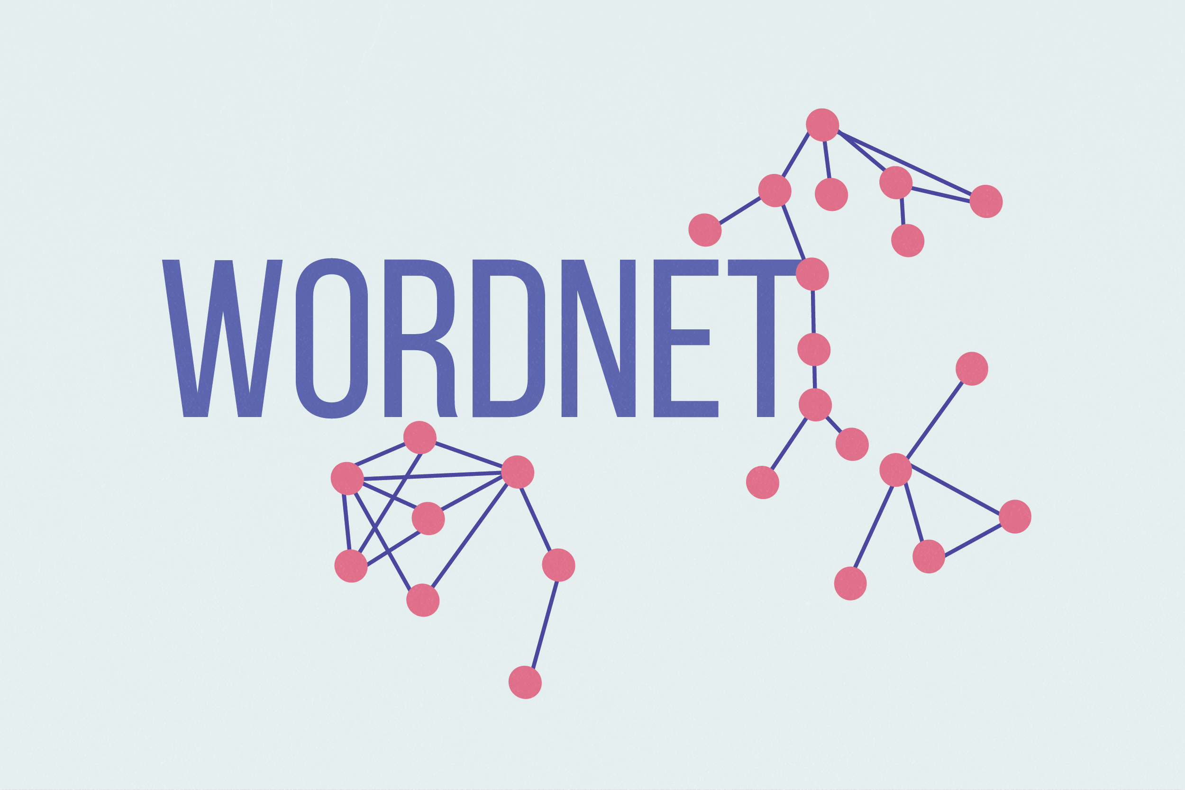
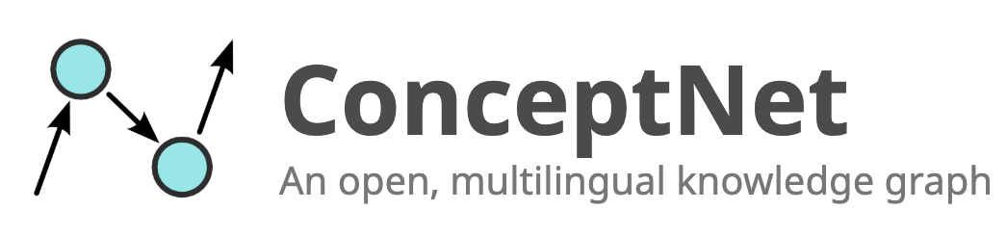
KGs are everywhere
General-purpose KGs
Bio & Medical KGs
Product Graphs & E-commerce
Common-sense KGs & NLP

Slide 19
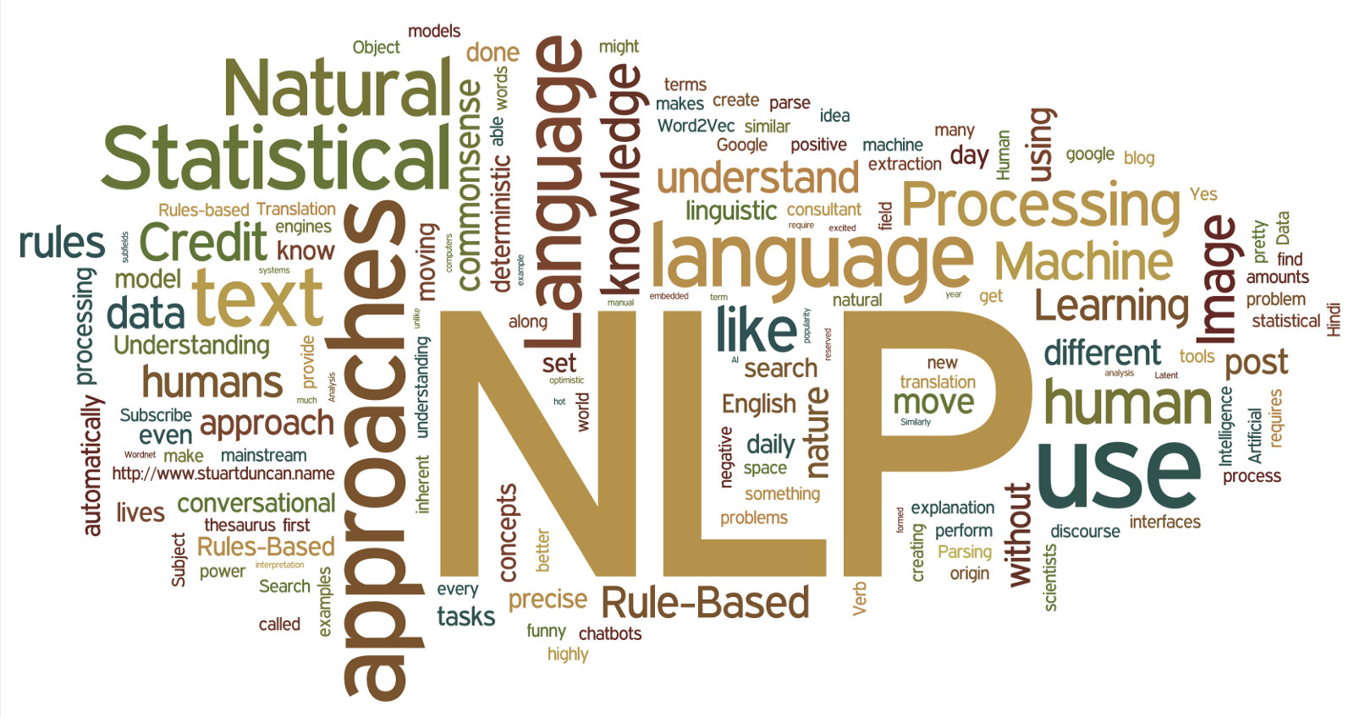

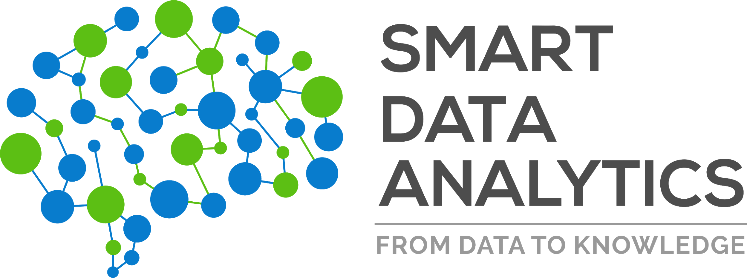
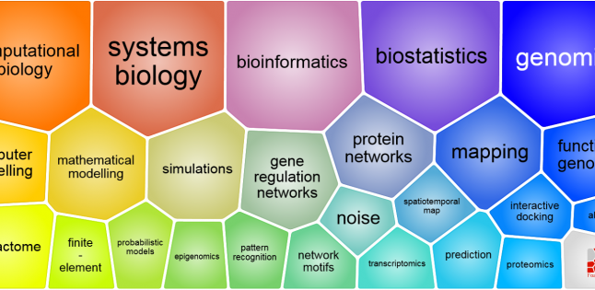



Applications of KGs
Foundational to knowledge-driven AI systems
Enable many downstream applications (NLP tasks, QA systems, etc)
Sorry, I don't know that one.
Natural Language Processing
QA & Dialogue systems
Knowledge Graphs
Computational Biology
Recommendation Systems

Slide 20
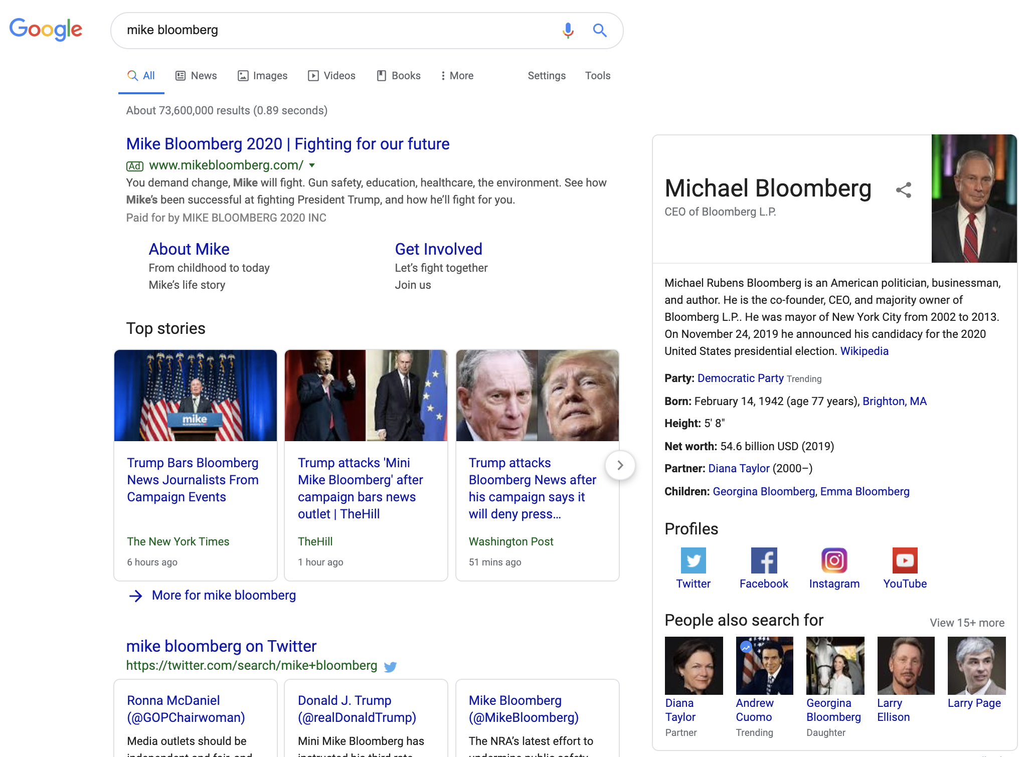
Application in Search Engine
When you search in Google
Facts from KG

Slide 21
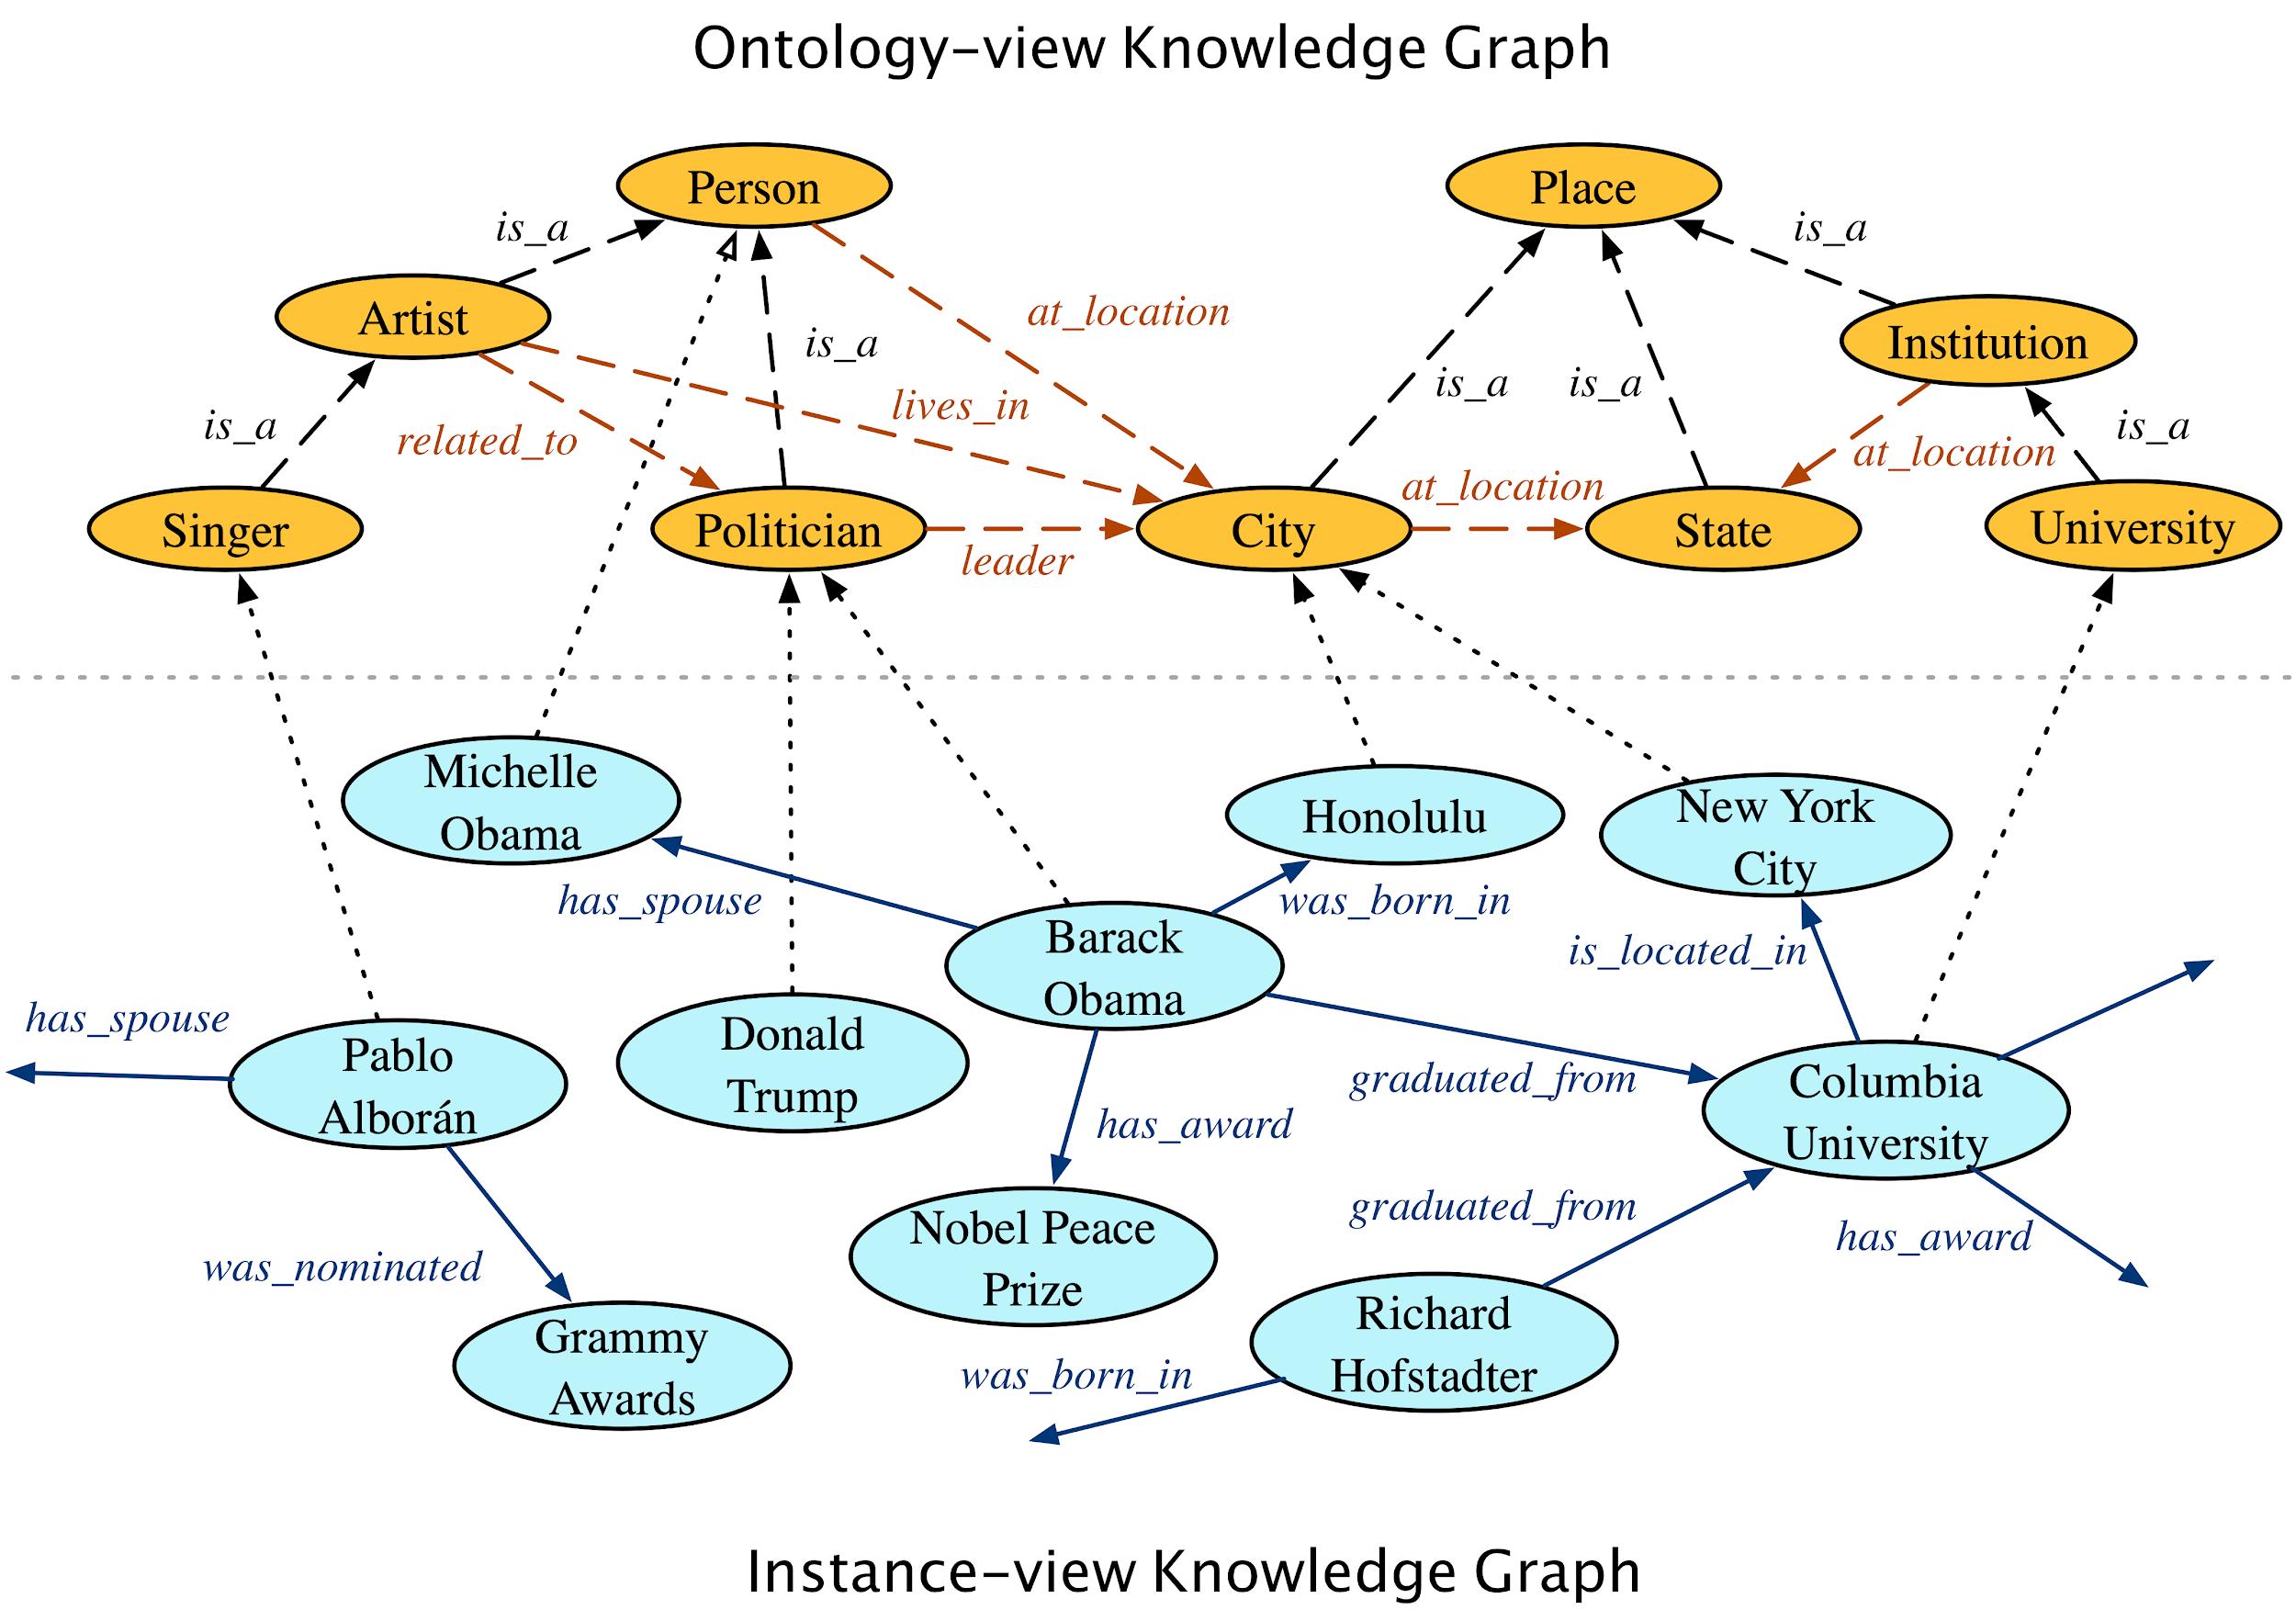
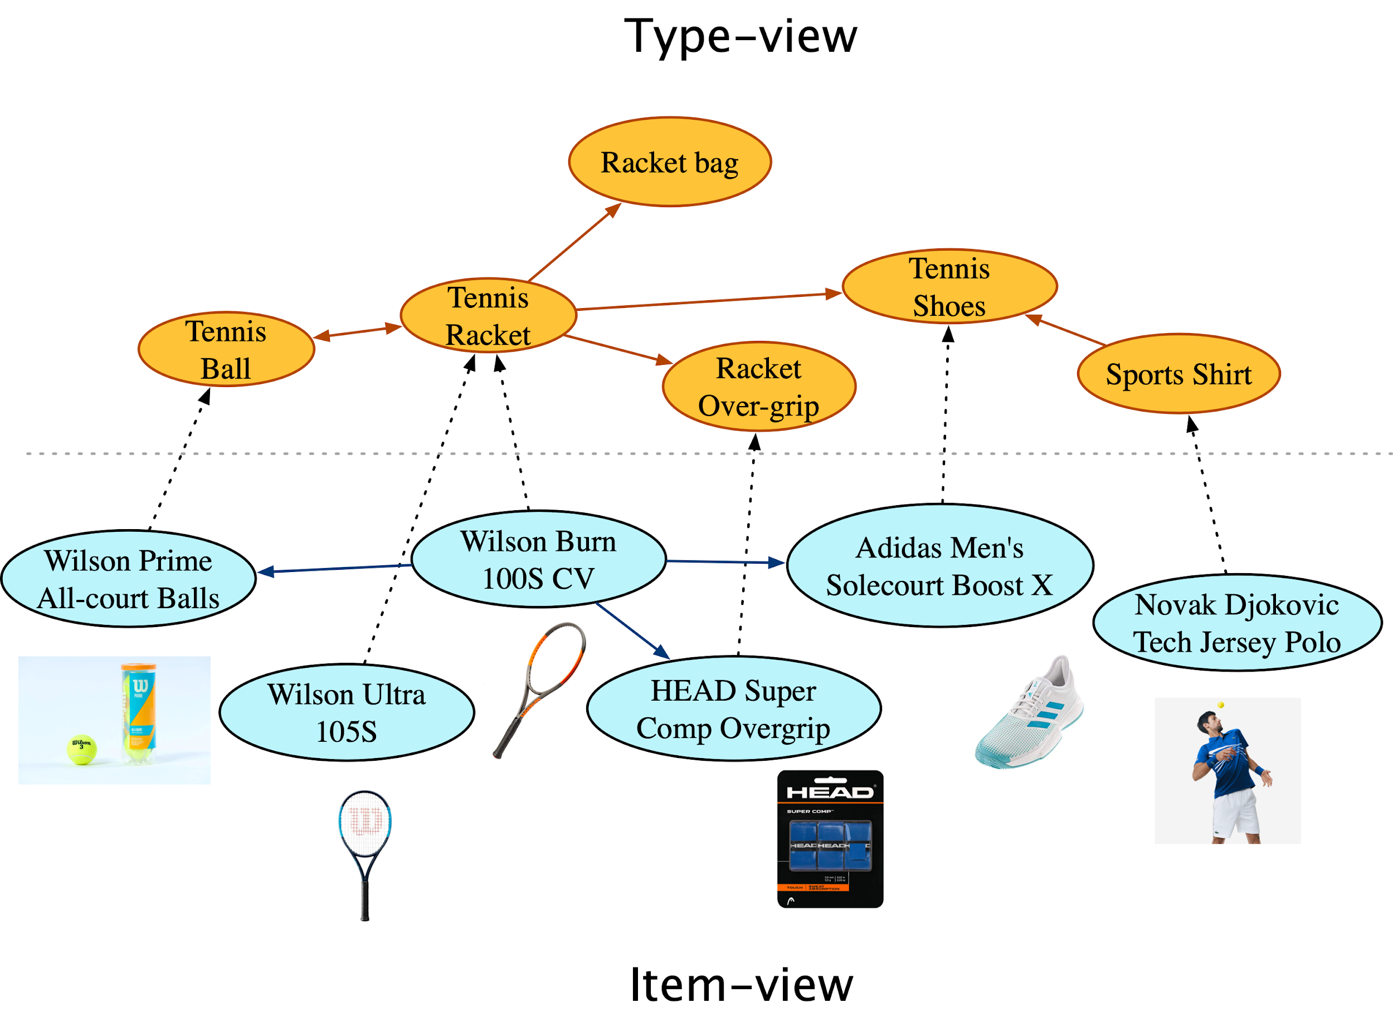
Applications to Product KG
Hao et al., “P-Companion: A Principled Framework for Diversified Complementary Product Recommendation”, CIKM’20

Slide 22
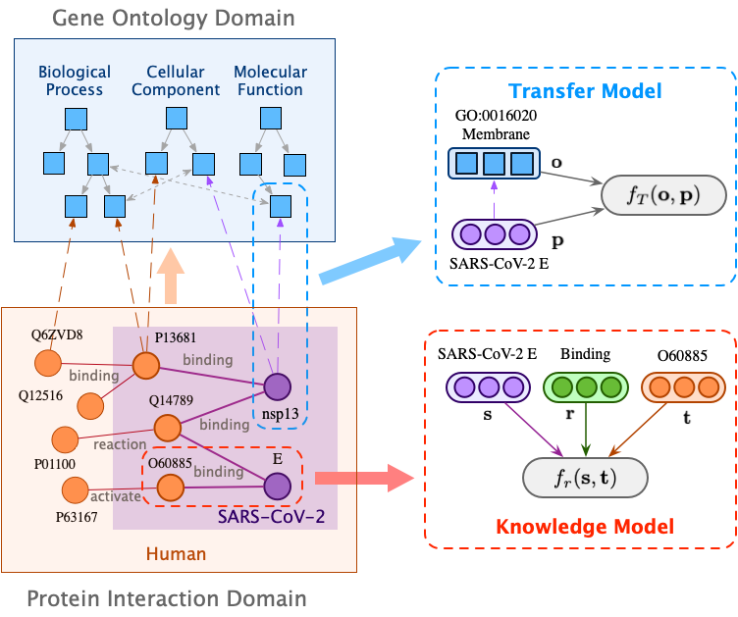
Application to Biological KG
Hao et al., “Bio-JOIE: Joint Representation Learning of Biological Knowledge Bases”, ACM BCB’20 (best student paper award)

Slide 23
Knowledge Graph Embedding
Goal: Encode entities as low-dimensional vectors and relations as parametric algebraic operations
Input: Relation facts (triples)
Output: representations of objects and relations

Slide 24







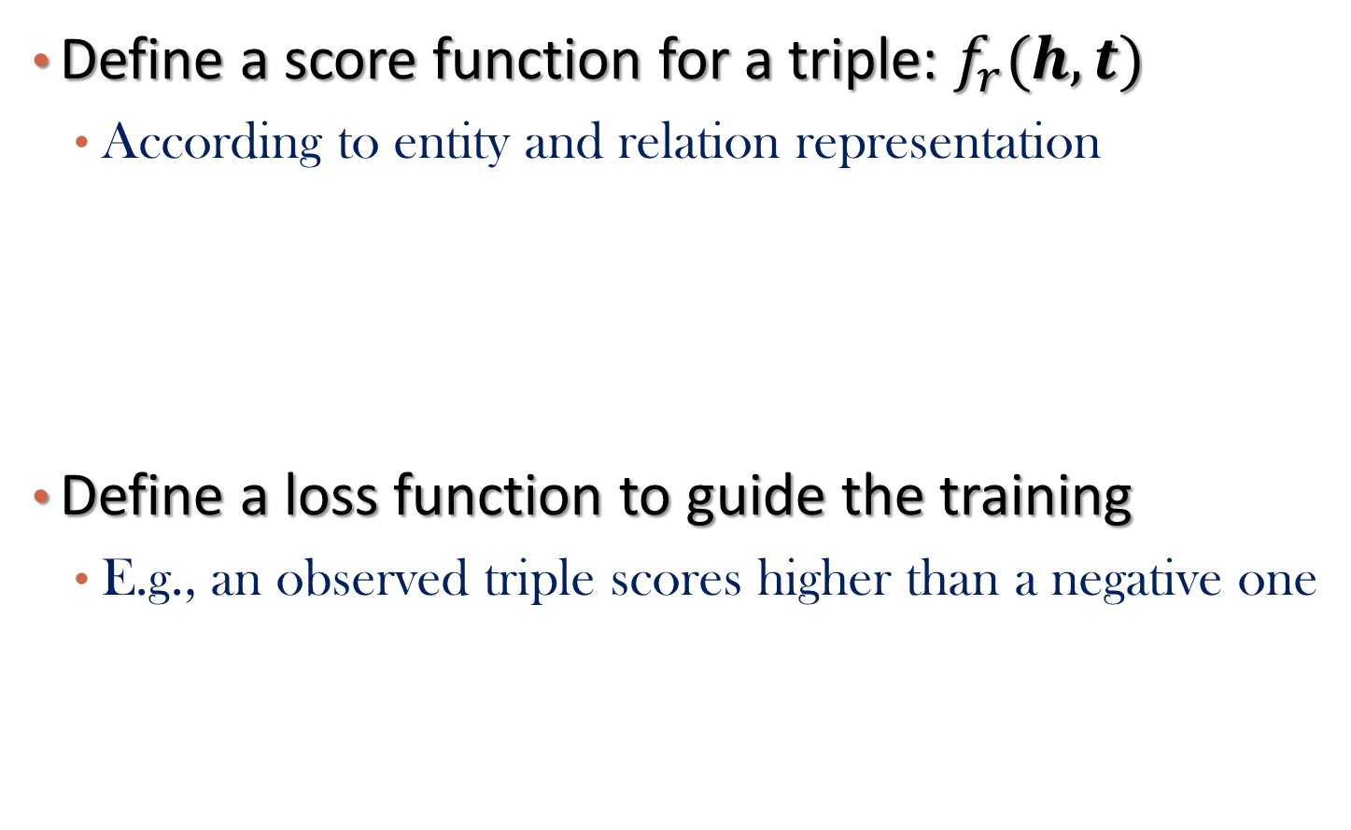
Key Idea of KG embedding algorithms
Define a score function for a triple: $f_{r}(h,t)$
According to entity and relation representation
Define a loss function to guide the training
E.g., an observed triple scores higher than a negative one
Triple
Score Function

Slide 25
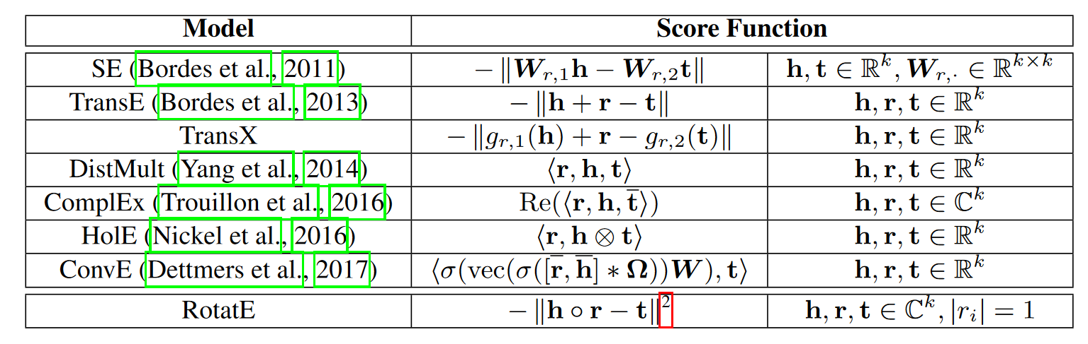
Summary of Existing Approaches
Source: Sun et al., RotatE: Knowledge Graph Embedding by Relational Rotation in Complex Space (ICLR’19)

Slide 26
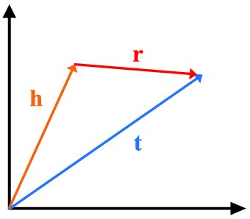
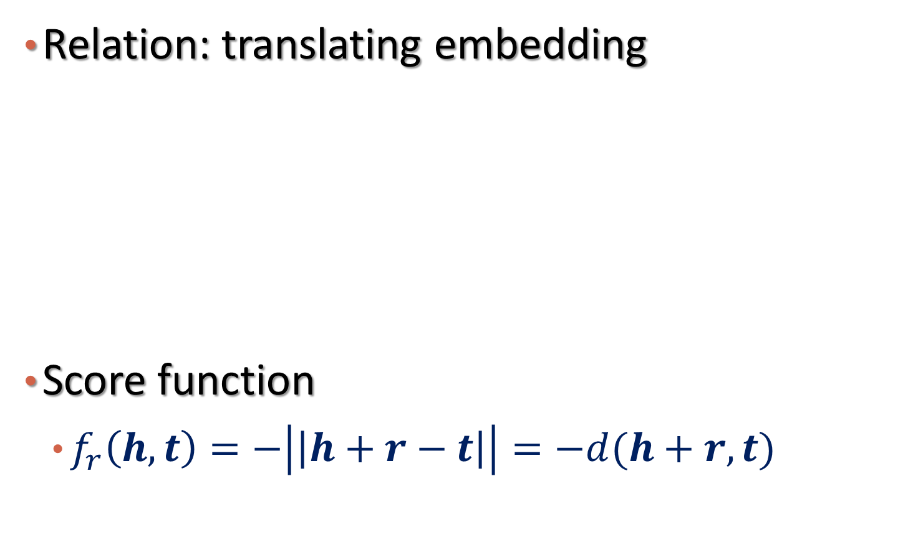
TransE: Score Function
Relation: translating embedding
Score function
$f_{r}\left(h,t\right)=−\left|\left|h+r−t\right|\right|=−d(h+r,t)$
Beijing
China
D.C.
U.S.
London
UK
: Capitial
Bordes et al., Translating embeddings for modeling multi-relational data, NeurIPS 2013

Slide 27
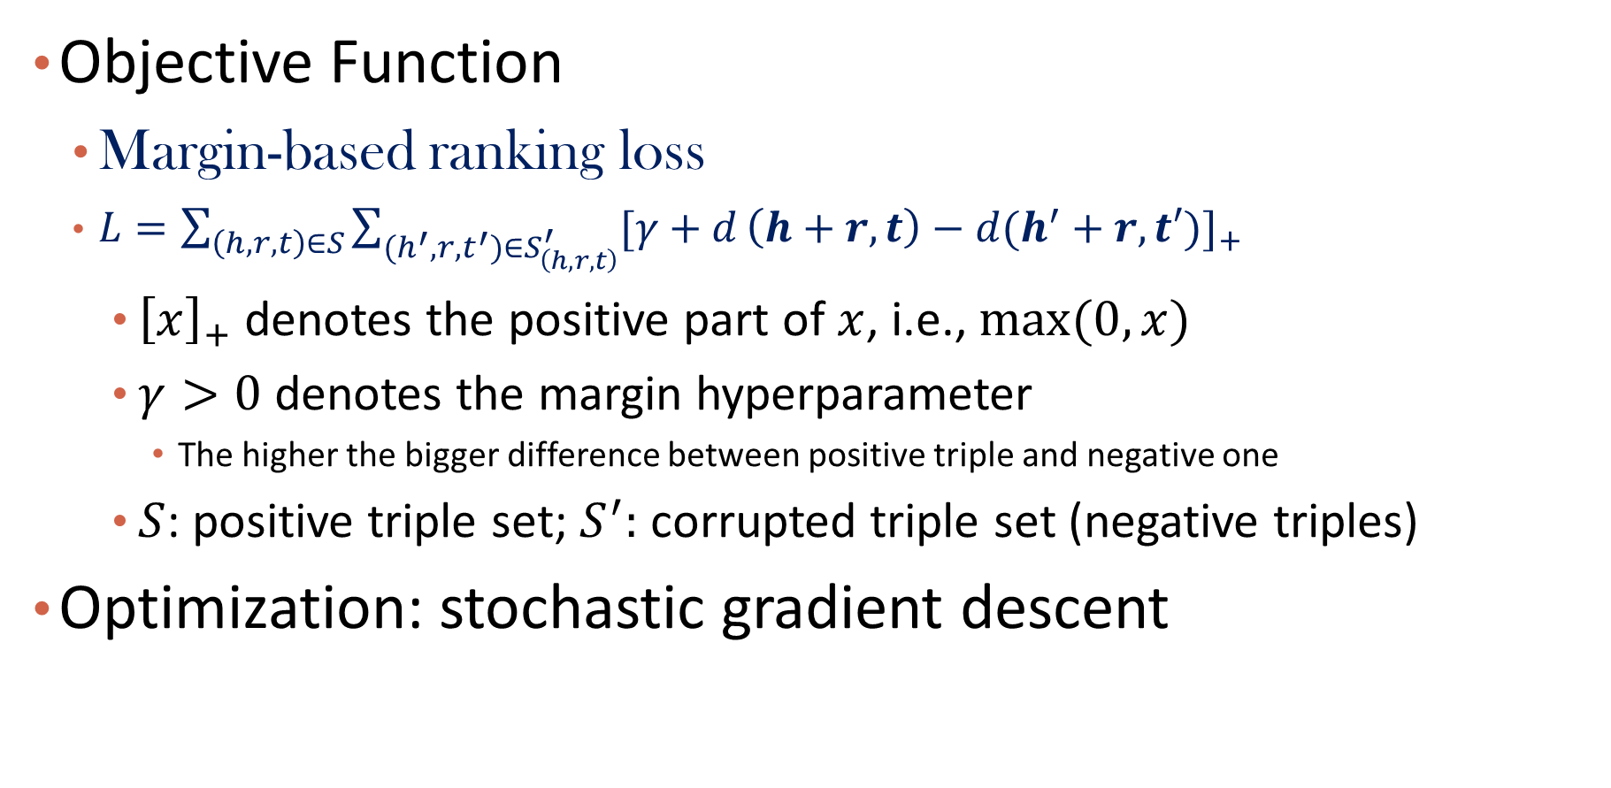
TransE: Objective Function
Objective Function
Margin-based ranking loss
$L={\sum_{\left(h,r,t\right)∈S}{\sum_{{(h}^{′},r,t^{′})∈S_{\left(h,r,t\right)}^{′}}{[γ+d}}\left(h+r,t\right)−d(h^{′}+r,t′)]}_{+}$
${\left[x\right]}_{+}$ denotes the positive part of $x$, i.e., $max⁡(0,x)$
$γ>0$ denotes the margin hyperparameter
The higher the bigger difference between positive triple and negative one
$S$: positive triple set; $S^{′}:$ corrupted triple set (negative triples)
Optimization: stochastic gradient descent

Slide 28
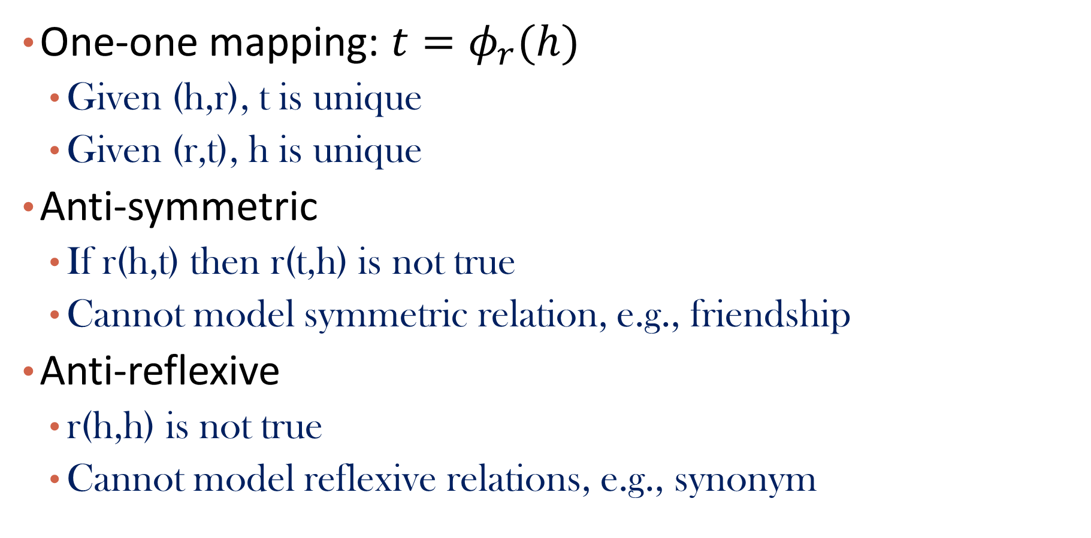
TransE: Limitations
One-one mapping: $t=φ_{r}(h)$
Given (h,r), t is unique
Given (r,t), h is unique
Anti-symmetric
If r(h,t) then r(t,h) is not true
Cannot model symmetric relation, e.g., friendship
Anti-reflexive
r(h,h) is not true
Cannot model reflexive relations, e.g., synonym

Slide 29
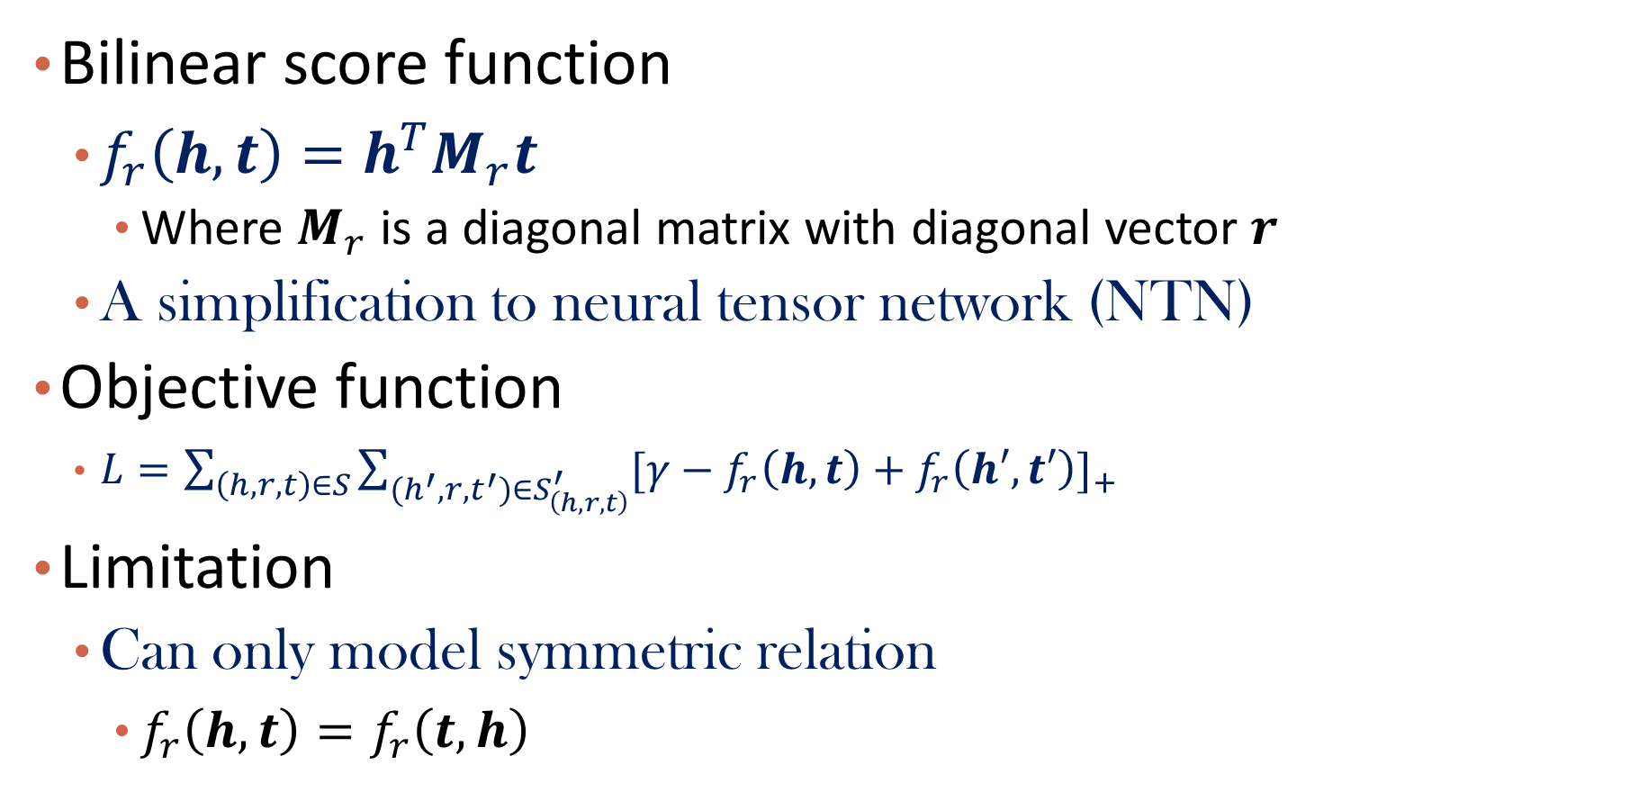
DistMult
Bilinear score function
$f_{r}\left(h,t\right)=h^{T}M_{r}t$
Where $M_{r}$ is a diagonal matrix with diagonal vector $r$
A simplification to neural tensor network (NTN)
Objective function
$L={\sum_{\left(h,r,t\right)∈S}{\sum_{{(h}^{′},r,t^{′})∈S_{\left(h,r,t\right)}^{′}}{[γ−f_{r}\left(h,t\right)}}+f_{r}\left(h′,t′\right)]}_{+}$
Limitation
Can only model symmetric relation
$f_{r}\left(h,t\right)=f_{r}\left(t,h\right)$
Yang et al., Embedding entities and relations for learning and inference in knowledge bases, ICLR 2015

Slide 30
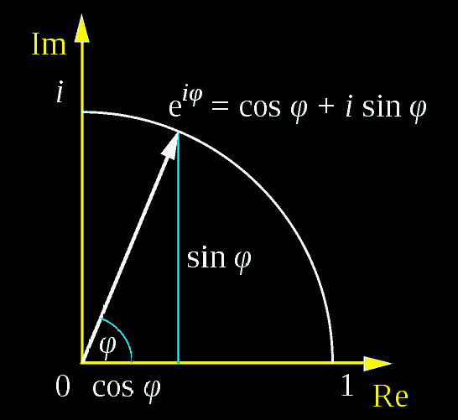
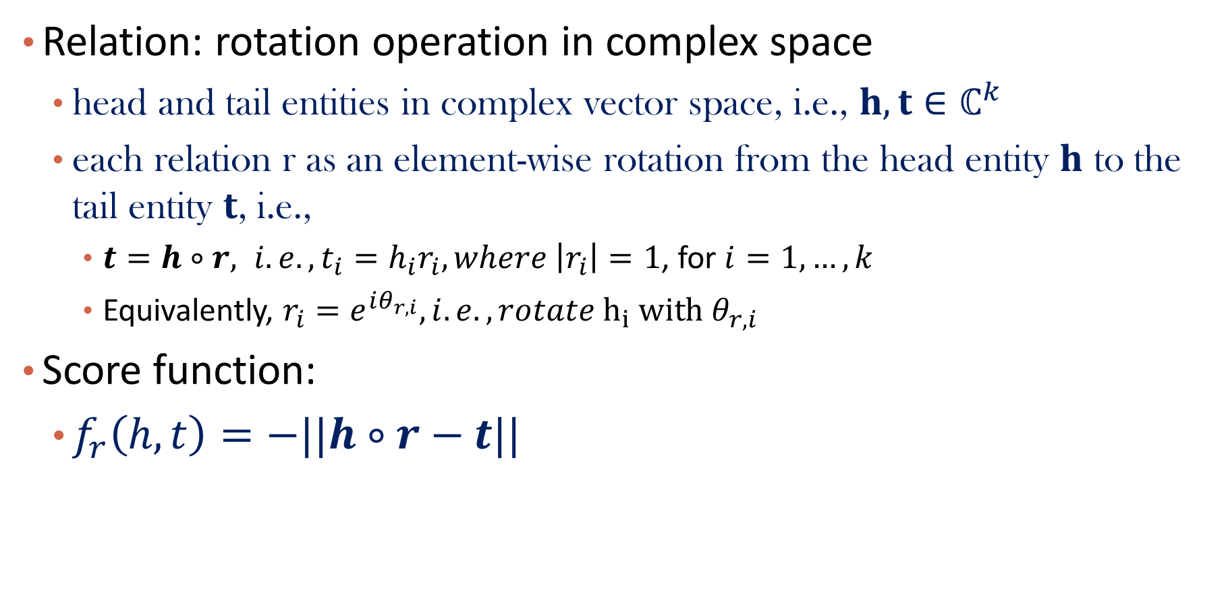
RotatE: Score Function
Relation: rotation operation in complex space
head and tail entities in complex vector space, i.e., $h, t∈ℂ^{k}$
each relation r as an element-wise rotation from the head entity 𝐡 to the tail entity 𝐭, i.e.,
$t=h∘r, i.e., t_{i}=h_{i}r_{i}, where \left|r_{i}\right|=1$, for $i=1,…,k$
Equivalently, $r_{i}=e^{iθ_{r,i}}, i.e., rotate h_{i} with θ_{r,i}$
Score function:
$f_{r}\left(h,t\right)=−||h∘r−t||$
Zhiqing Sun, Zhihong Deng, Jian-Yun Nie, and Jian Tang. “RotatE: Knowledge Graph Embedding by Relational Rotation in Complex Space.” ICLR’19.

Slide 31
RotatE: Geometric Interpretation
Consider 1-d case

Slide 32
RotatE: Objective function
Smarter negative sampling
The negative triple with higher score is more likely to be sampled
Cross-entropy loss

Slide 33
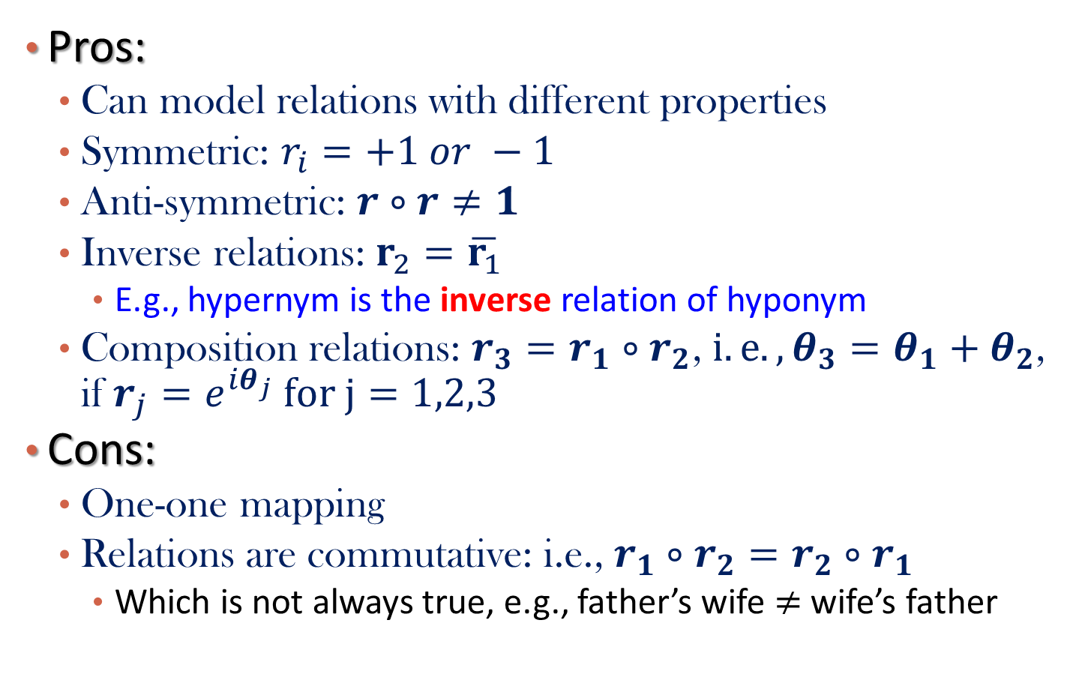
RotatE: Pros and Cons
Pros:
Can model relations with different properties
Symmetric: $r_{i}=+1 or −1$
Anti-symmetric: $r∘r≠1$
Inverse relations: $r_{2}=\overline{r_{1}}$
E.g., hypernym is the inverse relation of hyponym
Composition relations: $r_{3}=r_{1}∘r_{2}$, $i.e., θ_{3}=θ_{1}+θ_{2}$, if $r_{j}=e^{iθ_{j}} for j=1,2,3$
Cons:
One-one mapping
Relations are commutative: i.e., $r_{1}∘r_{2}=r_{2}∘r_{1}$
Which is not always true, e.g., father’s wife $≠$ wife’s father

Slide 34
Graph Embedding
What is Graph Embedding
Shallow Network Embedding
Knowledge Graph Embedding
Graph Neural Networks
Summary

Slide 35
Limitation of Shallow Network Embedding
Too many parameters
Each node is associated with an embedding vector, which are parameters
Not inductive
Cannot handle new nodes
Cannot handle node attributes

Slide 36
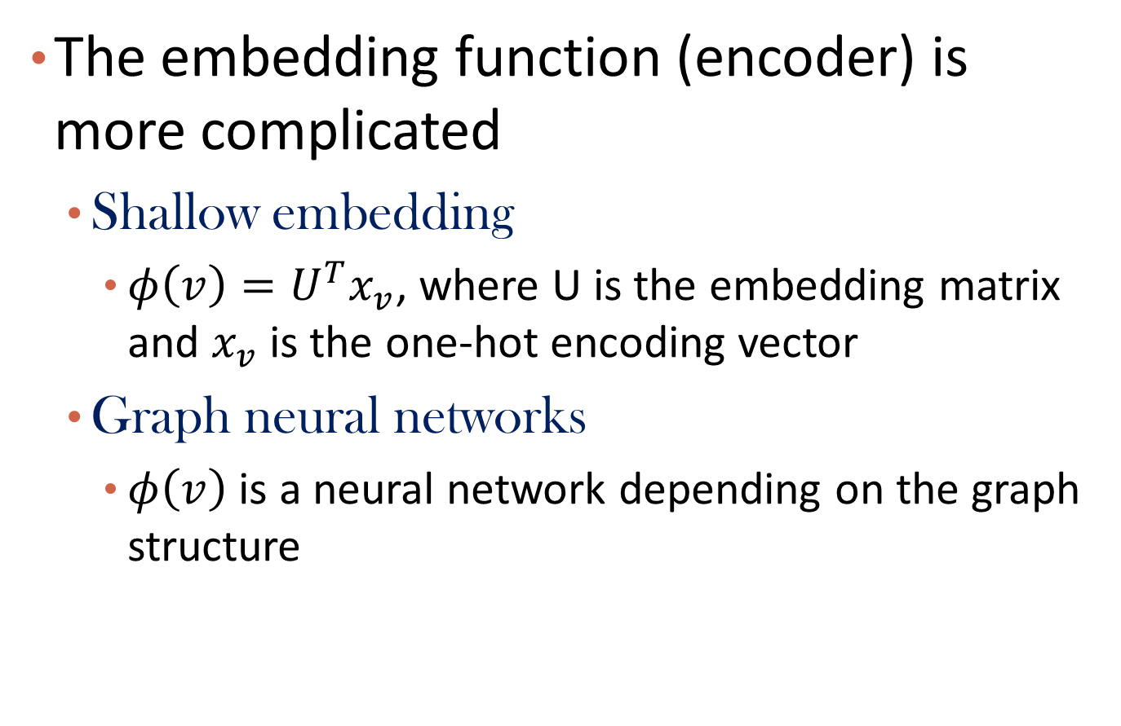
From shallow embedding to Graph Neural Networks
The embedding function (encoder) is more complicated
Shallow embedding
$φ\left(v\right)=U^{T}x_{v}$, where U is the embedding matrix and $x_{v}$ is the one-hot encoding vector
Graph neural networks
$φ\left(v\right)$ is a neural network depending on the graph structure

Slide 37
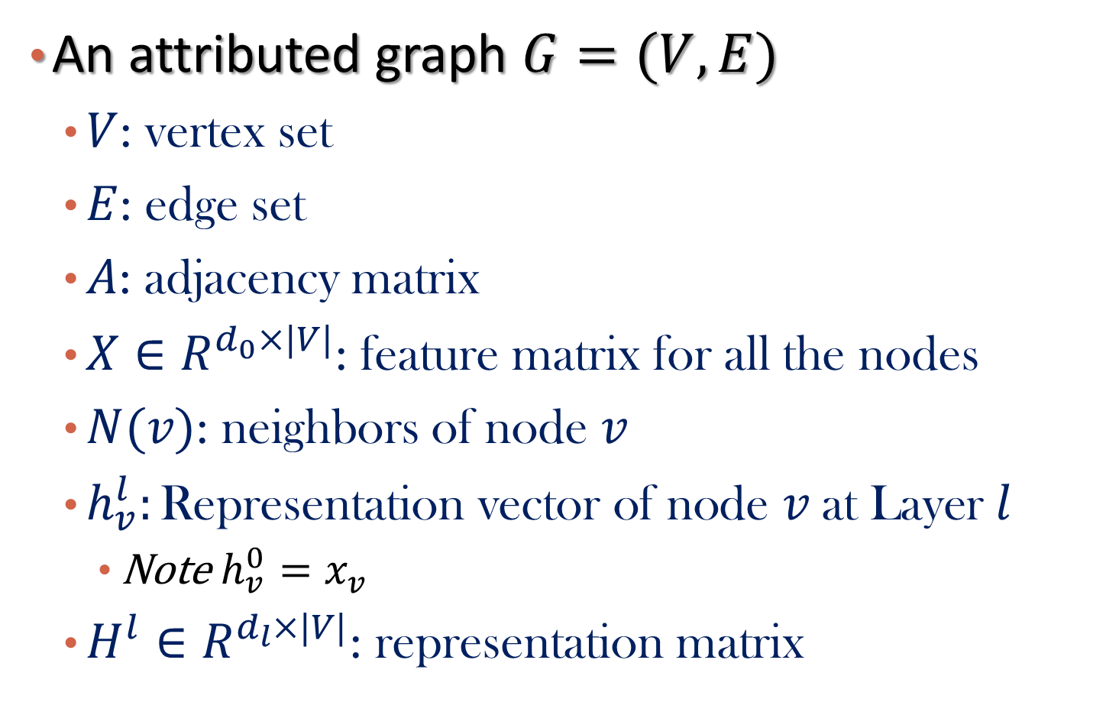
Notations
An attributed graph $G=(V,E)$
$V$: vertex set
$E$: edge set
$A$: adjacency matrix
$X∈R^{d_{0}×|V|}$: feature matrix for all the nodes
$N(v)$: neighbors of node $v$
$h_{v}^{l}:\text{Representation} \text{vector} \text{of} \text{node} v \text{at} \text{Layer} l$
Note $h_{v}^{0}=x_{v}$
$H^{l}∈R^{d_{l}×|V|}$: representation matrix

Slide 38
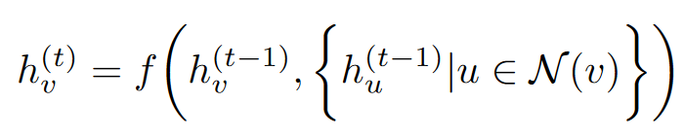
The General Architecture of GNNs
For a node v at layer t
A function of representations of neighbors and itself from previous layers
Aggregation of neighbors
Transformation to a different space
Combination of neighbors and the node itself
representation vector from previous layer for node v
representation vectors from previous layer for node v’s neighbors

Slide 39
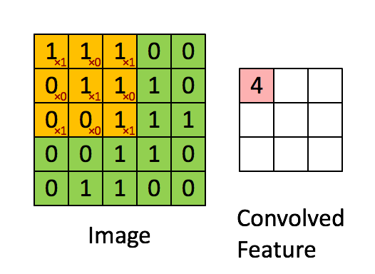
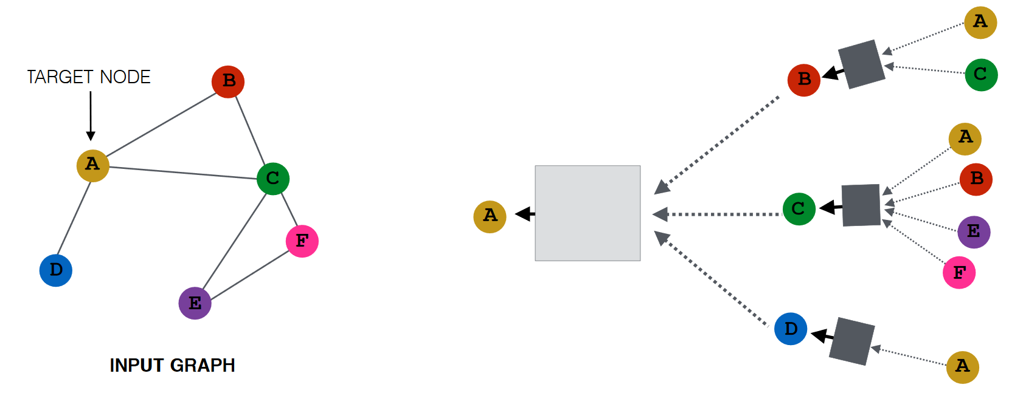
Compare with CNN
Recall CNN
Regular graph
GNN
Extend to irregular graph structure

Slide 40
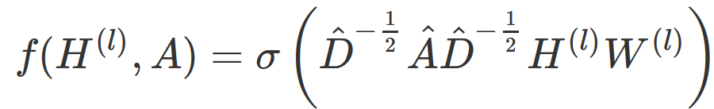
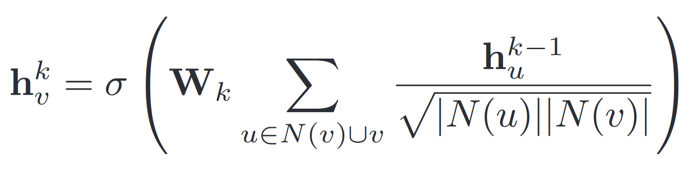

Graph Convolutional Network (GCN)
Kipf and Welling, ICLR’17
, $\hat{A }=A+I$
f: graph filter
From a node v’s perspective
$$W_{k}:weight matrix at Layer k, shared across different nodes$$

Slide 41
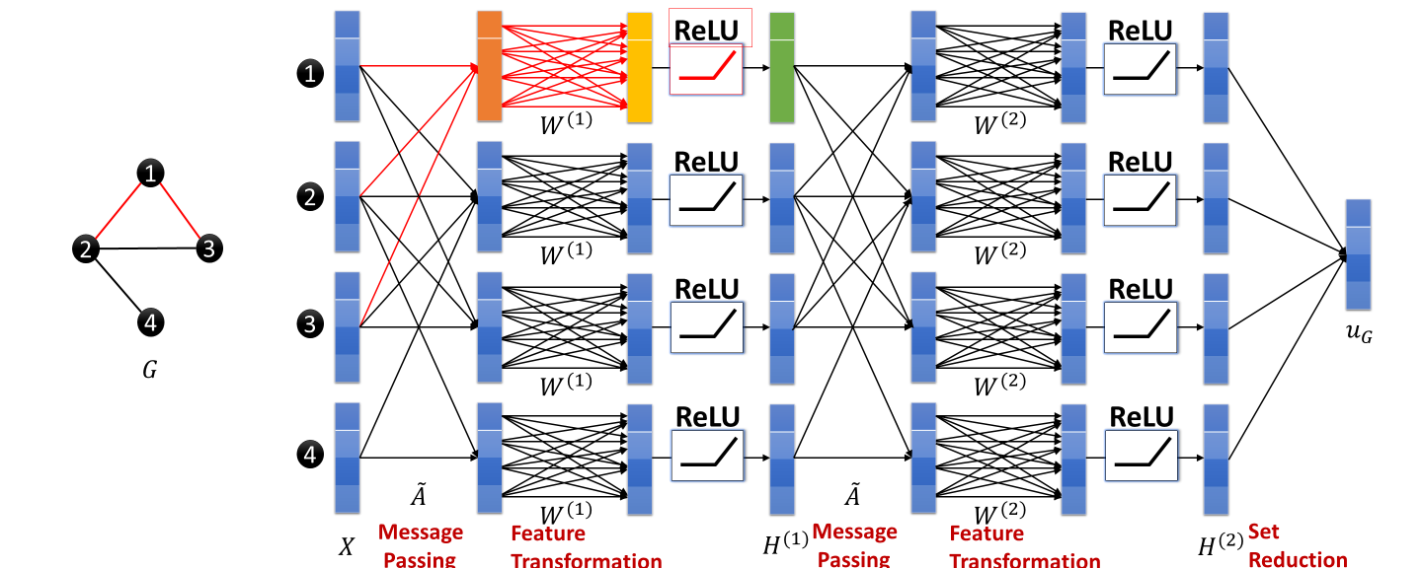
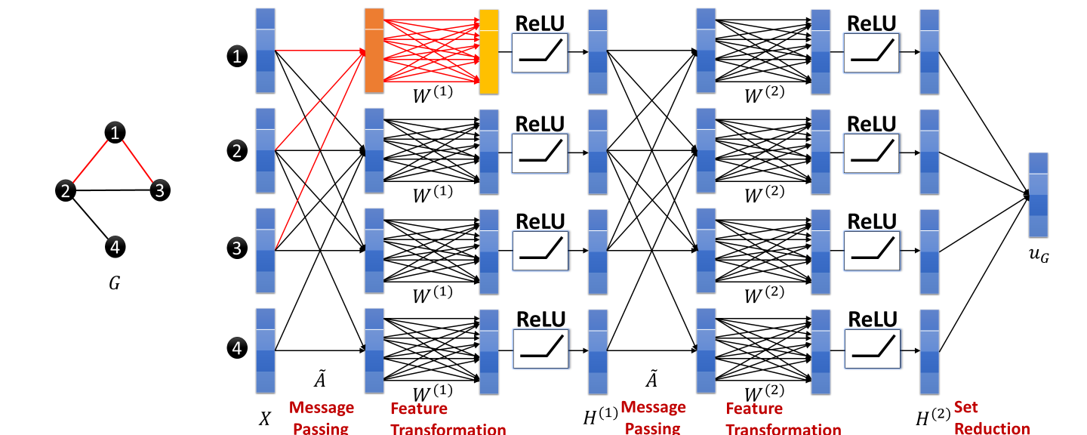
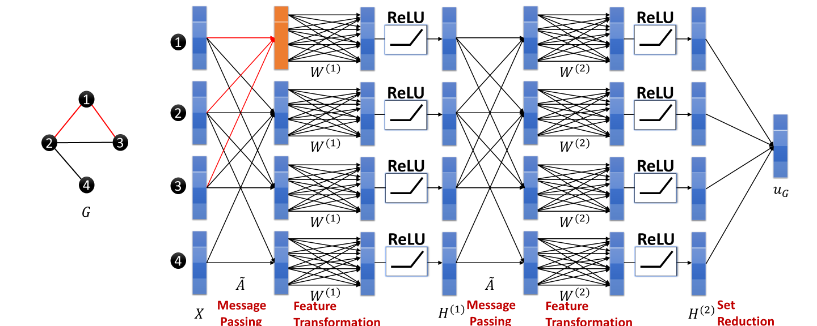
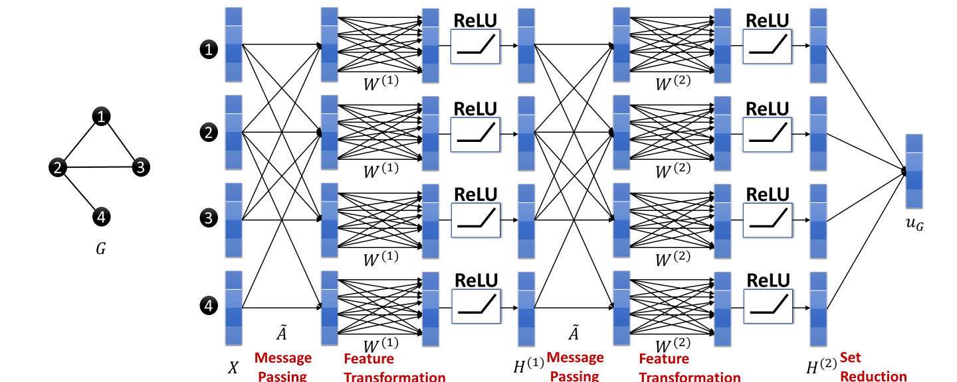
A toy example of 2-layer GCN on a 4-node graph
Computation graph
41

Slide 42
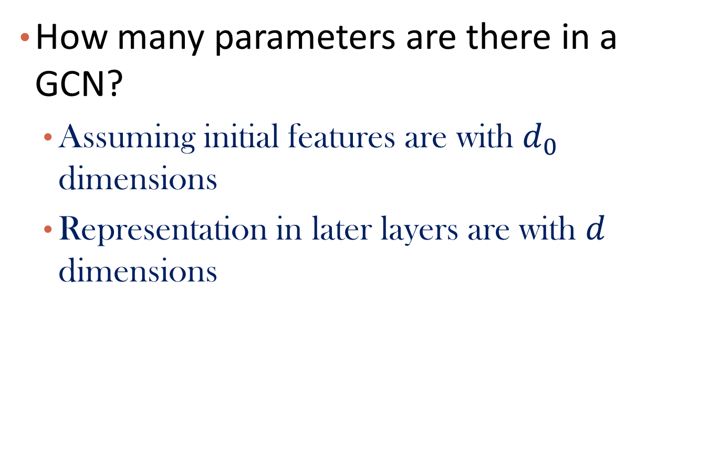
Question
How many parameters are there in a GCN?
Assuming initial features are with $d_{0}$ dimensions
Representation in later layers are with $d$ dimensions

Slide 43

GraphSAGE
Inductive Representation Learning on Large Graphs William L. Hamilton*, Rex Ying*, Jure Leskovec, NeurIPS’17
A more general form

Slide 44


More about AGG
Mean
LSTM
$π\left(⋅\right):a random permutation$
Pool
$γ\left(⋅\right):$Element-wise mean/max pooling of neighbor set
$$=γ$$

Slide 45
Message-Passing Neural Network
Gilmer et al., 2017. Neural Message Passing for Quantum Chemistry. ICML.
A general framework that subsumes most GNNs
Can also include edge information
Two steps
Get messages from neighbors at step k
Update the node latent represent based on the msg
e.g., Sum or MLP
e.g., LSTM, GRU
$A special case:GGNN,$ Li et al., Gated graph sequence neural networks, ICLR 2015

Slide 46

Graph Attention Network (GAN)
How to decide the importance of neighbors?
GCN: a predefined weight
Others: no differentiation
GAN: decide the weights using learnable attention
Velickovic et al., 2018. Graph Attention Networks. ICLR.

Slide 47


The attention mechanism
Potentially many possible designs

Slide 48


Some practical issues (1): over smoothing
Adding more GNN layers is not always helpful
Over smoothing issue!
Solution: (1) skip connection; (2) add MLP layers or use deep transformation within each GNN layer

Slide 49

Some practical issues (2): Sparse Graph
Augment sparse graphs
Add virtual edges, e.g., length-2 path
Add virtual nodes, e.g., a cluster node
CS224W: Machine Learning with Graphs: https://web.stanford.edu/class/cs224w/

Slide 50

How to train a GNN?
Let $z_{v}$ be the final layer output for node v
Define a task and the determine the loss
Node classification
Softmax($z_{v}$), then cross entropy loss
Link prediction
$σ(z_{u}^{T}z_{v})$ for link (u,v), then binary cross entropy loss
Graph classification
Softmax($aggregation$(${\left\{z_{v}\right\}}_{\left\{v∈V\right\}}$))

Slide 51
Downstream Tasks for Graphs

Slide 52
Typical Graph Functions
Node level
Similarity search
Link prediction
Classification
Community detection
Ranking
Graph level
Similarity search
Frequent pattern mining
Graph isomorphism test
Graph matching
Classification
Clustering
Graph generation

Slide 53

1. Semi-supervised Node Classification
Decoder using ${z_{v}=h}_{v}^{L}$
Feed into another fully connected layer
${\hat{y}}_{v}=σ(θ^{T}z_{v})$
Loss function
Cross entropy loss
In a binary classification case
$l_{v}=−y_{v}log{\hat{y}}_{v}−{(1−y}_{v})log⁡(1−{\hat{y}}_{v})$

Slide 54
Applications of Node Classification
Social network
An account is bot or not
Citation network
A paper’s research field
A program-derived graph
The type of a variable

Slide 55

2. Link Prediction
Decoder using ${z_{v}=h}_{v}^{L}$
Given a node pair $\left(u,v\right)$
Determine its probability $p_{uv}={σ(z}_{u}^{T}Rz_{v})$
R could be different for different relation type
Loss function
Cross entropy loss
$l_{uv}=−y_{uv}logp_{uv}−{(1−y}_{uv})log⁡(1−p_{uv})$

Slide 56
Link Prediction Applications
Social network
Friend recommendation
Citation network
Citation recommendation
Medical network
Drug and target binding or not
A program-derived graph
Code autocomplete

Slide 57

3. Graph Classification
Decoder using $h_{G}=g({\left\{z_{v}\right\}}_{v∈V})$
$g\left(⋅\right):a read out function$, e.g., sum
Feed $h_{G}$ into another fully connected layer
${\hat{y}}_{G}=σ(θ^{T}h_{G})$
Loss function
Cross entropy loss
In a binary classification case
$l_{G}=−y_{G}log{\hat{y}}_{G}−{(1−y}_{G})log⁡(1−{\hat{y}}_{G})$

Slide 58
Graph Classification Applications
Chemical compounds
Toxic or not
Proteins
Has certain function or not
Program-derived graphs
Contains bugs or not

Slide 59

4. Graph Similarity Computation
Decoder using${ h}_{G}=g({\left\{z_{v}\right\}}_{v∈V})$
Given a graph pair $\left(G_{1},G_{2}\right)$
Determine its score $s_{G_{1}G_{2}}=h_{G_{1}}^{T}Rh_{G_{2}}$
Loss function
E.g., Square loss
$l_{G_{1}G_{2}}={(y}_{G_{1}G_{2}}−s_{G_{1}G_{2}})^2$
Notes:
Siamese structure

Slide 60


A Concrete solution by SimGNN [Bai et al., AAAI 2019]
Goal: learn a GNN $φ: 𝒢×𝒢→R^{+}$ to approximate Graph Edit Distance between two graphs
Attention-based graph-level embedding
Histogram features from pairwise node similarities

Slide 61

Graph Similarity Computation Applications
Drug database
Drug similarity search
Program database
Code recommendation
Search ninja code for novice code
Search java code for COBOL code

Slide 62

Tutorial on GNN coding
https://colab.research.google.com/drive/1DIQm9rOx2mT1bZETEeVUThxcrP1RKqAn

Slide 63
Graph Embedding
What is Graph Embedding
Shallow Network Embedding
Knowledge Graph Embedding
Graph Neural Networks
Summary

Slide 64
Summary
Graph embedding
Shallow embedding
E.g., LINE
Knowledge graph embedding
E.g., TransE
Graph neural networks
E.g., GCN

Slide 65
References
Bryan Perozzi, Rami Al-Rfou, Steven Skiena, DeepWalk: Online Learning of Social Representations, KDD’14
Jian Tang, Meng Qu, Mingzhe Wang, Ming Zhang, Jun Yan, Qiaozhu Mei, LINE: Large-scale Information Network Embedding, WWW’15
Aditya Grover, Jure Leskovec, node2vec: Scalable Feature Learning for Networks, KDD’16
Kipf & Welling, Semi-Supervised Classification with Graph Convolutional Networks, ICLR 2017
Tutorial: http://snap.stanford.edu/proj/embeddings-www/files/nrltutorial-part2-gnns.pdf
Tutorial: http://tkipf.github.io/misc/SlidesCambridge.pdf
Bordes et al., Translating Embeddings for Modeling Multi-relational Data, NIPS 2013
Yang et al., Embedding entities and relations for learning and inference in knowledge bases, ICLR 2015
Zhiqing Sun, Zhihong Deng, Jian-Yun Nie, and Jian Tang. “RotatE: Knowledge Graph Embedding by Relational Rotation in Complex Space.” ICLR’19.

Slide 66


Audience Q&A Session
ⓘ Start presenting to display the audience questions on this slide.

