Slide 1
CS247: Advanced Data Mining
Recommender Systems I
Instructor: Yizhou Sun
yzsun@cs.ucla.edu
February 27, 2024

Slide 2
Recommender Systems
What is Recommender System?
Collaborative Filtering
Content-based Recommendation
Hybrid methods
Evaluation Metrics
Summary

Slide 3

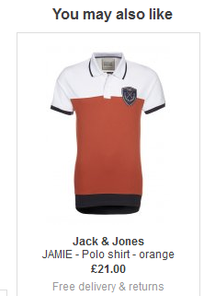
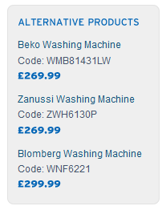

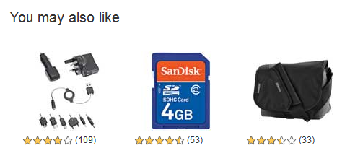
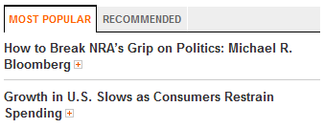
Recommender Systems
Application areas

Slide 4
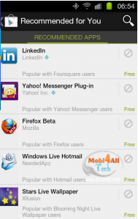
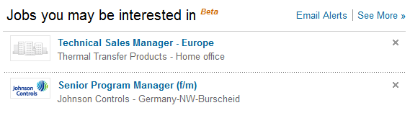
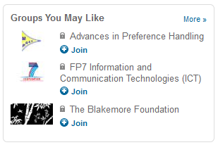

In the Social Web

Slide 5
Why using Recommender Systems?
Value for the customer
Find things that are interesting
Narrow down the set of choices
Help me explore the space of options
Discover new things
Entertainment
…
Value for the provider
Additional and probably unique personalized service for the customer
Increase trust and customer loyalty
Increase sales, click trough rates, conversion etc.
Opportunities for promotion, persuasion
Obtain more knowledge about customers
…

Slide 6
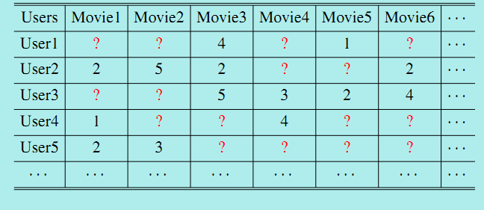
Recommendation as Matrix Completion
Matrix Representation

Slide 7
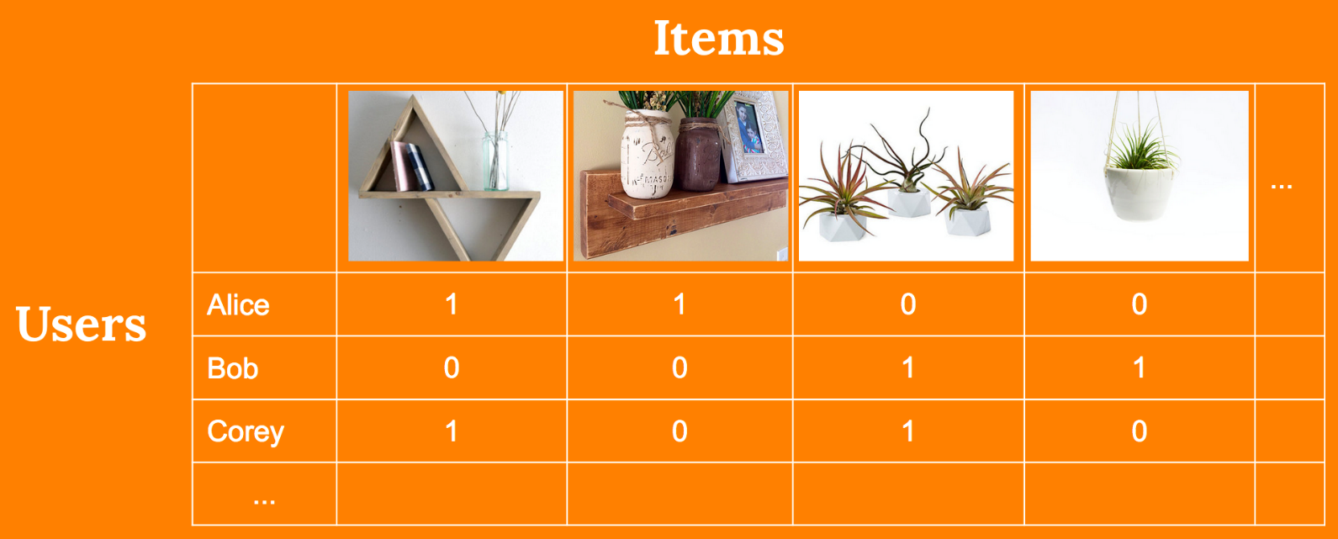
Explicit Feedback vs. Implicit Feedback
Explicit Feedback
Know the ratings
Implicit Feedback
only know whether user and item has interacted
Like (1) vs. unknown (0)

Slide 8
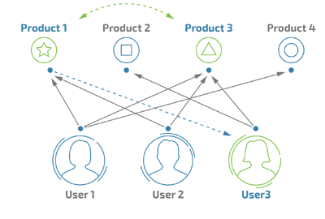
Recommendation as Link Prediction
Network view
Link prediction problem
?

Slide 9
Methods
Collaborative filtering
Content-based recommendation
Hybrid methods

Slide 10
Recommender Systems
What is Recommender System?
Collaborative Filtering
Content-based Recommendation
Hybrid methods
Evaluation Metrics
Summary

Slide 11
Collaborative Filtering (CF)
The most prominent approach to generate recommendations
used by large, commercial e-commerce sites
well-understood, various algorithms and variations exist
applicable in many domains (book, movies, DVDs, ..)
Approach
use the "wisdom of the crowd" to recommend items
Basic assumption and idea
Users give ratings to catalog items (implicitly or explicitly)
Customers who had similar tastes in the past, will have similar tastes in the future

Slide 12
Major Methods for CF
Memory-based Collaborative Filtering
User-based CF
Compute similarity between users and active users, and use similar users’ ratings as prediction
Item-based CF
Compute similarity between items, and predict similar rating to similar items that the active user has rated before
Model-based Collaborative Filtering

Slide 13
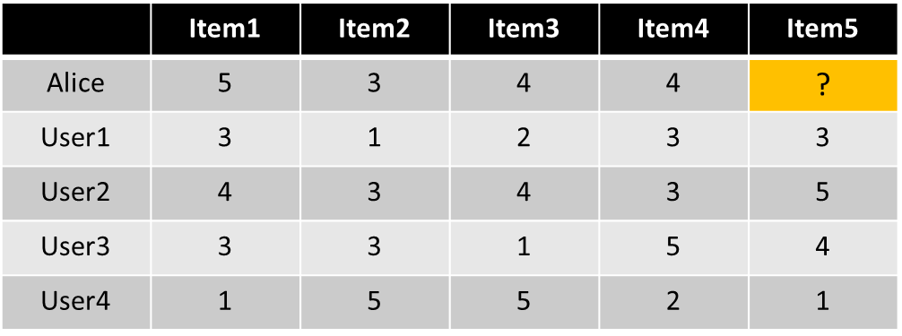
User-based Collaborative Filtering
Define similarity between users according to the history matrix
Decide how many “peers” to consider
Use peers’ ratings to predict the rating between an active user and an item

Slide 14

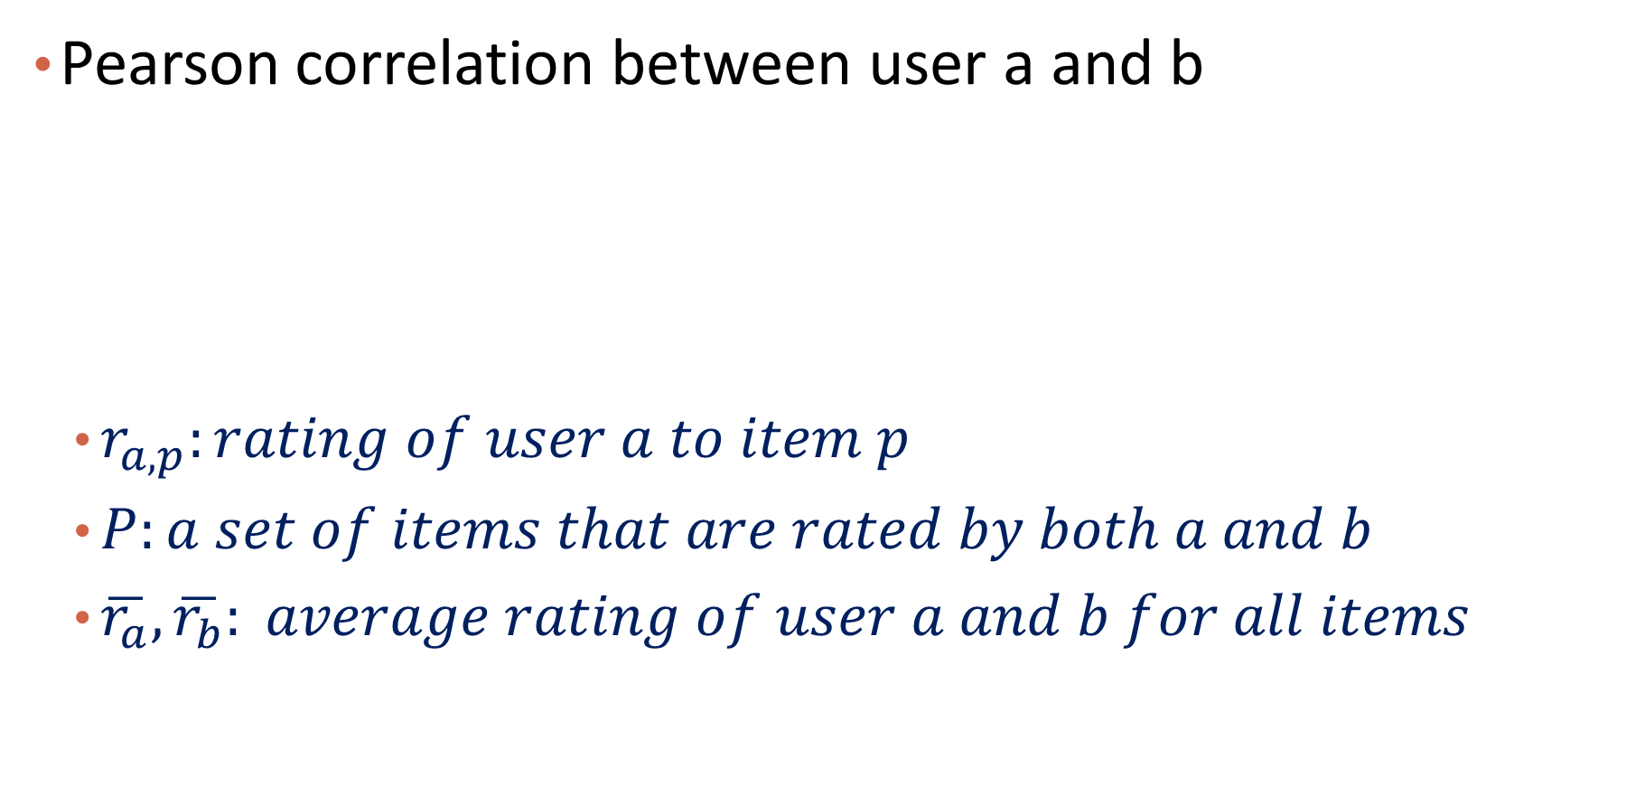
(1) Define Similarities between Users
Pearson correlation between user a and b
$r_{a,p}:rating of user a to item p$
$P:a set of items that are rated by both a and b$
$\overline{r_{a}},\overline{r_{b}}: average rating of user a and b for all items$
Notes:
Or, $sim\left(a,b\right)=\frac{cov(r_{a},r_{b})}{σ\left(r_{a}\right)σ(r_{b})}$
$cov(r_{a},r_{b})$: covariance between a and b
$$σ\left(r_{a}\right),σ\left(r_{b}\right):standard deviation of a and b$$

Slide 15
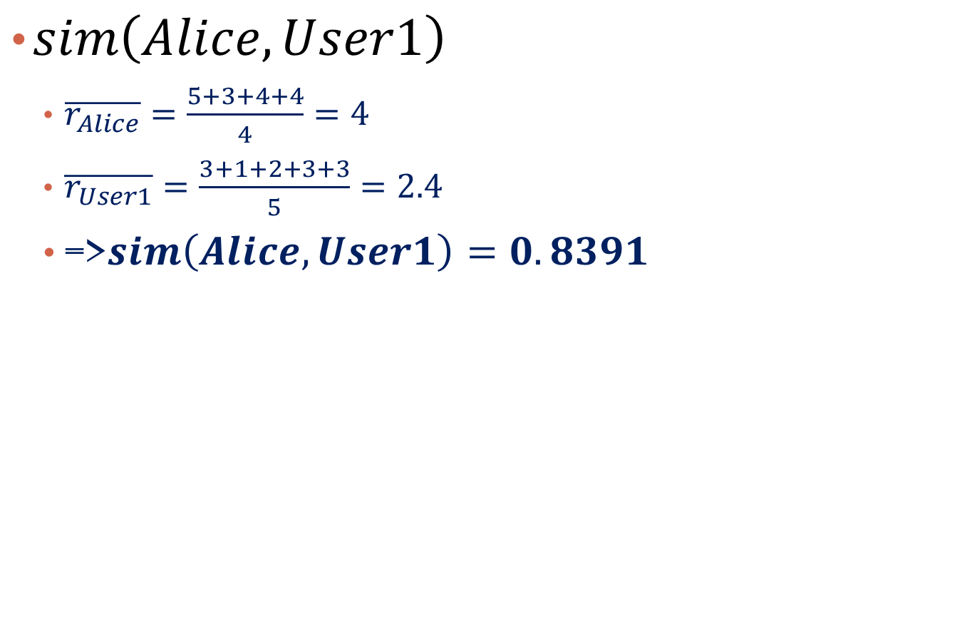
Example
$sim\left(Alice,User1\right)$
$\overline{r_{Alice}}=\frac{5+3+4+4}{4}=4$
$\overline{r_{User1}}=\frac{3+1+2+3+3}{5}=2.4$
=>$sim\left(Alice,User1\right)=0.8391$
 | Item1 | Item2 | Item3 | Item4 | Item5
Alice | 5 | 3 | 4 | 4 | ?
User1 | 3 | 1 | 2 | 3 | 3
User2 | 4 | 3 | 4 | 3 | 5
User3 | 3 | 3 | 1 | 5 | 4
User4 | 1 | 5 | 5 | 2 | 1
sim = 0.84
sim = 0.61
sim = -0.77

Slide 16
(2) Decide how many peers to use
Usually only use top K most similar users for prediction
i.e., based on top-K most similar users’ rating for an item

Slide 17
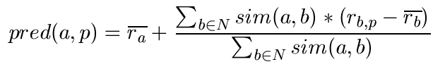
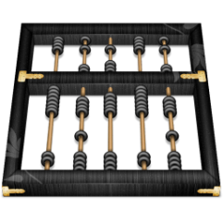
(3) Predict the rating
A common prediction function:
N denotes the k-nearest neighbor of a
Calculate, whether the neighbors' ratings for the unseen item p are higher or lower than their average
Combine the rating differences – use the similarity as a weight
Add/subtract the neighbors' bias from the active user's average and use this as a prediction

Slide 18
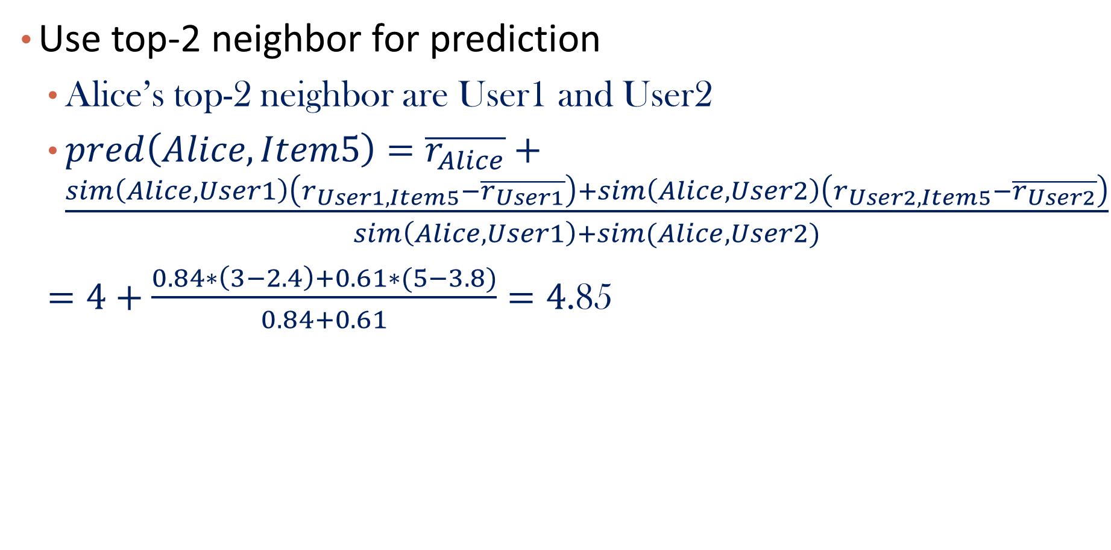
Example
Use top-2 neighbor for prediction
Alice’s top-2 neighbor are User1 and User2
$pred\left(Alice, Item5\right)=\overline{r_{Alice}}+\frac{sim\left(Alice,User1\right)\left(r_{User1,Item5}−\overline{r_{User1}}\right)+sim\left(Alice, User2\right)\left(r_{User2,Item5}−\overline{r_{User2}}\right)}{sim\left(Alice,User1\right)+sim(Alice,User2)}$
$=4+\frac{0.84∗\left(3−2.4\right)+0.61∗(5−3.8)}{0.84+0.61}=4$.85
 | Item1 | Item2 | Item3 | Item4 | Item5
Alice | 5 | 3 | 4 | 4 | ?
User1 | 3 | 1 | 2 | 3 | 3
User2 | 4 | 3 | 4 | 3 | 5
User3 | 3 | 3 | 1 | 5 | 4
User4 | 1 | 5 | 5 | 2 | 1
sim = 0.84
sim = 0.61

Slide 19
Model-based Collaborative Filtering
User-based CF is said to be "memory-based"
the rating matrix is directly used to find neighbors / make predictions
does not scale for most real-world scenarios
large e-commerce sites have tens of millions of customers and millions of items
Model-based approaches
based on an offline pre-processing or "model-learning" phase
at run-time, only the learned model is used to make predictions
models are updated / re-trained periodically
large variety of techniques used
model-building and updating can be computationally expensive

Slide 20
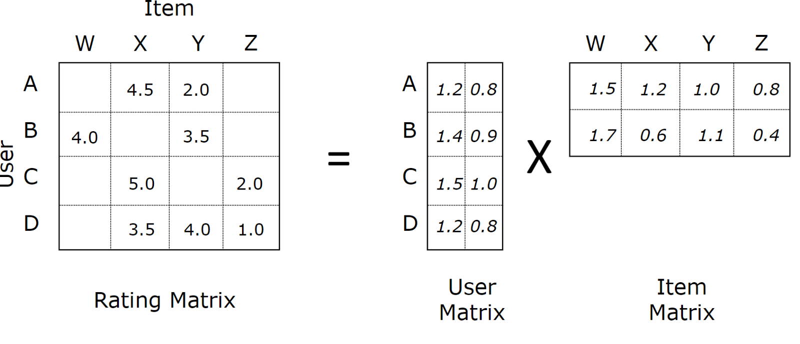
Matrix Factorization for Recommendation
Map users and items into the same latent space
Reference: Koren et al., “Matrix Factorization Techniques for Recommender System”, Computer (Volume: 42, Issue: 8), 2009

Slide 21
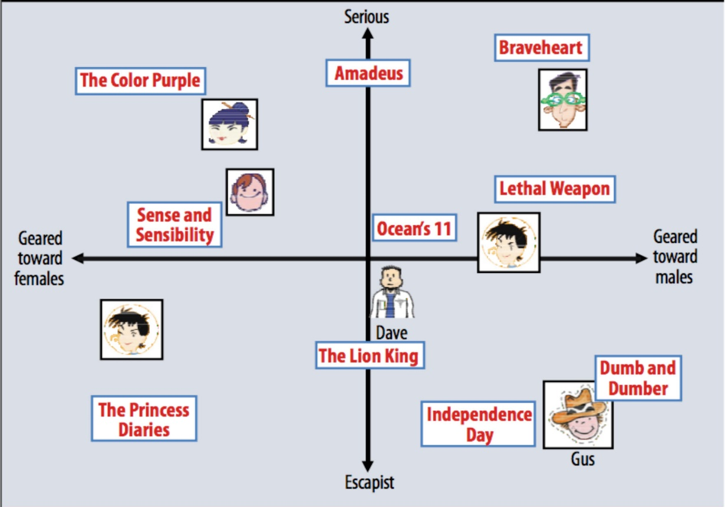
Now users and items are comparable
Recommendation: find items that are close to users in the new space
https://towardsdatascience.com/paper-summary-matrix-factorization-techniques-for-recommender-systems-82d1a7ace74

Slide 22
Procedure
Training stage
Use existing matrix to learn the latent feature vector for both users and items by matrix factorization
Recommendation stage
Predict the score for unknown (user, item) pairs

Slide 23
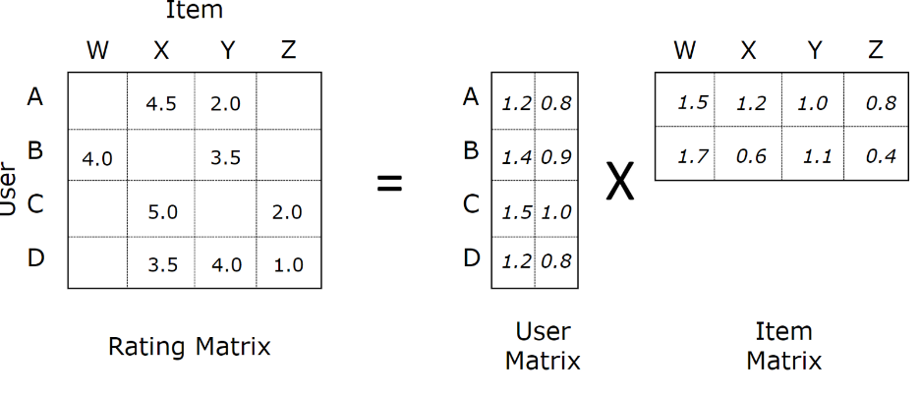
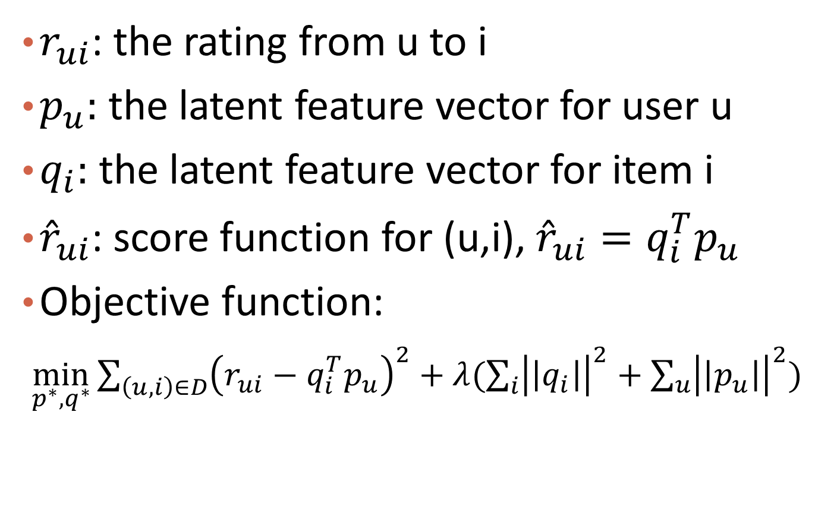
Training Stage
$r_{ui}$: the rating from u to i
$p_{u}:$ the latent feature vector for user u
$q_{i}:$ the latent feature vector for item i
${\hat{r}}_{ui}$: score function for (u,i), ${\hat{r}}_{ui}=q_{i}^{T}p_{u}$
Objective function:
${\min_{p^{∗},q^{∗}}{\sum_{\left(u,i\right)∈D}{\left(r_{ui}−q_{i}^{T}p_{u}\right)}}}^{2}+λ(\sum_{i}{{\left|\left|q_{i}\right|\right|}^{2}}+\sum_{u}{{\left|\left|p_{u}\right|\right|}^{2}})$

Slide 24
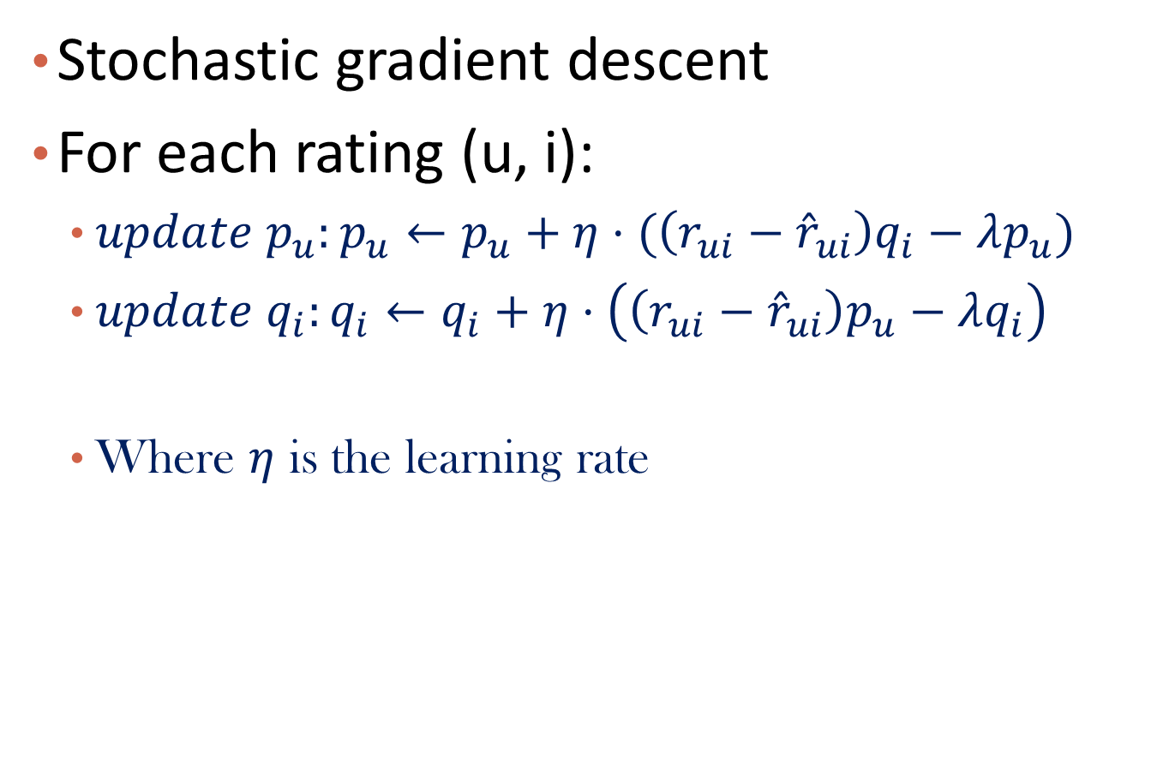
Learning Algorithm
Stochastic gradient descent
For each rating (u, i):
$update p_{u}:p_{u}←p_{u}+η⋅(\left(r_{ui}−{\hat{r}}_{ui}\right)q_{i}−λp_{u})$
$update q_{i}:q_{i}←q_{i}+η⋅\left(\left(r_{ui}−{\hat{r}}_{ui}\right)p_{u}−λq_{i}\right)$
Where $η$ is the learning rate

Slide 25
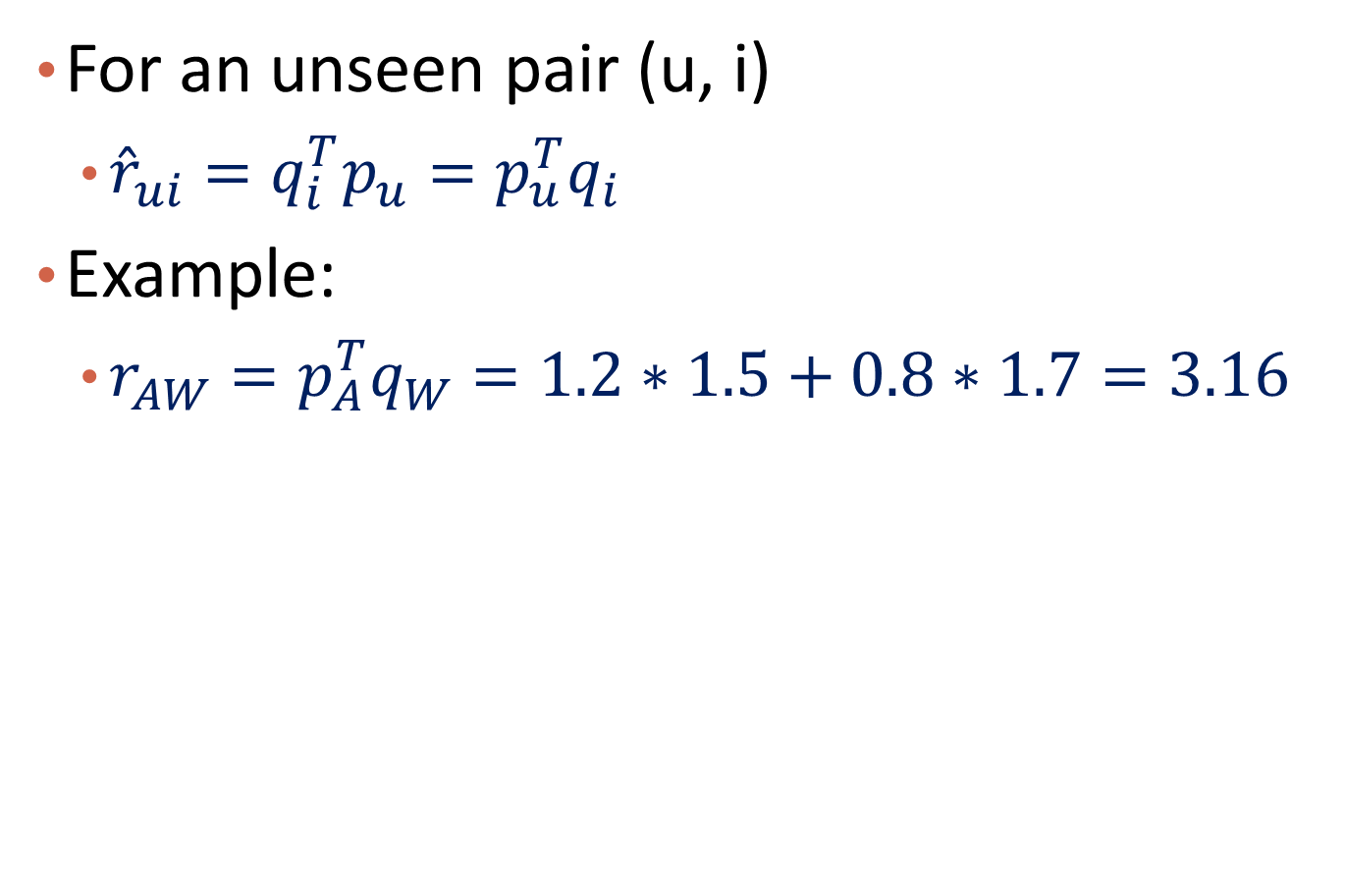
Prediction Stage
For an unseen pair (u, i)
${\hat{r}}_{ui}=q_{i}^{T}p_{u}=p_{u}^{T}q_{i}$
Example:
$r_{AW}=p_{A}^{T}q_{W}=1.2∗1.5+0.8∗1.7=3.16$

Slide 26
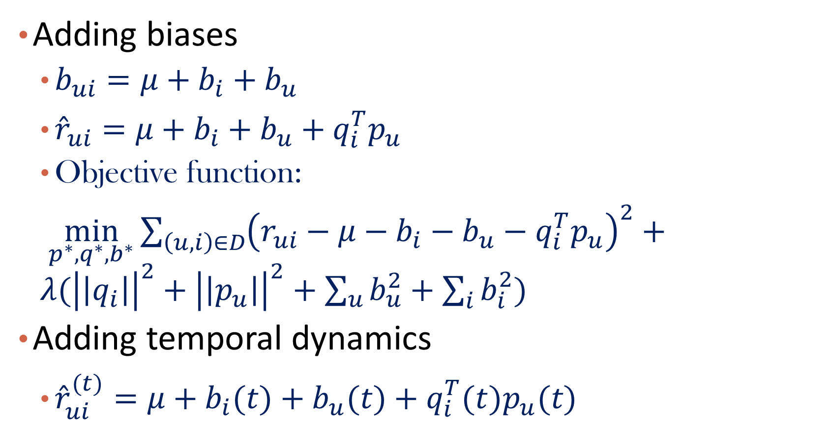
Variations
Adding biases
$b_{ui}=μ+b_{i}+b_{u}$
${\hat{r}}_{ui}={μ+b_{i}+b_{u}+q}_{i}^{T}p_{u}$
Objective function:
${\min_{p^{∗},q^{∗},b^{∗}}{\sum_{\left(u,i\right)∈D}{\left(r_{ui}−{μ−b_{i}−b_{u}−q}_{i}^{T}p_{u}\right)}}}^{2}+λ({\left|\left|q_{i}\right|\right|}^{2}+{\left|\left|p_{u}\right|\right|}^{2}+\sum_{u}{b_{u}^{2}}+\sum_{i}{b_{i}^{2}})$
Adding temporal dynamics
${\hat{r}}_{ui}^{(t)}={μ+b_{i}(t)+b_{u}(t)+q}_{i}^{T}{(t)p}_{u}(t)$

Slide 27
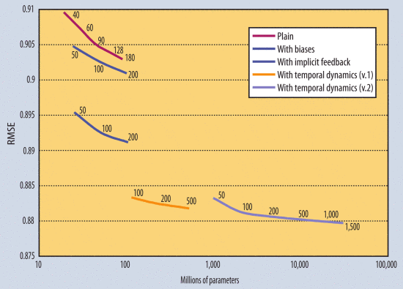
Results

Slide 28
Question
Can we make recommendation for new users or items using the above models?

Slide 29
Implicit Feedback Models
Only implicit signals are received
E.g., click though, music streaming play
Methods:
Turn it into binary classification problem: Logistic Matrix Factorization
Johnson, Logistic Matrix Factorization for Implicit Feedback Data, NIPS workshop 2014
Turn it into ranking problem: BPR: Bayesian Personalized Ranking
Rendel et al., BPR: Bayesian Personalized Ranking from Implicit Feedback, UAI’09

Slide 30
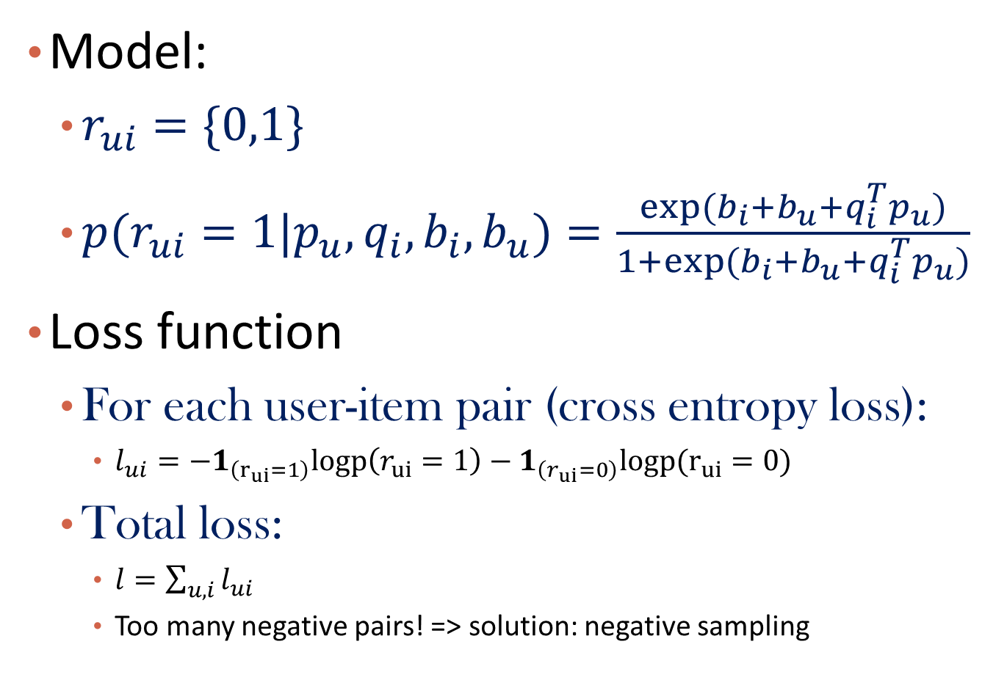
Logistic MF
Model:
$r_{ui}=\{0,1\}$
${p(r}_{ui}=1|p_{u},q_{i},b_{i},b_{u})=\frac{exp⁡({b_{i}+b_{u}+q}_{i}^{T}p_{u})}{1+{exp⁡(b_{i}+b_{u}+q}_{i}^{T}p_{u})}$
Loss function
For each user-item pair (cross entropy loss):
$l_{ui}=−1_{\left(r_{ui}=1\right)}logp\left(r_{ui}=1\right)−1_{\left(r_{ui}=0\right)}logp(r_{ui}=0)$
Total loss:
$l=\sum_{u,i}{l_{ui}}$
Too many negative pairs! => solution: negative sampling

Slide 31
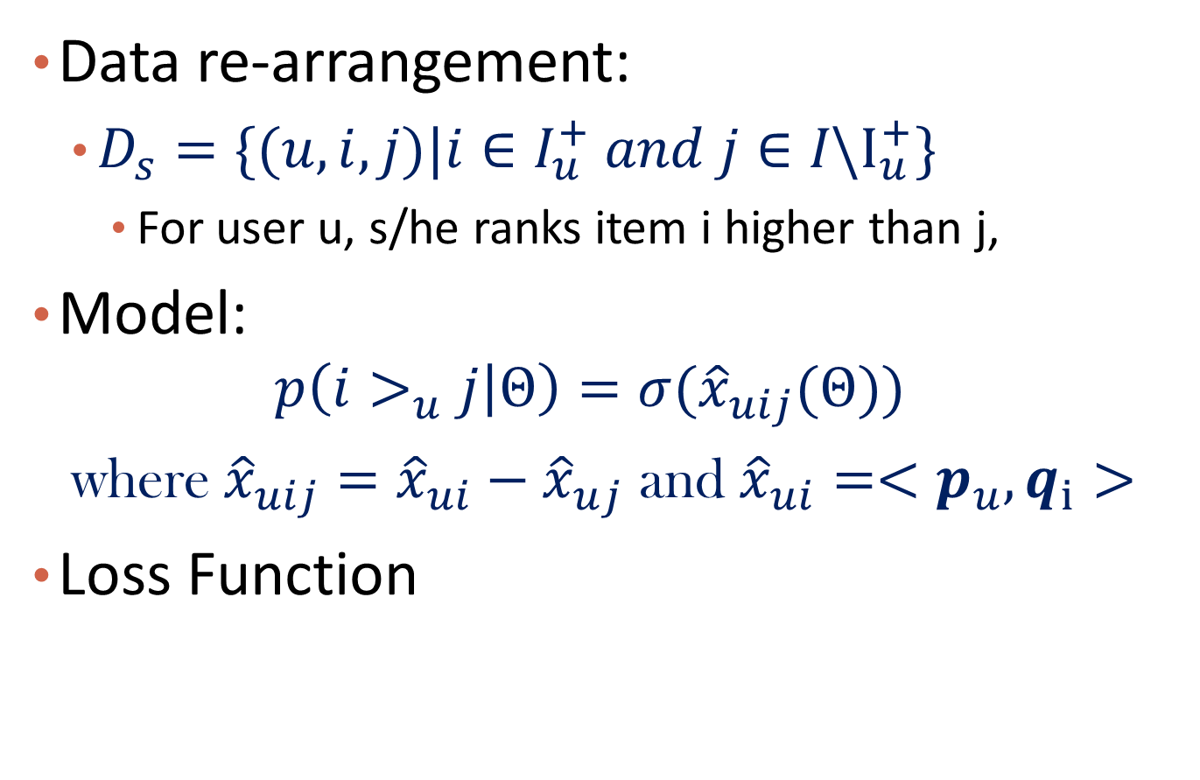
Bayesian Ranking
Data re-arrangement:
$D_{s}=\{(u,i,j)|i∈I_{u}^{+} and j∈I\backslash I_{u}^{+}\}$
For user u, s/he ranks item i higher than j,
Model:
$$p\left(i>_{u}j | Θ\right)=σ({\hat{x}}_{uij}(Θ))$$
where${\hat{x}}_{uij}={\hat{x}}_{ui}−{\hat{x}}_{uj}$ and ${\hat{x}}_{ui}=<p_{u},q_{i}>$
Loss Function

Slide 32
Discussion
How to further improve the sampling strategy? (Hint: consider negative sampling in Word2Vec)

Slide 33
Issues of CF
Cold Start: There needs to be enough other users already in the system to find a match.
Sparsity: If there are many items to be recommended, even if there are many users, the user/ratings matrix is sparse, and it is hard to find users that have rated the same items.
First Rater: Cannot recommend an item that has not been previously rated.
New items
Esoteric items
Popularity Bias: Cannot recommend items to someone with unique tastes.
Tends to recommend popular items.

Slide 34
Recommender Systems
What is Recommender System?
Collaborative Filtering
Content-based Recommendation
Hybrid methods
Evaluation Metrics
Summary

Slide 35
Content-based recommendation
Collaborative filtering does NOT require any information about content,
However, it might be reasonable to exploit such information
E.g. recommend fantasy novels to people who liked fantasy novels in the past
What do we need:
Information about the available items such as the genre ("content")
user profile describing what the user likes (the preferences)
The task:
Learn user preferences
Locate/recommend items that are "similar" to the user preferences

Slide 36
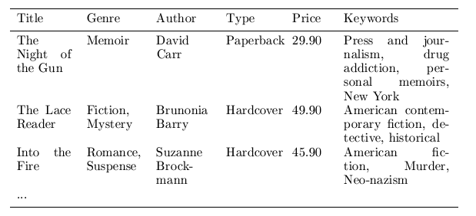
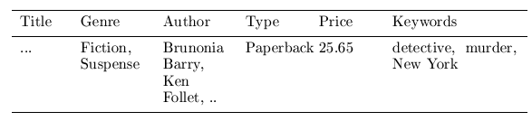

Content representation and item similarities
User profile
Simple approach
Compute the similarity of an unseen item with the user profile based on the keyword overlap (e.g. using the Dice coefficient)
sim(b_{i}, b_{j}) = $\frac{2 ∗|keywords\left(bi\right)∩keywords\left(bj\right)|}{\left|keywords\left(bi\right)\right|+|keywords\left(bj\right)|}$
Other advanced similarity measure
Item
Notes:
Intersection

Slide 37
Question
Can content-based recommendation handle new users/items?

Slide 38
Recommender Systems
What is Recommender System?
Collaborative Filtering
Content-based Recommendation
Hybrid methods
Evaluation Metrics
Summary

Slide 39
Hybrid Methods
Combining both user-item interaction and other external sources of information
One example:
Factorization Machines
Steffen Rendle, “Factorization Machines,” in ICDM’10, Sydney, Australia.

Slide 40
Factorization Machines
Treat each user-item transaction as one data point
U = {Alice (A), Bob (B), Charlie (C), …}
I = {Titanic (TI), Notting Hill (NH), Star Wars (SW), Star Trek (ST), . .}
S = {(A, TI, 2010-1, 5), (A,NH, 2010-2, 3), (A, SW, 2010-4, 1), (B, SW, 2009-5, 4), (B, ST, 2009-8, 5), (C, TI, 2009-9, 1), (C, SW, 2009-12, 5)}

Slide 41
FM: Feature Preparation
Each data point has a feature vector x, and a target value (e.g., rating score)

Slide 42
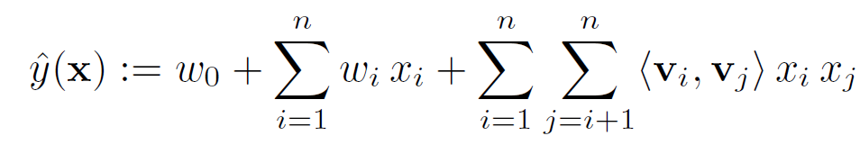
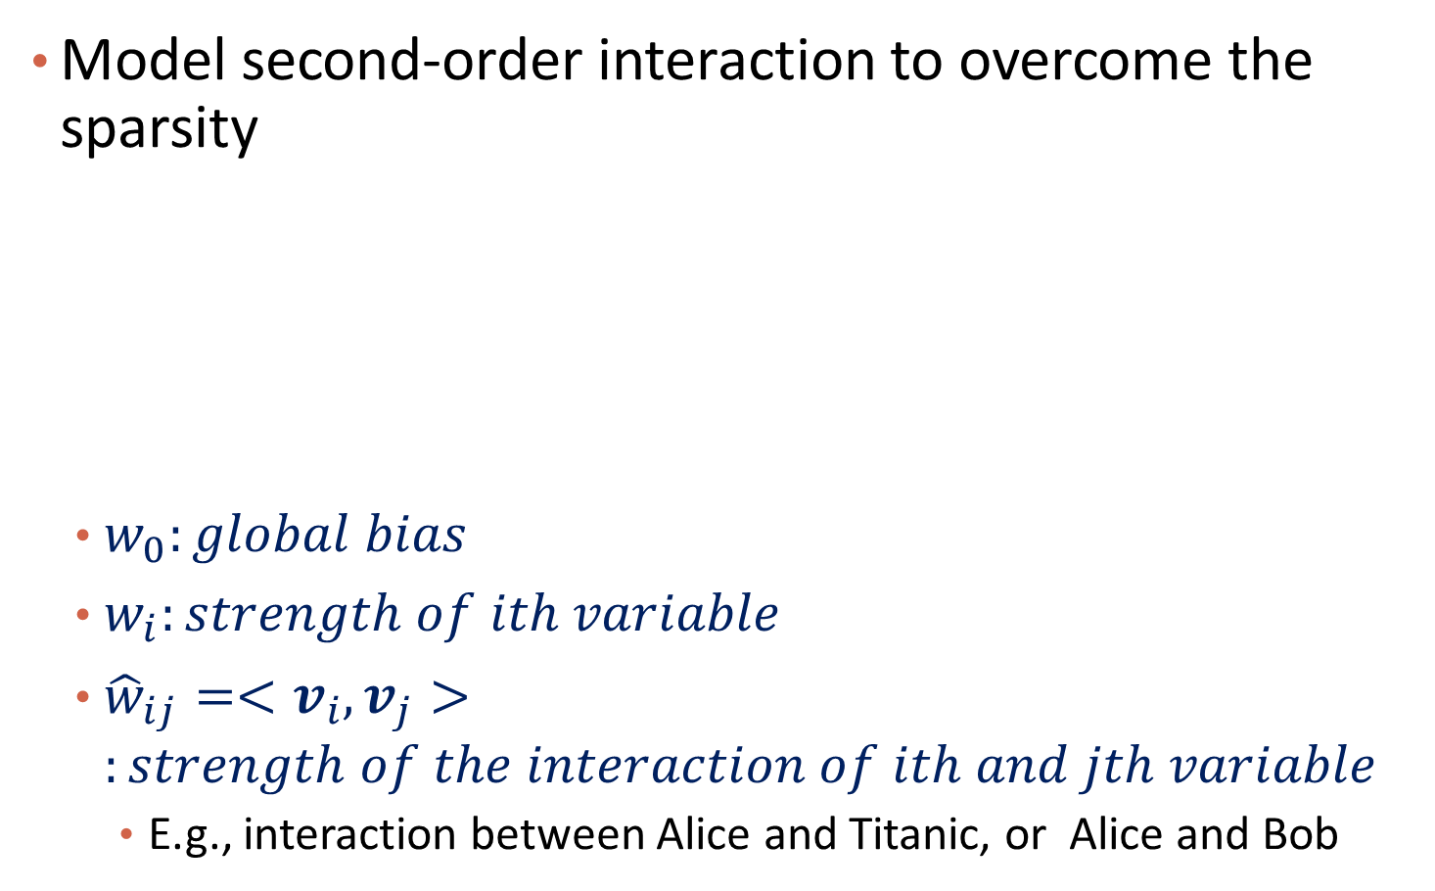
The Model
Model second-order interaction to overcome the sparsity
$w_{0}:global bias$
$w_{i}:strength of ith variable$
${\hat{w}}_{ij}=<v_{i},v_{j}>:strength of the interaction of ith and jth variable$
E.g., interaction between Alice and Titanic, or Alice and Bob

Slide 43
Time Complexity of Second-Order Interaction
O(kn)
k: dimension of v; n: dimension of x

Slide 44
Apply to Recommendation
Explicit Feedback:
Treat it as a prediction task, with mean square error loss
Implicit Feedback:
Treat it as a binary classification or ranking task, with logistic loss or pairwise logistic loss
Learning:
Stochastic gradient descent

Slide 45
Recommender Systems
What is Recommender System?
Collaborative Filtering
Content-based Recommendation
Hybrid methods
Evaluation Metrics
Summary

Slide 46

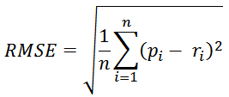
Accuracy measures: Explicit Feedback
Datasets with items rated by users
MovieLens datasets 100K-10M ratings
Netflix 100M ratings
Historic user ratings constitute ground truth
Metrics measure error rate
Mean Absolute Error (MAE) computes the deviation between predicted ratings and actual ratings
Root Mean Square Error (RMSE) is similar to MAE, but places more emphasis on larger deviation

Slide 47
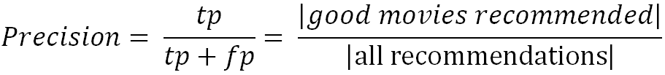
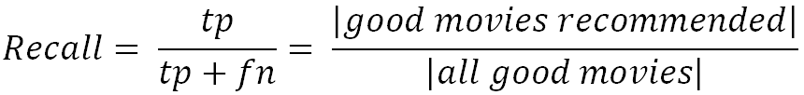
Implicit Feedback: Precision and Recall
Precision: a measure of exactness, determines the fraction of relevant items retrieved out of all items retrieved
E.g. the proportion of recommended movies that are actually good
Recall: a measure of completeness, determines the fraction of relevant items retrieved out of all relevant items
E.g. the proportion of all good movies recommended

Slide 48
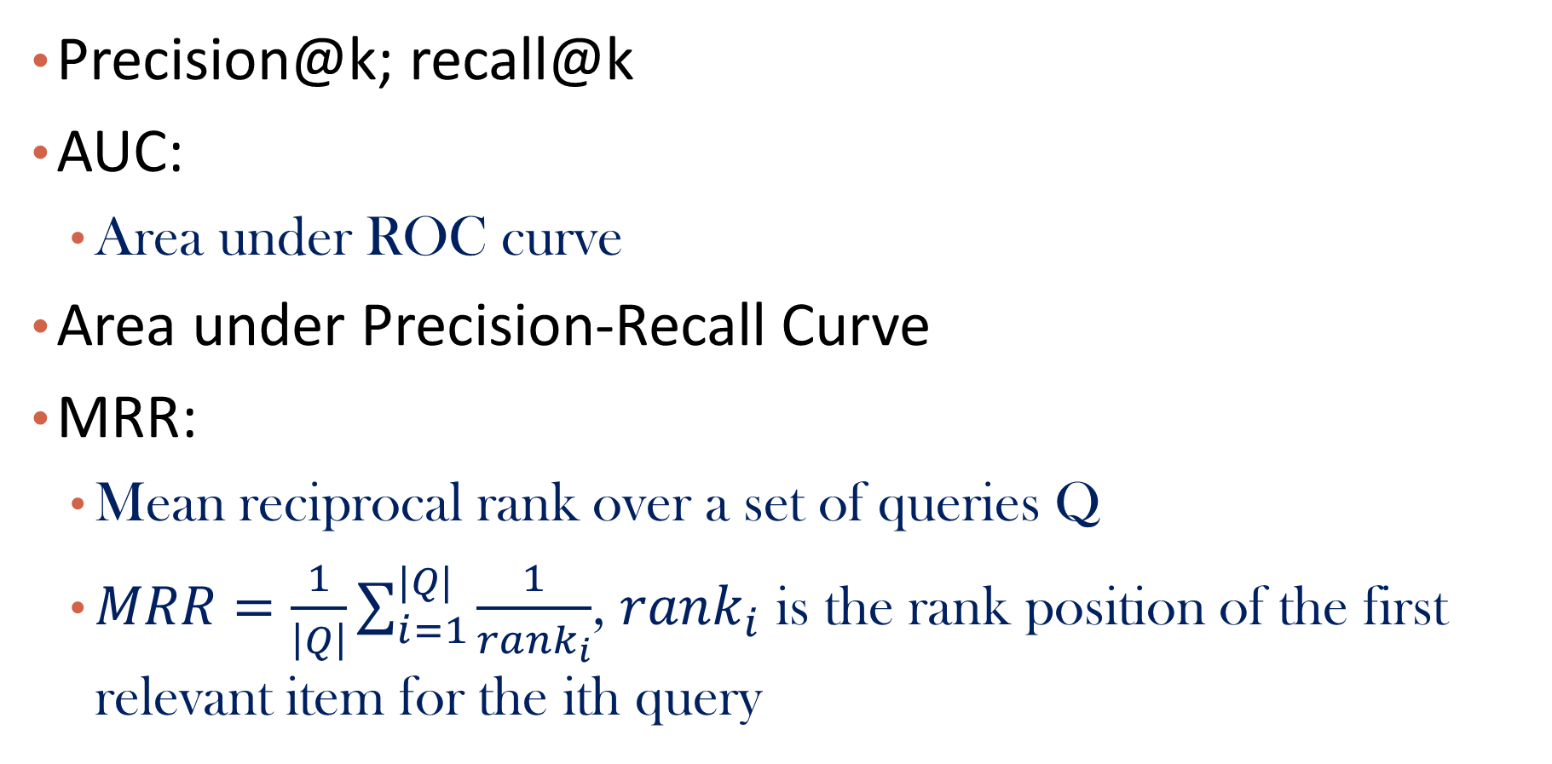
More Implicit Feedback Measures
Precision@k; recall@k
AUC:
Area under ROC curve
Area under Precision-Recall Curve
MRR:
Mean reciprocal rank over a set of queries Q
$MRR=\frac{1}{\left|Q\right|}\sum_{i=1}^{|Q|}{\frac{1}{rank_{i}}}$, $rank_{i}$ is the rank position of the first relevant item for the ith query

Slide 49
Recommender Systems
What is Recommender System?
Collaborative Filtering
Content-based Recommendation
Hybrid methods
Evaluation Metrics
Summary

Slide 50
Summary
Recommendation
User-based CF, matrix factorization-based CF
Explicit feedback, implicit feedback
Content-based recommendation
Hybrid methods
Evaluation

Slide 51
References
http://ijcai13.org/files/tutorial_slides/td3.pdf
http://research.microsoft.com/pubs/115396/EvaluationMetrics.TR.pdf
https://datajobs.com/data-science-repo/Recommender-Systems-[Netflix].pdf
http://www.librec.net/tutorial.html

