Slide 1
Finding Reusable Data Structures
Guoqing Xu
University of California, Irvine
OOPSLA’12 Conference Talk

Slide 2
Excessive Object Creation
A significant source of run-time bloat
Developers are encouraged to create objects
Costs of using objects
Creating, initializing, and destroying them all takes time and space
Example
Using objects to represent data items in a Big Data application can drive the GC time up to 47% of the total running time
The effort is unnecessary if identical objects are frequently created, initialized, and destroyed

Slide 3
Reusing Data Structures
A common practice
4/18 best practices are instructions to avoid repeated creation of identical objects (WebSphere Application Server best practices white paper)
Reusing object instances in the Big Data application can significantly reduce the GC effort
Our focus: a dynamic analysis to find and report reusable data structures

Slide 4
Reusability Levels
Reuse object instances (I)
Object lifetimes are disjoint
Reuse data structure shapes (S)
Reference relationships are identical
Reuse data content (D)
Data values contained in the fields are identical
Focus on allocation sites
Finding reuse opportunities among the data structures created by the same allocation site

Slide 5
Optimization Example
for(int i = 0; i < N; i++){
A a = new A(); a.f =1 ; B b = new B(); b.g = 1; a.link = b;
//use a
}
Reuse Instances
Reuse Shapes
Reuse Data
for(int i = 0; i < N; i++){
A a = getAInstance();
B b = getBInstance();
a.f =1 ; b.g = 1; a.link = b;
//use a
}
for(int i = 0; i < N; i++){
A a = getAInstance();
a.f =1 ; a.link.g = 1;
//use a
}
for(int i = 0; i < N; i++){
A a = getAInstance();
//use a
}
static A instance = new A();
A getAInstance(){
if(a.link == null){
a.link = new B();
a.f = 1; a.link.g = 1;
}
return instance;
}
static A instance = new A();
A getAInstance(){
if(a.link == null)
a.link = new B();
return instance;
}
static A instance = new A();
A getAInstance(){
return instance;
}
B getBInstance(){ … }
Notes:
Happens in the compiler

Slide 6
Approximating Instance Reusability
Goal: compute a measurement IR(a) for each allocation site a, indicating how likely a creates disjoint objects
At each GC, compute a DL ratio
# Dead Objs / # Live Objs
IR(a) = AVG_{GC} (# Dead Objs / # Live Objs)
The large number of GC runs help reduce the imprecision

Slide 7
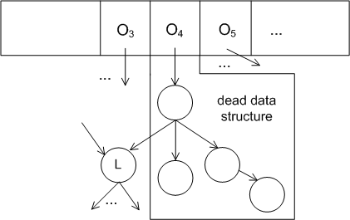
Computing IR
Counting incoming references for each object
Add an object to a dead object queue whenever its rc becomes 0
Add a pass at the end of each GC to traverse the objects from those (roots) in the queue
Identify a dead data structure

Slide 8
Approximating Shape Reusability
Goal: compute a measurement SR(a) for each allocation site a that indicates how likely a creates data structures with the same shape
Interested only in dead data structures
Encoding a shape into a (probabilistically) unique value
SR(a) is determined by comparing the encoded shapes for all dead data structures created by a

Slide 9
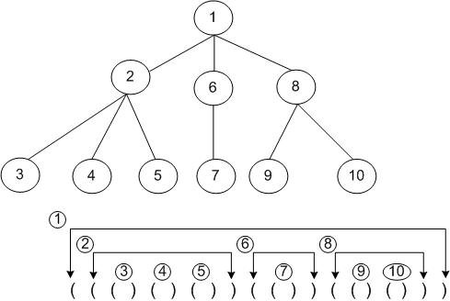
Encoding Shapes
Base algorithm: balanced parenthesis (BP) algorithm
Modified BP
Break cycles
Turn the vector into an integer value
s(n) = ID_{n} +
∑ _{child i} f_{i}* s(i)
Shapes_{n} [s(n) % 7]++
SR(n) = max(Shapes_{n})
/sum(Shapes_{n})
f_{i}

Slide 10
Encoding Data
Encode values contained in primitive-typed fields of a data structure into a (probabilistically) unique value
An algorithm similar to the shape encoding is used

Slide 11
Implementation
JikesRVM 3.1.0
Both baseline and optimizing compilers are modified
Add a one-word header, shared by alloc ID and reference count
Average overhead (across 14 programs) on FastAdativeImmix
10.8% running time overhead
30.3% space overhead

Slide 12
Six Case Studies
chart: 24.2% running time reduction and 15.3% GC time reduction by reusing XYSeries[]
1usearch: 9% GC run reduction and 4.7% peak memory reduction by reusing QueryParser
xalan: 22% GC time reduction by reusing XPathParser
SPECJbb2000: 4.7% throughput improvement after reusing the *Transaction data structures

Slide 13
Conclusions
A dynamic technique to approximate reusability for data structures to help developers find optimization opportunities
Define three reusability levels
Develop three approximations to compute reusability
Implemented in JikesRVM and evaluated on 14 large programs
Useful in exposing reuse opportunities

Slide 14
Thank You
Q/A

Slide 15
False Positives
Among the 20 alloc sites we have inspected, those for which no optimization opportunities could be found are considered as false positives
All false positives come from the (imprecise) approximation of object lifetimes
 | I | S | D
chart | 5 | 5 | 4
bloat | 0 | 0 | 0
luindex | 8 | 6 | 2
lusearch | 6 | 4 | 2
xalan | 0 | 0 | 0
jbb | 4 | 4 | 1

