Slide 1
NETWORK VERIFICATION, SYNTHESIS, AND THE CREATIVE HABIT
George Varghese

Slide 2
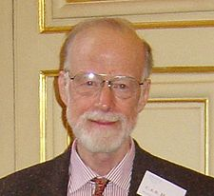
NETWORK VERIFICATION: WHEN HOARE MEETS CERF
Formal
Methods
Networking
FOR PUBLIC CLOUDS, PRIVATE CLOUDS, ENTERPRISE NETWORKS, ISPs, . . .
TOOLS
George Varghese
(based on a tutorial with Nikolaj Bjorner of MSR)

Slide 3
Goals of Course
Motivate: why this may be an important inter-disciplinary field that can have real impact
Expose: UCLA students to verification ideas and terminology
Survey: describe and put in context existing work in network verification & synthesis
Inspire: resources available, lessons for you to attempt network verification tasks

Slide 4
Acknowledgments
Slides borrowed from many sources, including
Marco Canini, Nate Foster, Brighten Godfrey, Peyman Kazemian, Dejan Kostic, Sharad Malik, Nick McKeown, Mooly Sagiv, Ragunathan, Jennifer Rexford
Apologies for missing any work related to network verification, please email it to me for inclusion in later version.

Slide 5
MOTIVATION

Slide 6
Motivation: State of Networks today
P1
1001
SQL
10*→ P1
1* → P2
,P2
Drop SQL
P2
Load balancing
Access Control Lists (ACLs)
Multiple Protocols: 6000 RFCs (MPLS, GRE . . .)
Multiple Vendors: Broadcom, Arista, Cisco, . . .
Manual Configurations: Additional arcane programs kept working by “masters of complexity” (Shenker)
Crude tools: SNMP, NetFlow, TraceRoute, . . .
Notes:
But to understand why correct design is hard it is important to see even why just understanding ordinary working networks such as lurk behind your Caltech firewall is hard.

Slide 7
Configuration Problems
Shortest Path
D
S
Manual Configurations: Managers override default shortest paths for security, load balancing, and economic reasons
Data Plane + Control Plane: Vendor-specific knobs in both
Problem: Manually programming individual routers to implement global policy leads to cloud failures
Notes:
But to understand why correct design is hard it is important to see even why just understanding ordinary working networks such as lurk behind your university firewall is hard.

Slide 8
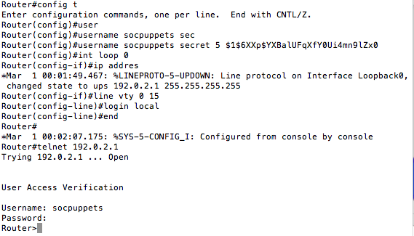
Sample Configuration File (like assembler, often 2000 lines)

Slide 9
Why manual reasoning is hard: DP
I
POLICY
Internet and Compute can communicate
Internet cannot send to controllers
Deny Any C UDP
Allow Any C
Allow C Any
B
X
D
E
F
G
H
DNS Services are now blocked!
Notes:
To illustrate why static, automated reasoning is imperative for large networks, Let me show you an incident that really happened in a real cloud. There are compute servers below, the routers are the blue boxes with crosses and the policy was that the Internet hosts could communicate with the compute servers but there are some privileged controllers such as the routers that the Internet hosts cannot send messages to.
Now trying to enumerate all the compute servers and Internet servers would take too many ACL rules and so the cloud operators had a rule at Router B that allowed folks from the Internet to send messages to anyone in cluster C. Unfortunately, a security audit by an external auditor on Feb 8th found that this allowed an external laptop to attack a router like D using so-called UDP message. They tried to close this security hole by adding a rule at N which denied UDP traffic from the Internet to send to the cluster. Their reasoning what that talking to the computer cluster required a different protocol called TCP.
They forgot that the Domain Name Service, also used UDP and the result of this “fix” was that a good service was now blocked.
This kind of manual trial-and-error attempt at reasoning about reachability goes on a great deal, alternating between leaving security holes and denying access to valid users. It often brings down large swaths of the network when done wrongly

Slide 10
But there is also a Control Plane
Can reach 1.2 in 1 hop
1.2.*
Accounting
1.2.*
1.2.*
1.2.*
Can reach 1.2 in 2 hops
1.2.*
Data Plane (DP): Collection of forwarding tables and logic that forward data packets, aka Forwarding
Control Plane (CP): Program that takes failed links, load into account to build data plane, aka Routing
Notes:
Lets see the control versus data plane distinction in a simple picture. Assume that Engineering wants to send expenses to accounting and accounting is all addresses that start with 1.2., So the two routers on top have forwarding rules that route packets with such destinations addresses to the right. But now suppose the topmost link fails. In order to still get our expenses paid, we need some other protocol to change the forwarding rule at the upper left router to reroute packets via the bottom router. So informally, the data plane is the collection of . . . and the control plane s

Slide 11
BGP Routing: Beyond shortest path
Route1 (p, . .)
Route2 (p, . .)
LP = 120
LP = 80
Route Processing Policy
Static Route
For p
Static Routes take precedence
Then come local preferences at this router (higher wins)
Then comes some form of path length
And more . . .
Notes:
Lets see the control versus data plane distinction in a simple picture. Assume that Engineering wants to send expenses to accounting and accounting is all addresses that start with 1.2., So the two routers on top have forwarding rules that route packets with such destinations addresses to the right. But now suppose the topmost link fails. In order to still get our expenses paid, we need some other protocol to change the forwarding rule at the upper left router to reroute packets via the bottom router. So informally, the data plane is the collection of . . . and the control plane s

Slide 12
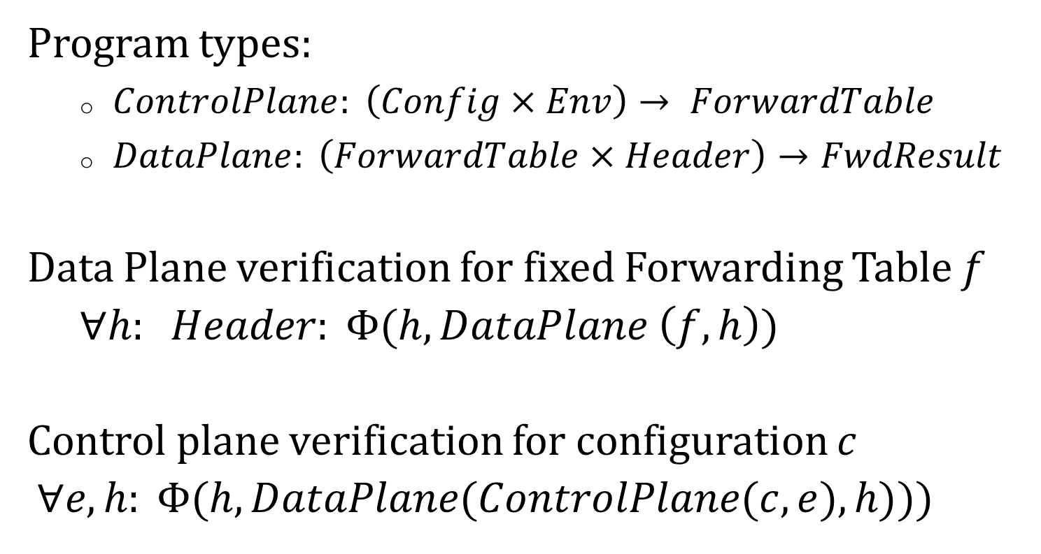
Control versus Data Plane Verification
Program types:
$ControlPlane: \left(Config×Env\right)→ ForwardTable$
$DataPlane: \left(ForwardTable×Header\right)→FwdResult$
Data Plane verification for fixed Forwarding Table $f$
$∀h: Header: Φ(h, DataPlane \left(f, h\right))$
Control plane verification for configuration $c$
$∀e, h: Φ(h, DataPlane(ControlPlane(c, e), h)))$
Notes:
We can be mildly more formal about by saying the control plane maps a set of configurations (remember those additional directives at each router, we”ll see examples of routing configs shortly) and environments (these are inputs like routing updates and failed links) and maps these into a set of forwarding tables, the data plane uses forwarding tables to map headers into forwarding results. The data plane verification task we have seen is to guarantee that for all headers (the header space), we maintain some predicate phi on the forwarding results such as Customer Virtual Machines should not access privileged routers etc. The control plane task is strictly harder: we want to show that for all environments (i.e, routing program inputs, we could call it the control space) and for all headers, we meet the same predicate. If we do only data plane verification and not verify the control plane, we risk the possibility of there being some routing input that could trigger a very bad forwarding bug in the future: what we call a latent bug

Slide 13
Errors manifest as Latent Bugs
Core
C via up
C via up
Static Route: C via M
B1
B2
C via up
C via M
management network
M
Data Center Network
Buggy static route causes B1 to propagate wrong route to C. Works fine till . . .
Specification: $∀e \left(routing messages received\right)$
PropagatedRoute (B1, e) = PropagatedRoute (B2, e)
Notes:
Here is a real latent routing bug that brought down one of our data centers recently. There are two routers B1 and B2 that backup for each other and provide connectivity for the data center to the Core. In B1, a manager set up something called a virtual route wrongly with just a small typing error and it set a manual so-called static route that said effectively that all packets to the Core C was to be sent to the management network M. As a result when the core sent route advertisements downward, B2 sent them down to the data center network but B1 did not because in BGP, static routes have priority. All this worked fine because B2 still provided connnectivity. But when B2 was taken down for maintenance, B1 began routing traffic to the core to the management network, losing data center connectivity to the Internet for several hours.
Without complely soilving global route verification, there is an easy local specification that we can hope for

Slide 14
Simple questions hard to answer today
Which packets from A can reach B?
Is Group X provably isolated from Group Y?
Is the network causing poor performance or the server? Are QoS settings to blame?
Why is my backbone utilization poor?
Is my load balancer distributing evenly?
Where are there mysterious packet losses?
Notes:
As a result, even simple questions about a network are hard to answer.

Slide 15
Motivation to do better
Internal: > 1 hr customer visible outage/quarter (P. Patel)
Azure: 30,000 cores down 3 hrs, L2/L3 configuration bug
Bing: Entire data center, 8 hours, L2/L3 configuration bug
External: (2012 NANOG Network Operator Survey):
35% > 25 tickets per month, > 1 hour to resolve
Amazon, BigDaddy, United Failures (NetCore paper)
Welsh: vast majority of Google “production failures” due to “bugs in configuration settings”
As we migrate to services ($100B public cloud market), network failure a debilitating cost.

Slide 16
Networks Tomorrow
Online services | → | latency, cost sensitive
Merchant Silicon | → | Build your own router
Rise of Data centers | → | Custom networks
Software defined Networks (SDNs) | → | Program custom design “routing”
P4 (next generation SDN) | → | redefine hardware forwarding at runtime
Opportunity to custom design networks to optimize goal.
Potential simplifications but hard to get right

Slide 17
THE CREATIVE HABIT: WHAT’S THAT?

Slide 18
Habits to Enable Creativity
Motivation: > How to get my Ph.D.?
Most courses about analyzing other people’s work
How do I come up with my own ideas?
Some of her Habits:
Rituals of Preparation
Know your creative DNA
Scratching
Find a Spone
While Twyla is about art, I would like to see if we can apply her ideas to computer science research. We”ll add her ideas for a few minutes to some lectures

Slide 19
ROAD MAP

Slide 20
Digital Hardware Design as Inspiration?
Specification
Specification
Functional Description (RTL)
Testbench & Vectors
Policy Language, Semantics
Testing
Functional Verification
Verification
Logical Synthesis
Synthesis
Static Timing
Performance verification?
Place & Route
Network Topology Design
Design Rule Checking (DRC)
Static checking (local checks)
Layout vs Schematic (LVS)
Wiring Checkers
Parasitic Extraction
Manufacture
& Validate
Dynamic checkers/ debuggers
Interference estimation?
Electronic Design Automation
(McKeown SIGCOMM 2012)
Network Design Automation
(NDA)?
Notes:
Inspired by Nick slide on left but we want to think through to a deeper extent what was a direction pointed to by Nick

Slide 21
This Course’s Slice of NDA
Specification
Policy Language, Semantics
Testing
Verification
Synthesis
Won’t discuss debugging, very little of run-time verification.
Mostly interested in where formal methods can help
Notes:
Inspired by Nick slide on left but we want to think through to a deeper extent what was a direction pointed to by Nick

Slide 22
This Course’s Slice of NDA
Specification
CTL, NoD, Klee Assert
Policy Language, Semantics
Testing
NetKAT, NetCore
NICE, ATPG
Verification
(e.g. reachabilty)
Data Plane: Anteater, VeriFlow, HSA, Atomic Predicates,
Cellular Verification, local checks
Control Plane: BatFish, ARC, ERA
Synthesis
(e.g. forwarding)
One big switch, NetCore, Propane
Won’t discuss debugging, very little of run-time verification.
Mostly interested in where formal methods can help
Notes:
Inspired by Nick slide on left but we want to think through to a deeper extent what was a direction pointed to by Nick

Slide 23
Course Road Map
Introduction to Formal Methods
Data Plane Verification
Data Plane Synthesis
Data Plane Testing
Control Plane Verification
Control Plane Synthesis

Slide 24
HOW THIS COURSE WILL BE RUN

Slide 25
Course Administration
Will start by giving some intro lectures (introduction to formal verification, etc)
You guys will be assigned papers each week and we will discuss each week (10 percent)
One midterm (30), one final (30), one project (30)
Notes:
As a result, even simple questions about a network are hard to answer.

Slide 26
Data Plane Verification Papers
[Kazemian 12] Header Space Analysis: NSDI 2012
[Kazemian 13] Real Time Network Policy Checking Using Header Space Analysis. NSDI 2013
[Dobrescu 14] Network Dataplane Verification. Dobrescu, Argyraki. NSDI 2014..
[Jayaraman 15] Automated Analysis and Debugging of Network Connectivity Policies. Jayaraman, Bjorner, Outhred, Kaufman
[Yang 15] Real time Verification using Atomic Predicates
[Yuanjie] Cellular Verification
[Plotkin 15] Scaling Network Veriﬁcation using Symmetry and Surgery. Plotkin et al, POPL 2016

Slide 27
Control Plane Verification
[Feamster 05] Detecting BGP Configuration Faults with Static Analysis. Feamster, Balakrishnan. NSDI 2005
[Fogel 15] A General Approach to Network Configuration Analysis, Fogel, Fung, Pedrosa, Walraed-Sullivan, Govindan, Mahajan, Millstein. NSDI 15.
[Jacobson 16[Fast Control Plane Analysis Using an Abstract Representation, Gember-Jacobson, Aaron and Viswanathan, Raajay and Akella, Aditya and Mahajan, Ratul, SIGCOMM 16

Slide 28
Synthesis/Compilation Papers
[Kang 13] “One Big Switch” Abstraction in Software-Defined Networks, Kang, Liu, Rexford, Walker. CoNEXT 2013
[Guha 13] Machine-Verified Network Controllers Guha, Reitblatt, Foster. PLDI 2013.
[Jose 15] Compiling P4 Programs, Jose, Yan, Varghese, McKeown. NSDI 2015
[Beckett 16]. Don‘t Mind the Gap: Bridging Network-wide Objectives and Device-level Configurations}, Becket at al, SIGCOMM 2016 Conference

Slide 29
Testing Papers
[Canini 12] A NICE Way to Test OpenFlow Applications, Canini, Venzano, Perešíni, Kostić, Rexford. NSDI 12.
[Zeng 12] Automatic test packet generation. Zeng, Kazemian, Varghese, McKeown CoNEXT 2012
[Fayaz 15] From Header Space to Control Space: Towards Comprehensive Control Plane Verification, Fayaz, Fogel, Mahajan, Millstein, Sekar, Varghese,
.

Slide 30
INTRODUCTION TO FORMAL METHODS FOR NOVICES (POSTPONE TO LECTURE 2)
Introduction to Formal Methods
Data Plane Verification
Data Plane Testing
Control Plane Verification
Control Plane Synthesis

Slide 31
Verification: Values and Obstacles
 | Hardware | Software | Networks
 | Chips | Devices (PC, phone) | Service
Bugs are: | Burned into silicone | Exploitable, workarounds | Latent, Exposed
Dealing with bugs: | Costly recalls | Online updates | Live site incidents
Obstacles to eradication: | Design Complexity | Code churn, legacy, false positives | Topology, configuration churn
Value proposition | Cut time to market | Safety/OS critical systems, Quality of code base | Meet SLA, Utilize bandwidth, Enable richer policies

Slide 32
Main Idea: Network as a Program
Model header as point in high dimensional space and all networking boxes as transformers of header space
3
1
Packet
Forwarding
2
Match
Action
+
0xx1..x1
+
11xx..0x
Send to port 3
Rewrite with 1xx011..x1
Send to port 2
Rewrite with 1x01xx..x1
ROUTER ABSTRACTED AS SET OF GUARDED COMMANDS . .
NETWORK BECOMES A PROGRAM →CAN USE PL METHODS
FOR VERIFICATION, TESTING, AND SYNTHESIS

Slide 33
Semantics Based Landscape (partial)
Hoare style proofs (1960s-1980s): axioms, inference rules, invariants : scales poorly, hard for humans
Model checking: search algorithmically over state space to check P. e.g., NuSMV, Impact, IC3
Proof Assistants: Humans help but system can check proofs. E.g., Coq, Isabelle.
Testing: Symbolic execution to maximize coverage and check property failures (e.g., Klee, SAGE)
Notes:
To put some perspective into what we do in Header Space Analysis, I need to give you some background on proof techniques used in computing systems, starting with programs and soon extended to hardware verification. M. Talupur: model checking will replace simulation for 50% of units

Slide 34
Ex: Approaches for Token Passing
Program: Receive & Send Token
Initially: s₀ token is at A
A
Inductive Invariant I: Exactly 1 token at
Node or Link (also correctness spec)
Token
Proof Assistant : Show each action maintains I
Algorithmic Search: Want to show for all states reachable from s₀ that
there is exactly 1 Token in every state.
Testing: Generate executions to exercise every action.

Slide 35
Pros and Cons
Model checking: SMV, nuSMV, Impact, IC3
Pros: “push-button verification”;
Cons: finite state systems (e.g., fixed network). Hard to scale (needs abstraction, equivalencing, compression)
Proof Assistants: Coq, Isabelle.
Pros: Much harder work (must supply invariants)
Cons: works for infinite state systems (e.g., all networks) and ideally needs methods to suggest invariants
Testing:
Pros: Can uncover bugs in large code without models
Cons: Incomplete (state space too large), imprecise
Notes:
To put some perspective into what we do in Header Space Analysis, I need to give you some background on proof techniques used in computing systems, starting with programs and soon extended to hardware verification. M. Talupur: model checking will replace simulation for 50% of units

Slide 36
To apply these techniques
Need to have:
Examples:
a modelling language for networks
a specification language for correctness
a system, data structures to encode program and data and a solver
state machines, Datalog, Propositional Logic
CTL, Modal Logic, Datalog,
NuSMV using BDDs for routers and packets

