Slide 1
Computer
Science
What to Expect of Classifiers?
Reasoning about Logistic Regression with Missing Features
Pasha Khosravi, Yitao Liang, YooJung Choi and Guy Van den Broeck.
Computer Science Department, UCLA

Slide 2
Motivation
Classifier (ex. Logistic Regression)
}
Train
Predict
Test samples with
Missing Features

Slide 3
Common Approaches
Common approach is to fill out the missing features, i.e. doing imputation.
They make unrealistic assumptions (mean, median, etc).
More sophisticated methods such as MICE don’t scale to bigger problems (also have assumptions).
We want a more principled way of dealing with this.
Notes:
Imputation make strong assumptions about the data distribution (for example mean, median imputation assume features are independent)

Slide 4
Generative vs Discriminative Models
Notation:
Generative Model: A model that defines joint features and class probability distribution, $P\left(C, X\right)$. For example, Naïve Bayes.
Discriminative Model: A model that defines class conditional probability distribution, $P\left(C \right|X)$. For example, Logistic Regression.
Notes:
Not as accurate as discriminative models

Slide 5
Generative vs Discriminative Models
 | Generative Models (ex. Naïve Bayes) | Discriminative Models (ex. Logistic Regression)
Classification Accuracy
Missing Features
Notes:
Not as accurate as discriminative models

Slide 6
Generative vs Discriminative Models
What if we train two models:
Generative model for feature distribution $P(X)$.
Discriminative model for the classifier $F\left(X\right)=P\left(C \right| X).$
Now what? How to do predictions using the two models?
Notes:
Not as accurate as discriminative models

Slide 7
Expected Predication
“Expected Prediction” is a principled way to reason about outcome of a classifier, $F(X)$, w.r.t. a feature distribution $P(X)$.
M: Missing features y: Observed Features

Slide 8
Expected Predication Intuition
Imputation Techniques: Replace the missing-ness uncertainty with one or multiple possible inputs, and evaluate the models.
Expected Prediction: Considers all possible inputs and compute weighted average of the evaluations.

Slide 9
Hardness of Taking Expectations
How can we compute the expected prediction?
In general, it is intractable for arbitrary pairs of discriminative and generative models.
We proved that even for the simple case where F is Logistic Regression and P is Naïve Bayes, the task is NP-Hard.
Notes:
Maybe.. Add example or LR and NB formulas and who more intuition why its hard….

Slide 10
What to do instead?
What if we only have a generative model that is both good at: 1) Classifying 2) Missing features.
Conformant learning
Given a discriminative classifier, learn a generative model that
Conforms to the classifier.
Maximizes the likelihood of joint feature distribution P(X)
No missing features $→$ Same quality of classification
Has missing features $→$ No problem, do inference
Notes:
it when no feature are missing, and at the same time behave well when features go missing.

Slide 11
Naïve Conformant Learning (NaCL)
We focus on of Conformant Learning involving Logistic Regression and Naïve Bayes
Given a NB model there is unique LR model that conform to it
Given a LR model there is many NB models that conform to it

Slide 12
Naïve Conformant Learning (NaCL)
We showed that we can write the Naïve Conformant Learning Optimization task as a Geometric Program.
Solving geometric programs has an exact and efficient algorithm, and modern GP solvers can handle large problems.
For NaCL, we have $O(nk)$ number of constraints. $n$ is the number of features, and $k$ is the number of classes.
Notes:
The constraints make sure the NB model always conforms to the LR model for all inputs.

Slide 13
Naïve Conformant Learning (NaCL)
Logistic Regression Weights
}
“Best” Conforming Naïve Bayes
NaCL
GitHub: github.com/UCLA-StarAI/NaCL
Notes:
The constraints make sure the NB model always conforms to the LR model for all inputs.

Slide 14
Experiments: Fidelity to Original Classifier
Using Cross Entropy to compare
- probabilities of the original classifier vs probabilities of NaCL’s learned model

Slide 15
Experiments: Classification Accuracy
More experimental results in the paper.

Slide 16
Other Applications
We saw Expected Prediction is very effective with handling missing features.
What else can we do?
Explanations
Feature Selection
Fairness

Slide 17
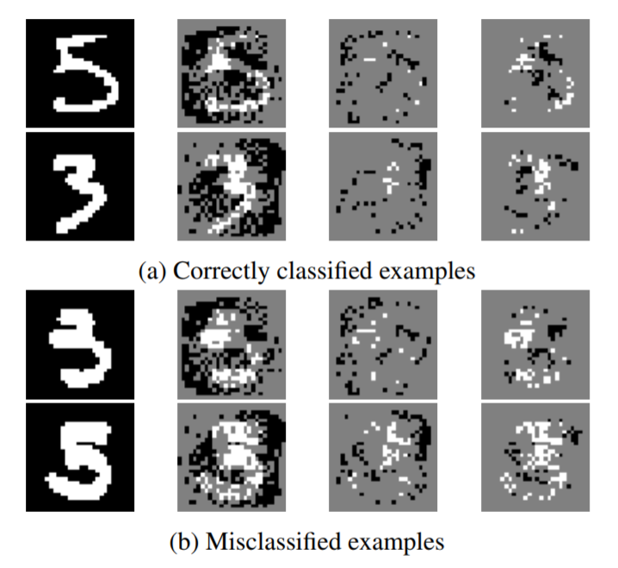
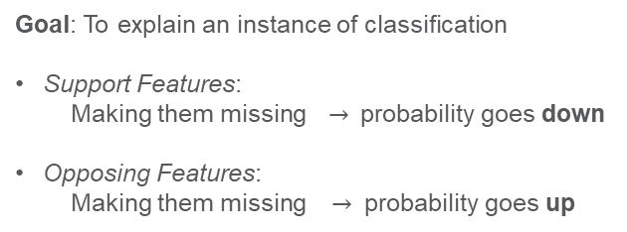
Local Explanations using Missing-ness
Goal: To explain an instance of classification
Support Features: Making them missing $→$ probability goes down
Opposing Features: Making them missing $→$ probability goes up
Sufficient Explanations
Remove maximum number of supporting features until expected classification is about to change, then show the remaining support features.

Slide 18
Conclusion
Expected Prediction is an effective tool for several applications such as missing data, generating explanations
We introduced NaCL, which given a logistic regression model, learns a Naïve Bayes model that conforms with the LR model and also maximizes joint feature likelihood.
Future work would be looking at more expressive pair of models, and potentially choose models that make the expected prediction tractable.

Slide 19
What to Expect of Classifiers? Reasoning about Logistic Regression with Missing Features
GitHub: github.com/UCLA-StarAI/NaCL

