Slide 1
Computer
Science
On Tractable Computation of Expected Predictions
Pasha Khosravi, YooJung Choi, Yitao Liang, Antonio Vergari and Guy Van den Broeck.
Computer Science Department, UCLA

Slide 2
Motivation
Classifier / Regressor
}
Train
Predict
Test samples with
Missing Features

Slide 3
Expected Prediction
We would like to probabilistically reason about the expected predictions of regressors and classifiers given partial observations.
$x^{o} =$ observed features
$x^{m}=$ missing features

Slide 4
Expected Prediction
Essentially, the task boils down to computing the k-th moment of a predictive model f w.r.t. a feature distribution p:

Slide 5
Few applications of moments
We have partial observations $x^{o}$:
Want to do expected prediction?
Want to do compute variance?

Slide 6
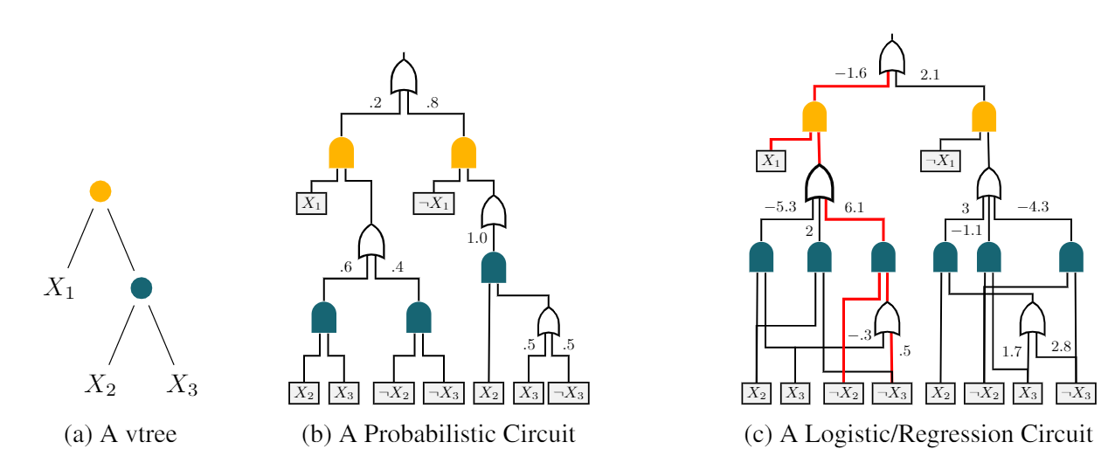
Probabilistic Circuits
They have both Generative and Discriminative versions

Slide 7
Hardness of Taking Expectations
In this paper, we focus on:
Smooth and structured decomposable generative circuits for $p$. Smooth, deterministic, and structured decomposable discriminative circuits for $f$.
If $f$is a regression circuit, and $p$ is a generative circuit with different vtree Proved #P-Hard
If $f$is a classification circuit, and $p$ is a generative circuit with different vtree Proved NP-Hard
If $f$is a regression circuit, and $p$ is a generative circuit with the same vtree Polytime algorithm

Slide 8
Recursive algorithm
Closed form recursive algorithm that “Breaks down” the computation of expected predictions to their children
For example, for OR nodes (n,m) we look at subproblems (1,3), (1,4), (2,3), (2,4) Similar breakdown for AND nodes.
n
m
3
4
1
2

Slide 9
Regression Experiments

Slide 10
Approximate Algorithm for classification
In case of classification even with same vtree the task was intractable.
We can approximate using Taylor series and higher moments of the underlying regression circuit.

Slide 11
Classification Experiments

Slide 12
Another Application: Data Analysis
Expected Prediction can provide insight into behavior of predictive models in different
sub-populations.
We have learned an RC and a PC circuit from “Yearly Health Insurance Costs of patients”
Q1: Difference of costs between smokers and non-smokers or between female and male patients?

Slide 13
Application: Data Analysis
Can also answer more complex queries like:
Q2: Average cost for female (F) smokers (S) with one Child (C) in the South East (SE)?
Q3: Standard Deviation of the cost for the same sub-population?

