Slide 1

2012
Moving Object Segmentation by Pursuing Local Spatio-Temporal Manifolds
Yuanlu Xu

Slide 2
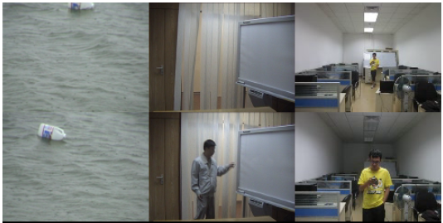
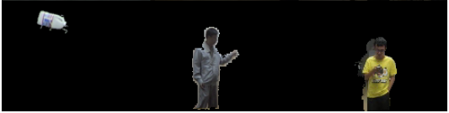
Problem
Segmenting moving foreground in a video

Slide 3
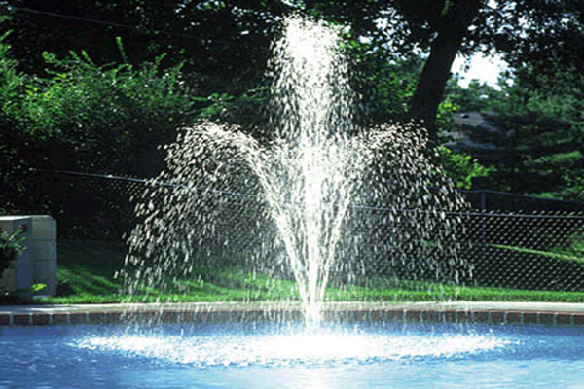


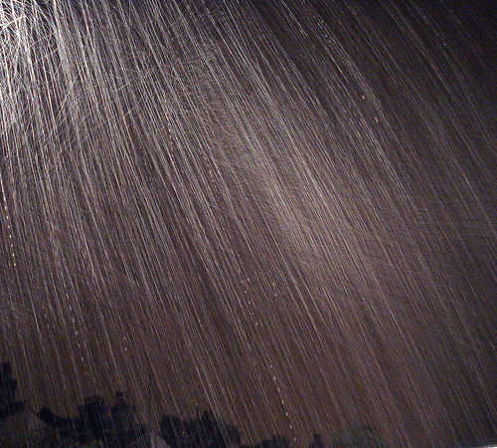
Related work & intuitions
Dynamic background ~ dynamic textures
Image sequences of certain textures moving and changing under certain properties.
S. Soatto, G. Doretto, and Y. Wu. “Dynamic textures”. IJCV 2003

Slide 4
Related work & intuitions
Dynamic background ~ dynamic textures
How to model?
The output of a linear dynamic system driven by IID Gaussian noises.
Intuition for moving object segmentation:
A complex scene containing dynamic background is composed of several independent dynamic textures.

Slide 5
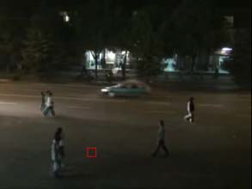
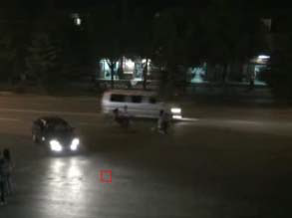
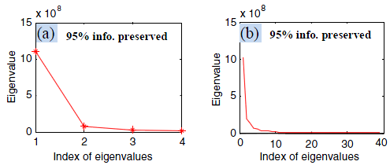
Related work & intuitions
Illumination changes ~ modeling illumination
Observing eigenvalue curves of different state bricks, (a) background, (b) foreground occlusion
Y. Zhao et al. “Spatio-temporal patches for night background modeling by subspace learning”. ICPR 2008

Slide 6
Related work & intuitions
Illumination changes ~ modeling illumination
Intuition for handling illumination changes:
The set of bricks of a given background location under various lighting conditions lies in a low-dimensional manifold.

Slide 7
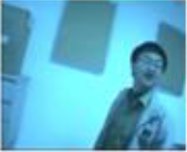
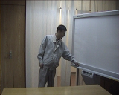
Related work & intuitions
Indistinctive changes
Similar appearance → incorporating extra information
Intuition for distinguishing indistinctive moving objects:
Modeling background appearance variations, estimating next state, distinguishing moving objects not following the similar changes

Slide 8
Intuitions & assumptions
Intuitions
Assumptions
A complex scene containing dynamic background is composed of several independent dynamic textures.
The set of bricks of a given background location under various lighting conditions lies in a low-dimensional manifold.
Modeling background appearance variations.
Given a background location, the sequence of bricks (under dynamic changes, illumination changes) lies in a low-dimensional manifold, and the variations satisfy local linear.
The bricks with indistinctive and distinctive foreground occlusions can be well separated from the background by distinguishing differences in both appearance and variations.

Slide 9
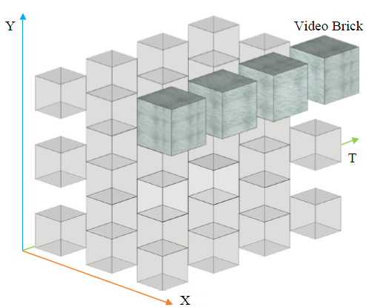
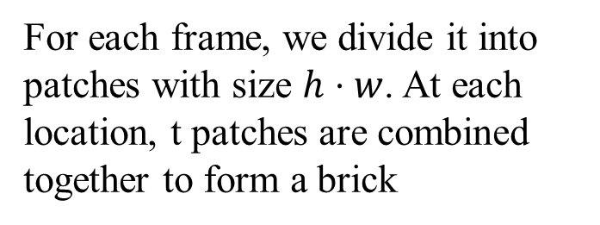
Representation
Segmenting Brick in Video:
For each frame, we divide it into patches with size $h⋅w$. At each location, t patches are combined together to form a brick

Slide 10
Representation
Center Symmetric – Spatio Temporal LTP (CS-STLTP) Descriptor

Slide 11

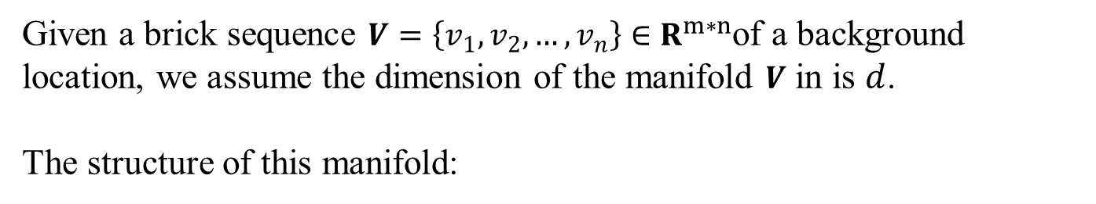
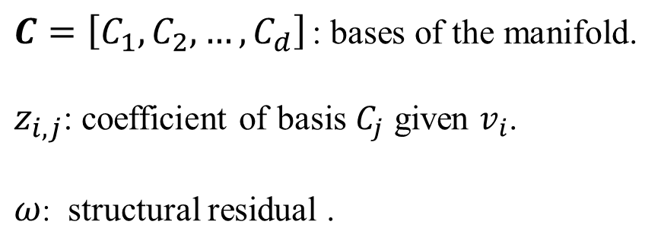
Mathematical formulation
Given a brick sequence $V=\left\{v_{1}, v_{2}, …,v_{n}\right\}∈R^{m∗n}$of a background location, we assume the dimension of the manifold $V$ in is $d$.
The structure of this manifold:
$$v_{i}= \sum_{j=1}^{d}{z_{i,j}C_{j}} +ω$$
$C=\left[C_{1}, C_{2},…,C_{d}\right]$: bases of the manifold.
$z_{i,j}$: coefficient of basis $C_{j}$ given $v_{i}$.
$ω$: structural residual .

Slide 12
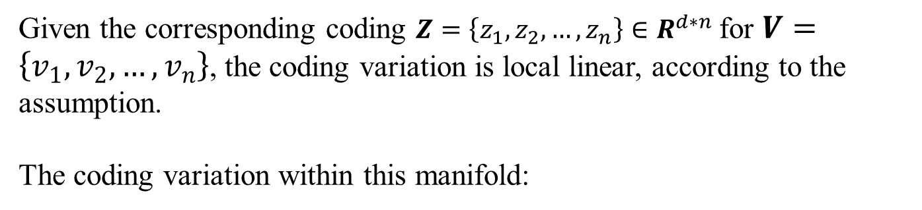
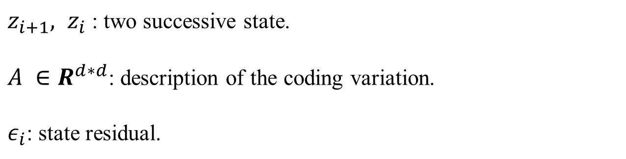
Mathematical formulation
Given the corresponding coding $Z=\left\{z_{1}, z_{2}, …,z_{n}\right\}∈R^{d∗n}$for $V=\left\{v_{1}, v_{2}, …,v_{n}\right\}$, the coding variation is local linear, according to the assumption.
The coding variation within this manifold:
$$z_{i+1} = Az_{i}+ε_{i}$$
$z_{i+1}, z_{i}$: two successive state.
$A ∈R^{d∗d}$: description of the coding variation.
$ε_{i}$: state residual.

Slide 13
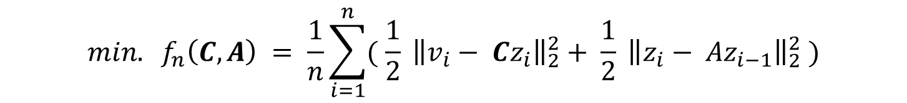
Mathematical formulation
The problem of pursuing the structure of and the variation within a manifold is formulated as minimizing the empirical energy function:
$$min. f_{n}\left(C, A\right) = \frac{1}{n}\sum_{i=1}^{n}{( \frac{1}{2}{\left. \left\|v_{i}− Cz_{i}\right.\right\|}_{2}^{2}+ \frac{1}{2}{\left. \left\|z_{i}− {Az}_{i−1}\right.\right\|}_{2}^{2} })$$
$$(V=\left\{v_{1}, v_{2}, …,v_{n}\right\}∈R^{m∗n}, Z∈R^{d∗n}, C∈R^{m∗d}, A∈R^{d∗d})$$
min. structural residual
min. state residual

Slide 14
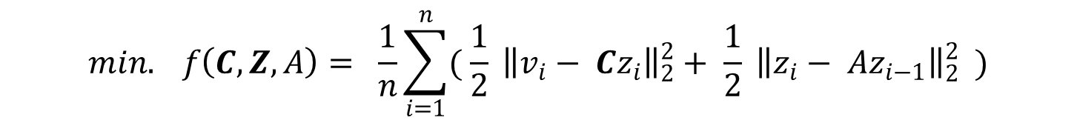
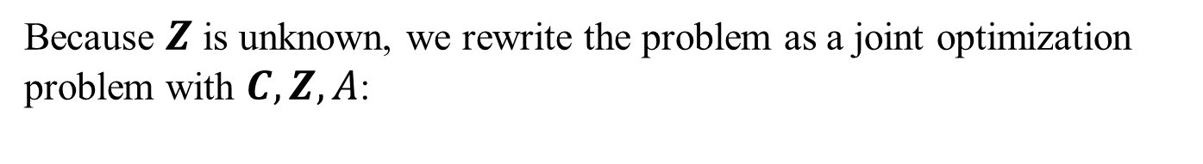
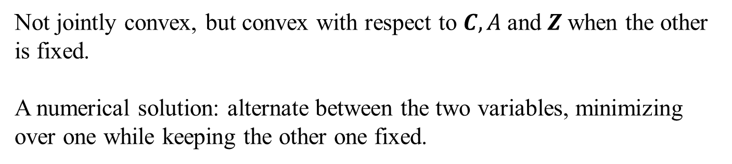
Mathematical formulation
Because $Z$ is unknown, we rewrite the problem as a joint optimization problem with $C,Z, A$:
$$min. f\left(C,Z, A\right)= \frac{1}{n}\sum_{i=1}^{n}{( \frac{1}{2}{\left. \left\|v_{i}− Cz_{i}\right.\right\|}_{2}^{2}+ \frac{1}{2}{\left. \left\|z_{i}− {Az}_{i−1}\right.\right\|}_{2}^{2} } )$$
Not jointly convex, but convex with respect to $C, A$and $Z$when the other is fixed.
A numerical solution: alternate between the two variables, minimizing over one while keeping the other one fixed.

Slide 15
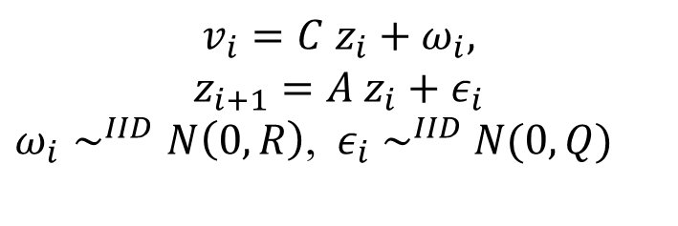
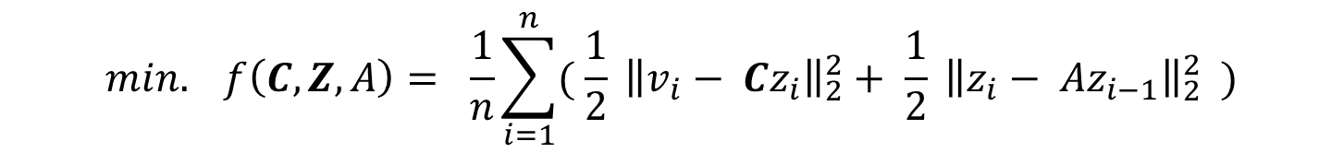
Representation
$$min. f\left(C,Z, A\right)= \frac{1}{n}\sum_{i=1}^{n}{( \frac{1}{2}{\left. \left\|v_{i}− Cz_{i}\right.\right\|}_{2}^{2}+ \frac{1}{2}{\left. \left\|z_{i}− {Az}_{i−1}\right.\right\|}_{2}^{2} } )$$
Rewritten as a linear dynamic system (LDS)
$$v_{i}=C{ z}_{i}+ω_{i},$$
$$z_{i+1}=A{ z}_{i}+ε_{i}$$
$ω_{i}∼^{IID}N\left(0,R\right)$, ${ ε}_{i}{ ∼}^{IID} N(0,Q)$
structural residual ⬄ structural noise
state residual ⬄ state noise

Slide 16
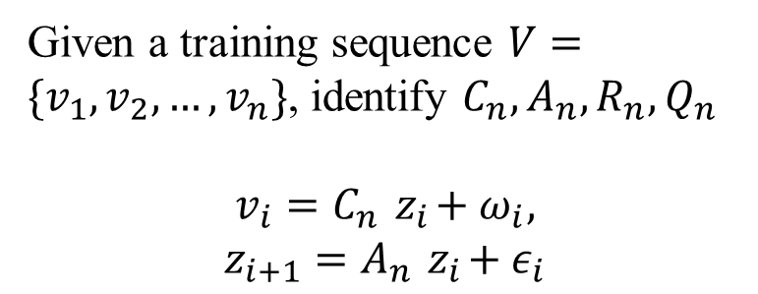
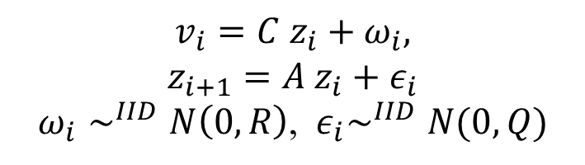
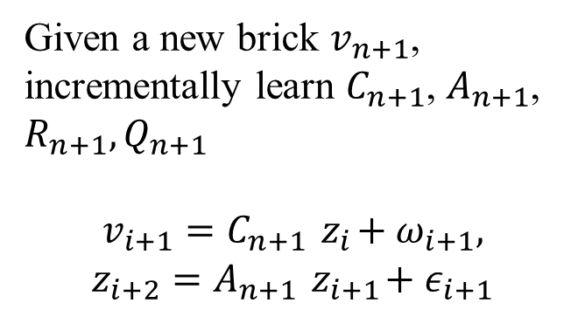
Learning
$$v_{i}=C{ z}_{i}+ω_{i},$$
$$z_{i+1}=A{ z}_{i}+ε_{i}$$
$ω_{i}∼^{IID}N\left(0,R\right)$, ${ ε}_{i}∼^{IID}N(0,Q)$
Initial Learning
Online Learning
Given a training sequence $V=\{v_{1}, v_{2},…, v_{n}\}$, identify $C_{n}, A_{n}, R_{n},Q_{n}$
$$v_{i}=C_{n}{ z}_{i}+ω_{i},$$
$$z_{i+1}=A_{n}{ z}_{i}+ε_{i}$$
Given a new brick $v_{n+1}$, incrementally learn $C_{n+1}$, $A_{n+1}$, $R_{n+1},Q_{n+1}$
$$v_{i+1}=C_{n+1}{ z}_{i}+ω_{i+1},$$
$$z_{i+2}=A_{n+1}{ z}_{i+1}+ε_{i+1}$$

Slide 17

Learning
Sub-optimal analytical solution
Initial Learning
S. Soatto, G. Doretto, and Y. Wu. “Dynamic textures”. IJCV 2003.
Learning $C_{n+1}$: incremental subspace learning - Candid Covariance-free IPCA (CCIPCA) and IPCA
Learning $A_{n+1}$: Linear problem of the latest $l$ states
Online Learning
J. Weng et al. “Candid covariance-free incremental principal component analysis”. TPAMI 2003.
Y. Li. “On incremental and robust subspace learning”. Pattern Recognition 2004.

Slide 18

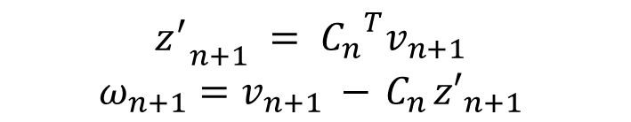
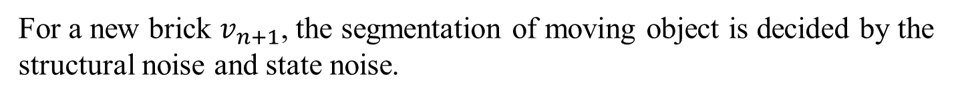
Inference
For a new brick $v_{n+1}$, the segmentation of moving object is decided by the structural noise and state noise.
Structural noise:
$${z_{}^{′}}_{n+1} = {C_{n}^{}}^{T}v_{n+1}$$
$$ω_{n+1}=v_{n+1} −{ C}_{n}{z′}_{n+1}$$
State noise:
$$ε_{n} ={z_{}^{′}}_{n+1} −{ A}_{n}z_{n}$$

Slide 19
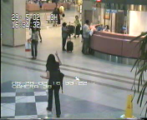

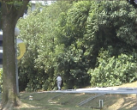

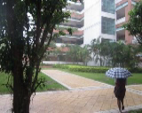
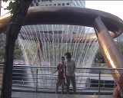
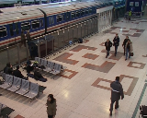
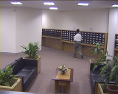
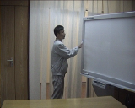
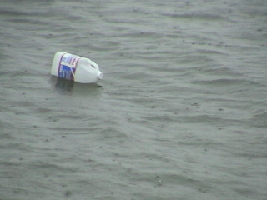
Experimental Results
Datasets
Busy scenes
Dynamic scenes
Illumination changes
Water Surface
Swaying Trees
Airport
Sudden Light
Heavy Rain
Active Fountain
Train Station
Gradual Light
Waving Curtain
Floating Bottle

Slide 20

Experimental Results
Scene | GMM | Im-GMM | Online-AR | JDR | Struct1-SVM | SILTP | STDB (RGB) | STDB (Ftr.)
1# Airport | 46.99 | 47.36 | 62.72 | 60.23 | 65.35 | 68.14 | 75.52 | 66.40
2# Floating Bottle | 57.91 | 57.77 | 43.79 | 45.64 | 47.87 | 59.57 | 69.04 | 75.85
3# Waving Curtain | 62.75 | 74.58 | 77.86 | 72.72 | 77.34 | 78.01 | 87.74 | 79.57
4# Active Fountain | 52.77 | 60.11 | 70.41 | 68.53 | 74.94 | 76.33 | 76.85 | 79.68
5# Heavy Rain | 71.11 | 81.54 | 78.68 | 75.88 | 82.62 | 76.71 | 86.86 | 81.35
6# Sudden Light | 47.11 | 51.37 | 37.30 | 52.26 | 47.61 | 52.63 | 51.56 | 70.23
7# Gradual Light | 51.10 | 50.12 | 13.16 | 47.48 | 62.44 | 54.86 | 54.84 | 72.52
8# Train Station | 65.12 | 68.80 | 36.01 | 57.68 | 61.79 | 67.05 | 73.43 | 66.46
9# Swaying Trees | 19.51 | 23.25 | 63.54 | 45.61 | 24.38 | 42.54 | 43.70 | 48.49
10# Water Surface | 79.54 | 86.01 | 77.31 | 84.27 | 83.13 | 74.30 | 88.54 | 87.88
Average | 55.39 | 59.56 | 57.02 | 60.23 | 59.79 | 63.08 | 70.81 | 72.84

Slide 21
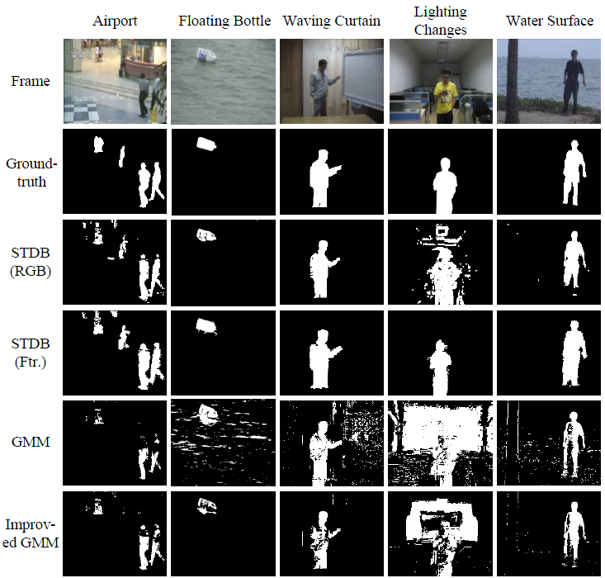
Experimental Results

Slide 22
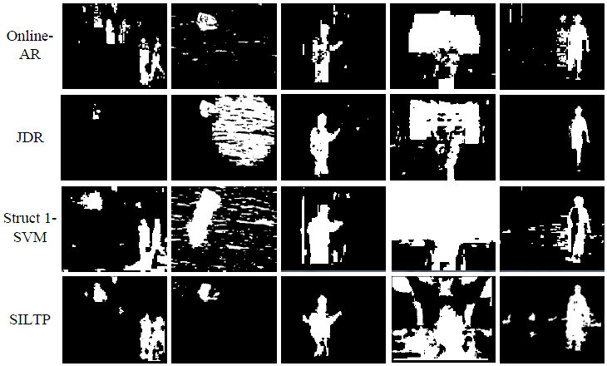
Experimental Results

Slide 23
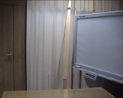

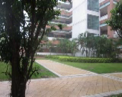
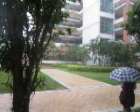
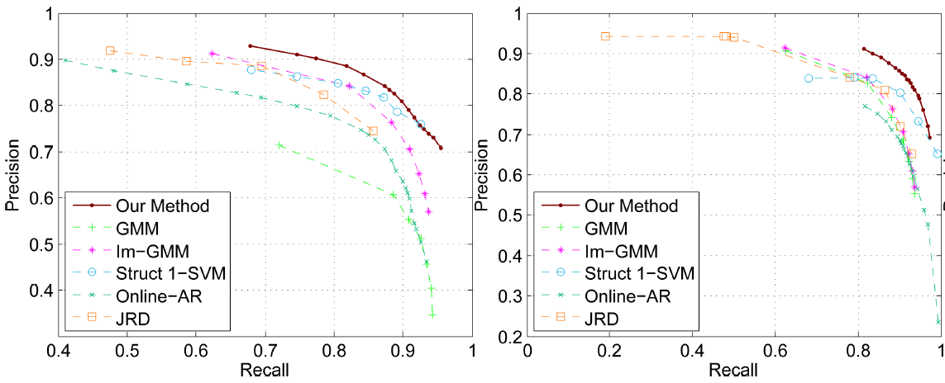
Experimental Results

Slide 24
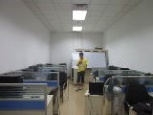

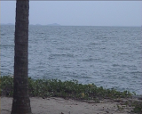

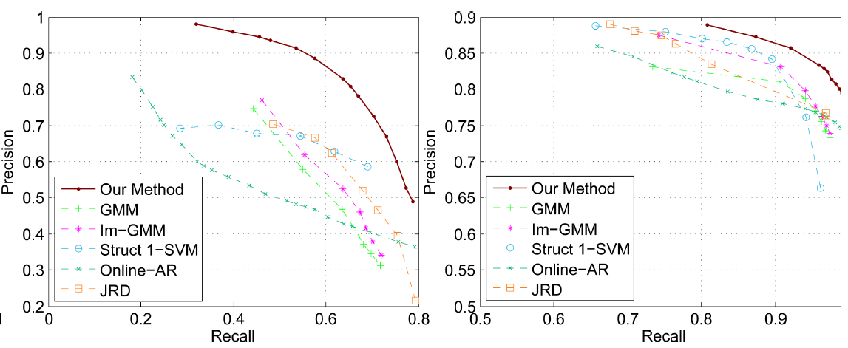
Experimental Results

Slide 25
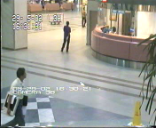
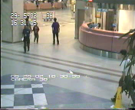
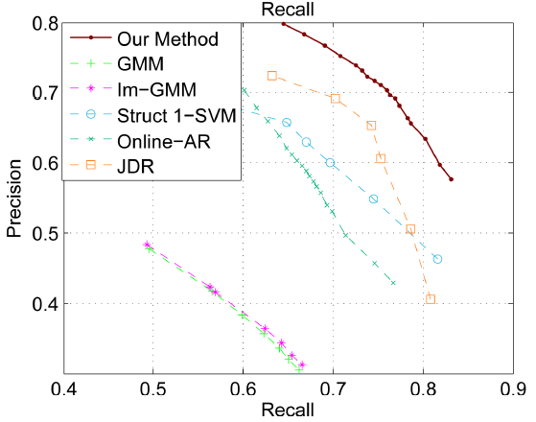
Experimental Results

Slide 26
Experimental Results
Selection of structural update approach
 | CCIPCA |  | IPCA
Scene | Accuracy (%) | Efficiency (fps) | Accuracy (%) | Efficiency (fps)
1# Airport | 75.52 | 4.1 | 65.13 | 2.3
2# Floating Bottle | 69.04 |  | 70.02
3# Waving Curtain | 87.74 |  | 78.47
4# Active Fountain | 76.85 |  | 81.38
5# Heavy Rain | 86.86 |  | 79.84
6# Sudden Light | 51.56 |  | 53.63
7# Gradual Light | 54.84 |  | 59.79
8# Train Station | 73.43 |  | 68.69
9# Swaying Trees | 43.70 |  | 70.17
10# Water Surface | 88.54 |  | 89.43
Average | 70.81 |  | 71.66
Dynamic scenes: IPCA is much better than CCIPCA
Busy scenes: CCIPCA is much better than IPCA
Illumination changes: IPCA slightly better than CCIPCA
Efficiency: CCIPCA is much faster than IPCA

Slide 27
Contribution
Formulating the problem of modeling background by pursuing local spatio-temporal manifolds of video brick sequences.
Representing spatio-temporal statistics in video bricks with CS-STLTP descriptor.
Pursuing local spatio-temporal manifolds with two LDSs: a time-invariant LDS for initial learning and a time-variant LDS for online learning.
Online learning the structure of local spatio-temporal manifolds with incremental subspace learning and the state variations with re-solving linear problems.

Slide 28
Problems
CS-STLTP behaves well in handling illumination changes, but not sufficient to capture variation statistics.
In highly dynamics scenes, the assumption of local linear variation can hardly hold.
CCIPCA suffers updating the great changes of the structure of the manifold. IPCA behaves better than CCIPCA but suffers the computational complexity.

Slide 29
Published Papers
Yuanlu Xu, Hongfei Zhou, Qing Wang, Liang Lin. “Realtime Object-of-Interest Tracking by Learning Composite Patch-based Templates”. ICIP 2012 (accepted)
Liang Lin, Yuanlu Xu, Xiaodan Liang. “Complex Background Subtraction by Pursuing Dynamic Spatio-temporal Manifolds”. ECCV 2012 (submitted)

Slide 30
QUESTIONS?

Slide 31
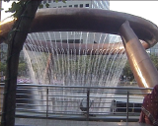
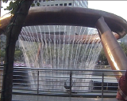
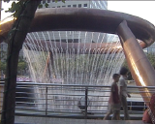



Difficulties
Dynamic backgrounds
Illumination changes (especially sudden changes)

Slide 32





Difficulties
Indistinctive moving objects
Moving camera (e.g., shaking, hand-held)

Slide 33
Contribution
Formulating the problem of modeling background by pursuing local spatio-temporal manifolds of video brick sequences.
Representing spatio-temporal statistics in video bricks.
Pursuing local spatio-temporal manifolds.
Maintaining local spatio-temporal manifolds online.

Slide 34



Mathematical formulation
Similar to sparse coding, to prevent $C$ being arbitrarily large, which results $Z$ arbitrarily small, we add the constraint ${\left\|C_{k}\right\|}_{2} ≤1$, and the constraint set $Γ$ is formulated as:
$$Γ ≜ \left\{C∈R^{m∗d}, ∀k=1,2,…,d, {\left\|C_{k}\right\|}_{2} ≤1\right\}$$
$$∀{ \left\|C_{1}\right\|}_{2} ≤1, {\left\|C_{2}\right\|}_{2} ≤1, ∀ 0≤θ≤1,$$
$${\left\|θC_{1}+\left(1−θ\right)C_{2}\right\|}_{2} ≤ {\left\|θC_{1}\right\|}_{2}+ {\left\|\left(1−θ\right)C_{2}\right\|}_{2}$$
$≤ {θ\left\|C_{1}\right\|}_{2}+ {\left(1−θ\right)\left\|C_{2}\right\|}_{2}$
$≤θ+\left(1−θ\right)≤1$
Thus $Γ$ is a convex set.

Slide 35

Mathematical formulation
Because $Z$ is unknown, we rewrite the problem as a joint optimization problem with $C,Z, A$:
$$min. f\left(C,Z, A\right)= \frac{1}{n}\sum_{i=1}^{n}{( \frac{1}{2}{\left. \left\|v_{i}− Cz_{i}\right.\right\|}_{2}^{2}+ \frac{1}{2}{\left. \left\|z_{i}− {Az}_{i−1}\right.\right\|}_{2}^{2} } )$$
$$subject to C∈Γ$$
Not jointly convex, but convex with respect to $C, A$and $Z$when the other is fixed.
A numerical solution: alternate between the two variables, minimizing over one while keeping the other one fixed.

Slide 36
Mathematical formulation
In practice, above joint optimization problem is simplified as a two step optimization:
1. Rewrite the problem as a time-variant linear dynamic system, solve the structure of the system, ignore the state (coding) variation.
2. Given the structure of the system, solve the state variation, based on the corresponding state for each brick.

Slide 37



Representation
Local Binary Pattern (LBP) / Local Ternary Pattern (LTP)

Slide 38


Representation
Scale Invariant LTP (SILTP)
S. Liao et al. “Modeling pixel process with scale invariant local patterns for background subtraction in complex scenes”. CVPR 2010

Slide 39

Representation
Scale Invariant LTP (SILTP)
SILTP is more robust in handling scale changes (illumination changes).

Slide 40
Representation

Slide 41


Representation
Center Symmetric Coding
8 neighboring pixels around the center are formed into 4 pairs ${(P}_{0}, P_{4}), {(P}_{1}, P_{5})$,${(P}_{2}, P_{6}),{(P}_{3}, P_{7}).$

Slide 42



Representation
$$min. f\left(C,Z, A\right)= \frac{1}{n}\sum_{i=1}^{n}{( \frac{1}{2}{\left. \left\|v_{i}− Cz_{i}\right.\right\|}_{2}^{2}+ \frac{1}{2}{\left. \left\|z_{i}− {Az}_{i−1}\right.\right\|}_{2}^{2} } )$$
Rewritten as a linear dynamic system (LDS)
structure of the manifold ⬄ appearance matrix
structural noise $ω_{i}∼^{IID}N\left(0,R\right)$⬄ structural residual
$$v_{i}=C{ z}_{i}+ω_{i},$$
$$z_{i+1}=A{ z}_{i}+ε_{i}$$
state noise ${ ε}_{i}∼^{IID}N(0,Q)$
⬄ state residual
state variations of the manifold ⬄ dynamics matrix

Slide 43


Initial learning
Sub-optimal analytical solution
Assumption:
The dimension of the manifold is $d$, the dimension of the state noise is $d_{ε}$, $d>d_{ε}$. The appearance matrix satisfies $C_{n}^{T}C_{n}=I_{d}$.
The analytical solution for the structure of the manifold is
The decomposition is simulated by SVD.
$$W=U S V^{T}, C_{n}=U\left(1:d,:\right), Z_{n}=S(1:d,1:d) {V(1:d,:)}^{T}$$
S. Soatto, G. Doretto, and Y. Wu. “Dynamic textures”. IJCV 2003.

Slide 44





Initial learning
Given the states $\left[z_{1} z_{2} …z_{n}\right]$, solving the dynamics matrix $A_{n}$ by linear programming:
To estimate noise covariance$Q_{n}$, we treat $ε_{i}$ as the reconstruction error $e_{i}=z_{i+1} −A_{n} z_{i}$, and $Q_{n}$ is represented as
$$Q_{n}= E\left(e_{i} {e_{i}^{}}^{T}\right)= \lim_{j→+∞}{\frac{1}{j}\sum_{k=1}^{j}{e_{k}}{e_{k}^{}}^{T}}$$
$$≈ \frac{1}{n−1}\sum_{k=1}^{n−1}{e_{k}{e_{k}^{}}^{T}}$$
To reduce the dimension of $e_{i}$, let $Q_{n}=B_{n} {B_{n}^{}}^{T}$ and apply PCA to $Q_{n}$, $ε_{i}=B^{−1}e_{i}$.

Slide 45




Initial learning
Since different manifold has different dynamic properties, the dimension of the manifold is determined by the training samples.
Static
Dynamic
Dimension Low
Dimension High

Slide 46



Online learning
Against foreground occlusions
We define a noise-free video brick under the current model to compensate the missing background samples.
The noise-free video brick ${\hat{v}}_{n+1}$ is defined as

Slide 47

Online learning
To update the structure of the manifold, we regard $W_{n+1}$ as the extension by adding a new column (update sample) to $W_{n}$.
The problem of updating $C_{n+1}$ is formulated as incremental subspace learning.
To find a more effective approach, we employ two incremental subspace learning methods:
Candid Covariance-free Incremental PCA (CCIPCA), without estimating the covariance matrix.
Incremental PCA (IPCA), estimating the covariance matrix.

Slide 48



Online learning
CCIPCA
J. Weng et al. “Candid covariance-free incremental principal component analysis”. IEEE TPAMI 2003.

Slide 49





Online learning
IPCA
For a $d$-dimension manifold, with eigenvectors $C_{n}$, and eigenvalues $Λ_{n}$, the covariance matrix is estimated as
With the new sample, the new covariance matrix is estimated as
Using the new covariance matrix to estimate the new eigenvectors $C_{n+1}$, $Λ_{n+1}$.
Y. Li. “On incremental and robust subspace learning”. Pattern Recognition 2004.

Slide 50



Online learning
Update the state variation $A_{n+1}$, $B_{n+1}$ by re-estimating the new state $z_{n+1}$,
$A_{n+1}$ is updated by re-computing the linear problem,
$B_{n+1}$ by re-estimating the covariance matrix,
$${[ e}_{n−l+1} e_{n−l+2} ⋯e_{n} ]={[ z}_{n−l+2} z_{n−l+3} ⋯z_{n+1} ]$$
                $−$ $A_{n}{ [ z}_{n−l+1} z_{n−l+2} ⋯z_{n}]$
$$Q_{n+1}= E\left(e_{i} {e_{i}^{}}^{T}\right)=\frac{1}{l}\sum_{k=n−l+1}^{n}{e_{k}}{e_{k}^{}}^{T}$$

Slide 51


Online learning
Anti-degeneration

Slide 52

Algorithm

Slide 53


Experimental Results
Behave poorly on highly dynamic backgrounds!

