Slide 1

Inference
Algorithms: A Tutorial
Yuanlu Xu, SYSU, China merayxu@gmail.com
2013.3.20

Slide 2
Chapter 1
Graphical Models

Slide 3
Graphical Models
A ‘marriage’ between probability theory and graph theory
Why probabilities?
Reasoning with uncertainties, confidence levels
Many processes are inherently ‘noisy’→ robustness issues
Why graphs?
Provide necessary structure in large models:
- Designing new probabilistic models.
- Reading out (conditional) independencies.
Inference & optimization:
- Dynamical programming
- Belief Propagation
- Monto Carlo Methods
From Slides by Ryan Adams - University of Toronto

Slide 4
Types of Graphical Model
i
Parents(i)
j
i
Undirected graph
(Markov random field)
Directed graph
(Bayesian network)
factor graphs
interactions
variables
From Slides by Ryan Adams - University of Toronto

Slide 5

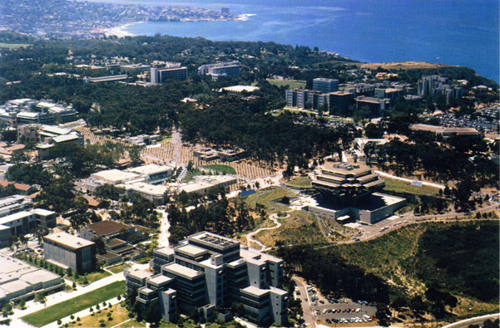


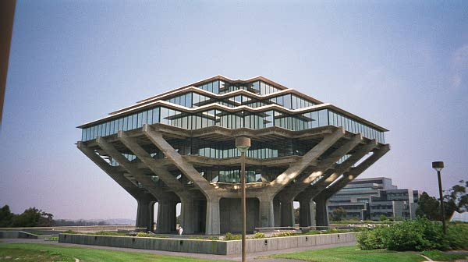



Example 1: Undirected Graph
?
air or water ?
?
low
information
regions
high
information
regions
neighborhood
information
From Slides by Ryan Adams - University of Toronto

Slide 6
Undirected Graphs
Nodes encode hidden information
(patch-identity).
They receive local information from the image (brightness, color).
Information is propagated though the graph over its edges.
Edges encode ‘compatibility’ between nodes.
From Slides by Ryan Adams - University of Toronto

Slide 7

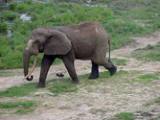
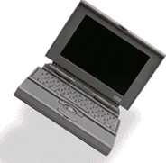
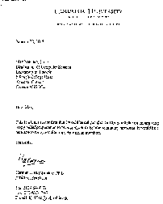

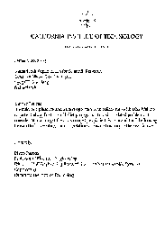
Example 2: Directed Graphs
…
TOPICS
war
animals
computers
Iraqi
the
Matlab
From Slides by Ryan Adams - University of Toronto

Slide 8
Section 1
Markov Random Field

Slide 9
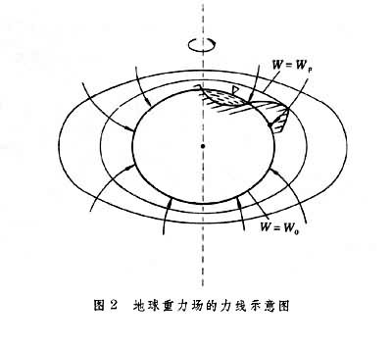
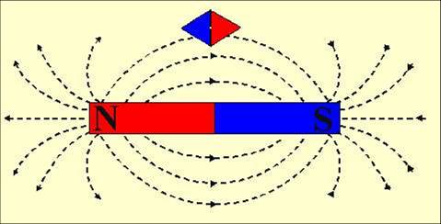
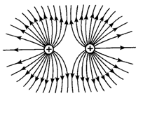
Field
(A) field of force
(B) magnetic field
(C) electric field

Slide 10
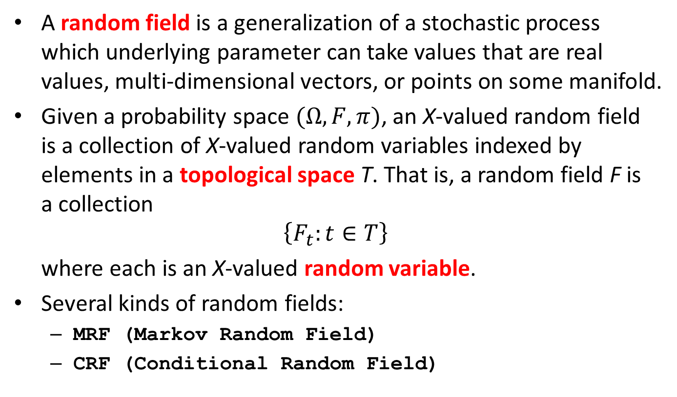
Random Fields
A random field is a generalization of a stochastic process which underlying parameter can take values that are real values, multi-dimensional vectors, or points on some manifold.
Given a probability space $(Ω,F,π)$, an X-valued random field is a collection of X-valued random variables indexed by elements in a topological space T. That is, a random field F is a collection
$$\left\{F_{t}:t∈T\right\}$$
where each is an X-valued random variable.
Several kinds of random fields:
  MRF (Markov Random Field)
  CRF (Conditional Random Field)

Slide 11


Problem
A graphical model for describing spatial consistency in images
Suppose you want to label image pixels with some labels {l₁,…,l_{k}} , e.g., segmentation, stereo disparity, foreground-background, etc.
real image
Ref:
1. S. Z. Li. Markov Random Field Modeling in Image Analysis. Springer-Verlag, 1991
2. S. Geman and D. Geman. Stochastic relaxation, gibbs distribution and bayesian restoration of images. PAMI, 6(6):721–741, 1984.
label image
From Slides by R. Huang – Rutgers University

Slide 12
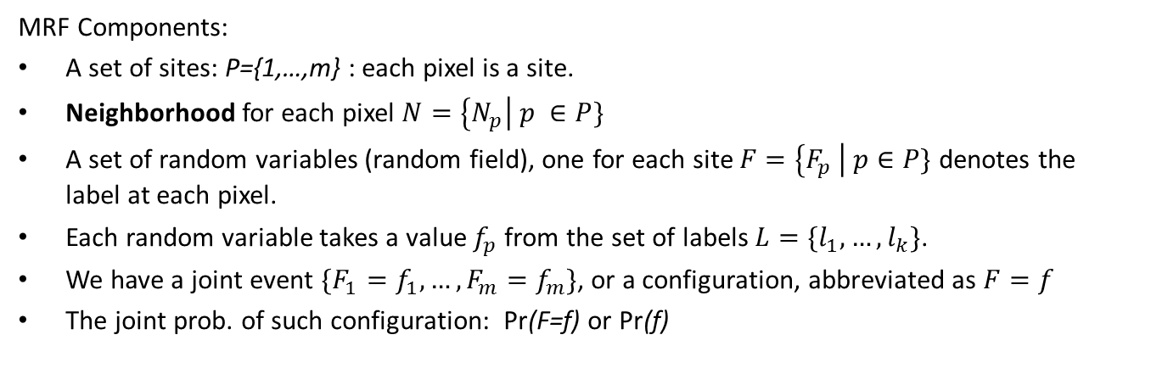
Definition
MRF Components:
A set of sites: P={1,…,m} : each pixel is a site.
Neighborhood for each pixel $N=\left\{N_{p}\right| p ∈P\}$
A set of random variables (random field), one for each site $F=\left\{F_{p} \right| p∈P\}$ denotes the label at each pixel.
Each random variable takes a value $f_{p}$ from the set of labels $L=\{l_{1}, …,l_{k}\}$.
We have a joint event $\{F_{1}=f_{1}, …,F_{m}=f_{m}\}$, or a configuration, abbreviated as $F=f$
The joint prob. of such configuration: Pr(F=f) or Pr(f)
From Slides by R. Huang – Rutgers University

Slide 13
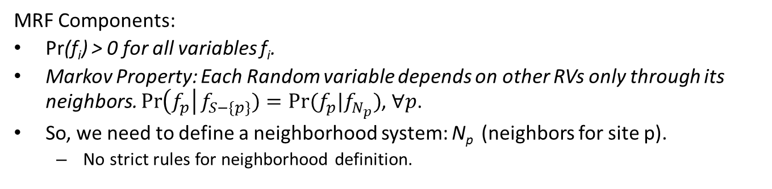
Definition
MRF Components:
Pr(f_{i}) > 0 for all variables f_{i}.
Markov Property: Each Random variable depends on other RVs only through its neighbors. $\operatorname{Pr}\left(f_{p}\right|f_{S−\{p\}})=Pr⁡(f_{p}|f_{N_{p}})$, $∀p$.
So, we need to define a neighborhood system: N_{p} (neighbors for site p).
  No strict rules for neighborhood definition.
Cliques for this neighborhood
From Slides by R. Huang – Rutgers University

Slide 14
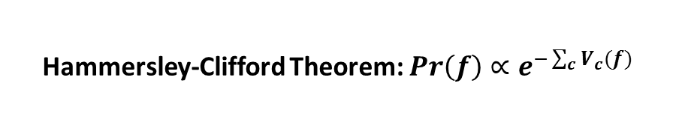
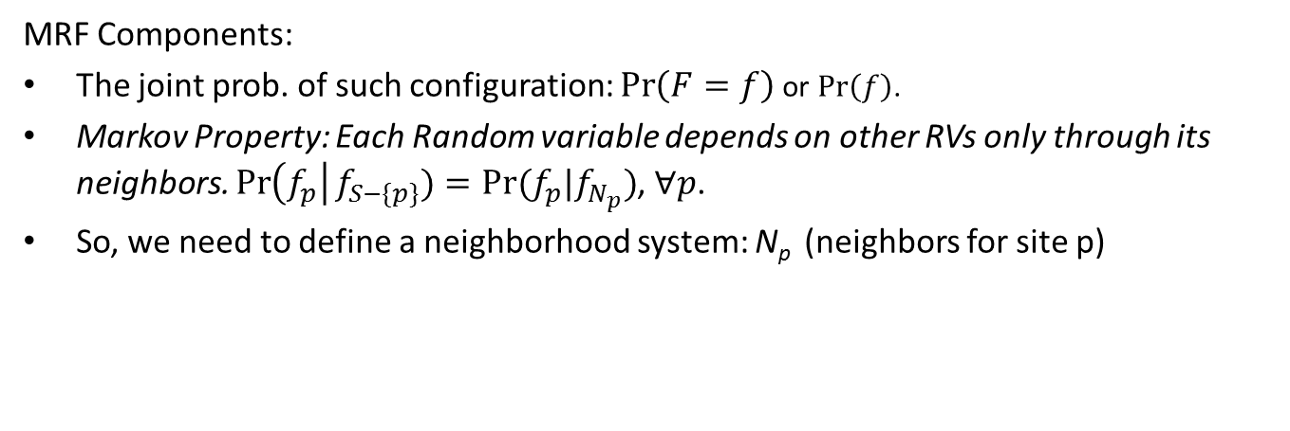
Definition
MRF Components:
The joint prob. of such configuration: $\operatorname{Pr}\left(F=f\right)$ or $\operatorname{Pr}\left(f\right)$.
Markov Property: Each Random variable depends on other RVs only through its neighbors. $\operatorname{Pr}\left(f_{p}\right|f_{S−\{p\}})=Pr⁡(f_{p}|f_{N_{p}})$, $∀p$.
So, we need to define a neighborhood system: N_{p} (neighbors for site p)
Hammersley-Clifford Theorem: $Pr\left(f\right)∝e^{−\sum_{c}{V_{c}(f)}}$
Sum over all cliques in the neighborhood system
V_{C} is clique potential
We may decide
1. NOT to include all cliques in a neighborhood; or
2. Use different V_{c} for different cliques in the same neighborhood
From Slides by R. Huang – Rutgers University

Slide 15

Optimal Configuration
Sum over all cliques in the neighborhood system
V_{C} is clique potential: prior probability that elements of the clique C have certain values
MRF Components:
Hammersley-Clifford Theorem:
  $Pr\left(f\right)∝e^{−\sum_{c}{V_{c}(f)}}$
Consider MRF’s with arbitrary cliques among neighboring pixels
$\operatorname{Pr}\left(f\right)∝exp⁡\left(−\sum_{c∈C}{\sum_{p1,p2∈c}{V_{c}(f_{p1},f_{p2})}}\right)$
Typical potential: Potts model:
From Slides by R. Huang – Rutgers University

Slide 16
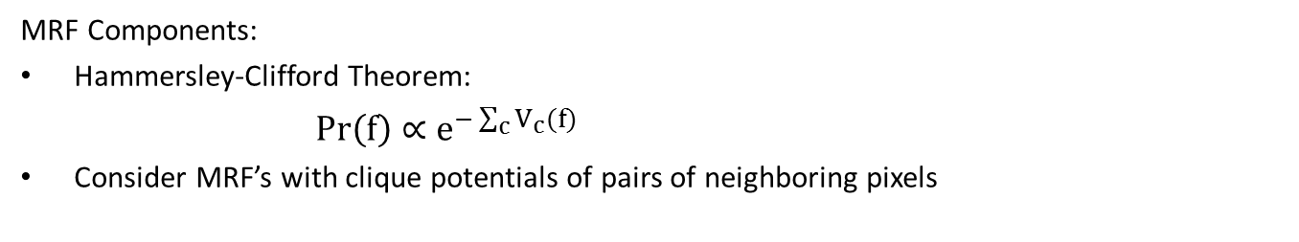
Optimal Configuration
MRF Components:
Hammersley-Clifford Theorem:
  $Pr\left(f\right)∝e^{−\sum_{c}{V_{c}(f)}}$
Consider MRF’s with clique potentials of pairs of neighboring pixels
Most commonly used….very popular in vision.
Energy function:
There are two constraints to satisfy:
Data Constraint: Labeling should reflect the observation.
Smoothness constraint: Labeling should reflect spatial consistency (pixels close to each other are most likely to have similar labels).
From Slides by R. Huang – Rutgers University

Slide 17
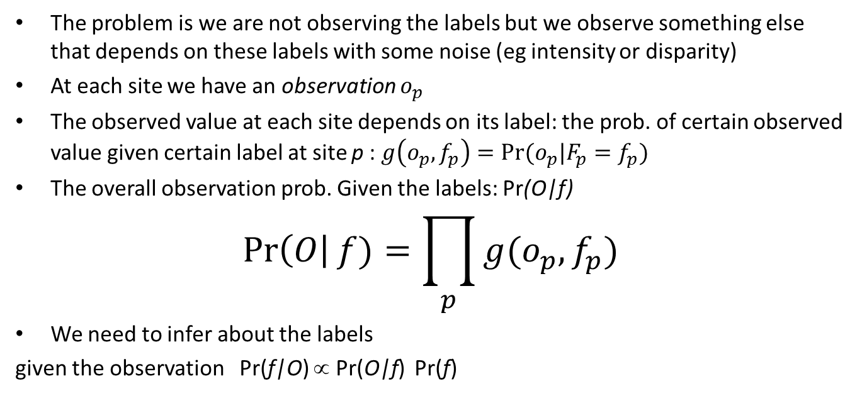
Probabilistic interpretation
The problem is we are not observing the labels but we observe something else that depends on these labels with some noise (eg intensity or disparity)
At each site we have an observation $o_{p}$
The observed value at each site depends on its label: the prob. of certain observed value given certain label at site p : $g\left(o_{p},f_{p}\right)=Pr⁡(o_{p}|F_{p}=f_{p})$
The overall observation prob. Given the labels: Pr(O|f)
$$\operatorname{Pr}\left(O\right|f)=\prod_{p}{g(o_{p}, f_{p})}$$
We need to infer about the labels
given the observation Pr(f|O) ∝ Pr(O|f) Pr(f)
From Slides by R. Huang – Rutgers University

Slide 18
Using MRFs
How to model different problems?
Given observations y, and the parameters of the MRF, how to infer the hidden variables, x?
How to learn the parameters of the MRF?
From Slides by R. Huang – Rutgers University

Slide 19
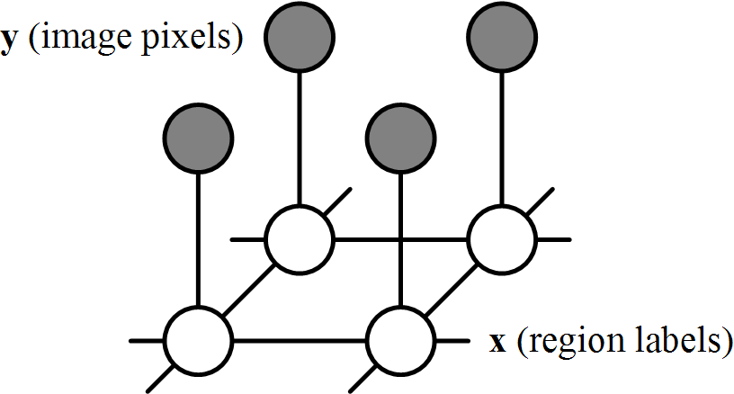
Modeling image pixel labels as MRF
real image
1
label image
From Slides by R. Huang – Rutgers University
MRF-based segmentation

Slide 20
MRF-based segmentation
Classifying image pixels into different regions under the constraint of both local observations and spatial relationships
Probabilistic interpretation:
region labels
model param.
image pixels
From Slides by R. Huang – Rutgers University

Slide 21
Model joint probability
region labels
model param.
image pixels
How did we factorize?
image-label
compatibility
Function
enforcing
Data
Constraint
label-label
compatibility
Function
enforcing Smoothness constraint
label
image
local
Observations
neighboring
label nodes
From Slides by R. Huang – Rutgers University

Slide 22
Probabilistic Interpretation
Data (observation) term:
Data Constraint
Neighborhood term: Smoothness Constraint
From Slides by R. Huang – Rutgers University
We need to infer about the labels given the observation
Pr( f | O ) ∝ Pr(O|f ) Pr(f)
MAP estimate of f should minimize the posterior energy

Slide 23
Applying and learning MRF
Methods to be described.
Pseduo-likelihood method.
From Slides by R. Huang – Rutgers University
MRF-based segmentation
EM algorithm
E-Step: (Inference)
M-Step: (learning)

Slide 24
Applying and learning MRF: Example
From Slides by R. Huang – Rutgers University

Slide 25
Chapter 2
Inference Algorithms

Slide 26
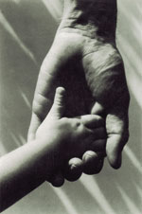
Inference in Graphical Models
Inference:
Answer queries about unobserved random variables, given values
of observed random variables.
More general: compute their joint posterior distribution:
Why do we need it?
Answer queries: -Given past purchases, in what genre books is a client interested?
-Given a noisy image, what was the original image?
Learning probabilistic models from examples
(expectation maximization, iterative scaling )
Optimization problems: min-cut, max-flow, Viterbi, …
learning
Example: P( = sea | image) ?
inference
From Slides by Max Welling - University of California Irvine

Slide 27
Approximate Inference
Inference is computationally intractable for large graphs (with cycles).
Approximate methods:
Message passing
  Belief Propagation
Inference as optimization
  Mean field
Sampling based inference (elaborated in next chapter)
  Markov Chain Monte Carlo sampling
  Data Driven Markov Chain Monte Carlo (Marr Prize)
  Swendsen-Wang Cuts
  Composite Cluster Sampling
From Slides by Max Welling - University of California Irvine

Slide 28
Section 1
Belief Propagation

Slide 29
Belief Propagation
Goal: compute marginals of the latent nodes of underlying graphical model
Attributes:
  iterative algorithm
  message passing between neighboring latent variables nodes
Question: Can it also be applied to directed graphs?
Answer: Yes, but here we will apply it to MRFs
From Slides by Aggeliki Tsoli

Slide 30
Belief Propagation Algorithm
Select random neighboring latent nodes x_{i}, x_{j}
Send message m_{i→j} from x_{i} to x_{j}
Update belief about marginal distribution at node x_{j}
Go to step 1, until convergence
    How is convergence defined?
y_{i}
y_{j}
x_{i}
x_{j}
m_{i→j}
Explain Belief Propagation Algorithm in a straightforward way.
Evaluation of a person.
From Slides by Aggeliki Tsoli

Slide 31
Step 2: Message Passing
Message m_{i→j} from x_{i} to x_{j} : what node x_{i} thinks about the marginal distribution of x_{j}
y_{i}
y_{j}
N(i)\j
x_{i}
x_{j}
m_{i→j}(x_{j}) = ∑_{(xi)} φ(x_{i}, y_{i}) ψ(x_{i}, x_{j}) ∏_{k∈N(i)\j} m_{k→i}(x_{i})
Messages initially uniformly distributed
From Slides by Aggeliki Tsoli

Slide 32
Step 3: Belief Update
Belief b(x_{j}): what node x_{j} thinks its marginal distribution is
N(j)
y_{j}
x_{j}
b(x_{j}) = k φ(x_{j}, y_{j}) ∏_{q∈N(j)} m_{q→j}(x_{j})
From Slides by Aggeliki Tsoli

Slide 33
Belief Propagation on trees
k
k
Mki
i
j
k
k
k
i
k
k
external evidence
message
Compatibilities (interactions)
belief (approximate marginal probability)
From Slides by Max Welling - University of California Irvine

Slide 34
Belief Propagation on loopy graphs
k
k
Mki
i
j
k
k
k
i
k
k
external evidence
message
Compatibilities (interactions)
belief (approximate marginal probability)
From Slides by Max Welling - University of California Irvine

Slide 35
Some facts about BP
BP is exact on trees.
If BP converges it has reached a local minimum of an objective function
(the Bethe free energy Yedidia et.al ‘00 , Heskes ’02)→often good approximation
If it converges, convergence is fast near the fixed point.
Many exciting applications:
- error correcting decoding (MacKay, Yedidia, McEliece, Frey)
- vision (Freeman, Weiss)
- bioinformatics (Weiss)
- constraint satisfaction problems (Dechter)
- game theory (Kearns)
- …
From Slides by Max Welling - University of California Irvine

Slide 36
Generalized Belief Propagation
Idea: To guess the distribution of one of your neighbors, you ask your other neighbors to guess your distribution. Opinions get combined multiplicatively.
BP
GBP
From Slides by Max Welling - University of California Irvine

Slide 37
Marginal Consistency
Solve inference problem
separately on each “patch”,
then stitch them together
using “marginal consistency”.
From Slides by Max Welling - University of California Irvine

Slide 38
Region Graphs (Yedidia, Freeman, Weiss ’02)
Stitching together solutions on local clusters by enforcing
“marginal consistency” on their intersections.
C=1
C=1
C=1
C=1
C=…
C=…
C=…
C=…
C=…
C=…
C=…
C=…
C=…
Region: collection of interactions & variables.
From Slides by Max Welling - University of California Irvine

Slide 39
Generalized BP
We can try to improve inference by taking into account higher-order interactions among the variables
An intuitive way to do this is to define messages that propagate between groups of nodes rather than just single nodes
This is the intuition in Generalized Belief Propagation (GPB)
From Slides by Aggeliki Tsoli

Slide 40
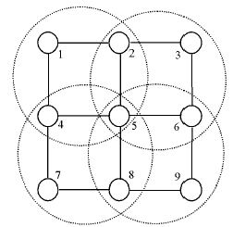
Generalized BP
1) Split the graph into basic clusters
[1245],[2356],
[4578],[5689].
From Slides by Aggeliki Tsoli

Slide 41
Generalized BP
2) Find all intersection regions of the basic clusters, and all their intersections
[25], [45], [56], [58],
[5]
From Slides by Aggeliki Tsoli

Slide 42
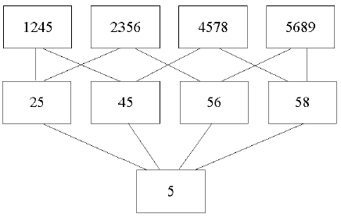
Generalized BP
3) Create a hierarchy of regions and their direct sub-regions
From Slides by Aggeliki Tsoli

Slide 43
Generalized BP
4) Associate a message with each line in the graph
e.g. message from
[1245]->[25]:
m_{14->25}(x₂,x₅)
From Slides by Aggeliki Tsoli

Slide 44
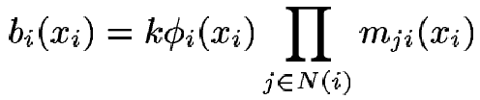

Generalized BP
5) Setup equations for beliefs of regions
- remember from earlier:
- So the belief for the region containing [5] is:
- for the region [45]:
- etc.
From Slides by Aggeliki Tsoli

Slide 45
Generalized BP
Belief in a region is the product of:
  Local information (factors in region)
  Messages from parent regions
  Messages into descendant regions from parents who are not descendants.
Message-update rules obtained by enforcing marginalization constraints.
From Slides by Jonathan Yedidia - Mitsubishi Electric Research Labs (MERL)

Slide 46
Generalized Belief Propagation
1245
2356
4578
5689
25
45
56
58
1
2
3
5
4
5
6
7
8
9
From Slides by Jonathan Yedidia - Mitsubishi Electric Research Labs (MERL)

Slide 47
Generalized Belief Propagation
1245
2356
4578
5689
25
45
56
58
1
2
3
5
4
5
6
7
8
9
From Slides by Jonathan Yedidia - Mitsubishi Electric Research Labs (MERL)

Slide 48
Generalized Belief Propagation
1245
2356
4578
5689
25
45
56
58
1
2
3
5
4
5
6
7
8
9
From Slides by Jonathan Yedidia - Mitsubishi Electric Research Labs (MERL)

Slide 49
Generalized Belief Propagation
1245
2356
4578
5689
25
45
56
58
1
2
3
5
4
5
6
7
8
9
From Slides by Jonathan Yedidia - Mitsubishi Electric Research Labs (MERL)

Slide 50
Generalized Belief Propagation
Use Marginalization Constraints to Derive Message-Update Rules
1
2
3
1
2
3
=
4
5
6
4
5
6
7
8
9
7
8
9
From Slides by Jonathan Yedidia - Mitsubishi Electric Research Labs (MERL)

Slide 51
Generalized Belief Propagation
Use Marginalization Constraints to Derive Message-Update Rules
1
2
3
1
2
3
=
4
5
6
4
5
6
7
8
9
7
8
9
From Slides by Jonathan Yedidia - Mitsubishi Electric Research Labs (MERL)

Slide 52
Generalized Belief Propagation
Use Marginalization Constraints to Derive Message-Update Rules
1
2
3
1
2
3
=
4
5
6
4
5
6
7
8
9
7
8
9
From Slides by Jonathan Yedidia - Mitsubishi Electric Research Labs (MERL)

Slide 53
Generalized Belief Propagation
Use Marginalization Constraints to Derive Message-Update Rules
1
2
3
1
2
3
=
4
5
6
4
5
6
7
8
9
7
8
9
From Slides by Jonathan Yedidia - Mitsubishi Electric Research Labs (MERL)

Slide 54
Section 2
Mean Field

Slide 55





Mean-field methods
Mean-fields methods (Jordan et.al., 1999)
Intractable inference with distribution
Approximate distribution from tractable family

Slide 56
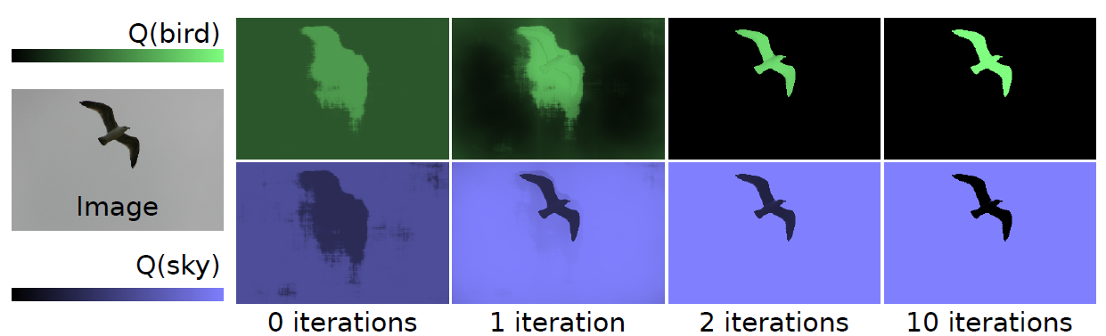
Q distribution

Slide 57
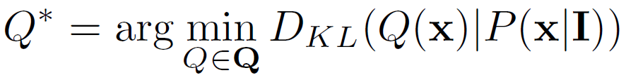

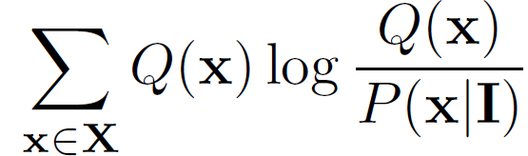

Variational Inference
Minimize the KL-divergence between Q and P

Slide 58
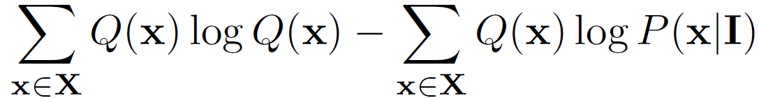
Variational Inference
Minimize the KL-divergence between Q and P

Slide 59
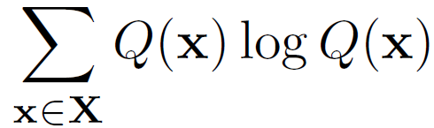
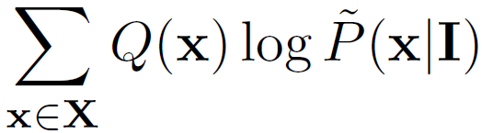


Variational Inference
Minimize the KL-divergence between Q and P

Slide 60





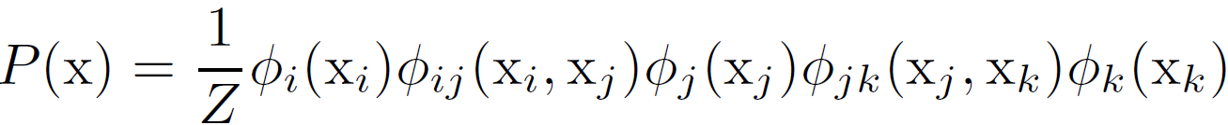
Markov Random Field (MRF)
Graph:
A simple MRF
Product of potentials defined over cliques

Slide 61

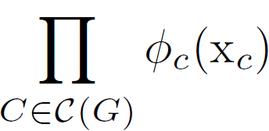
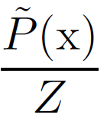

Markov Random Field (MRF)
Graph:
In general
Un-normalized part

Slide 62


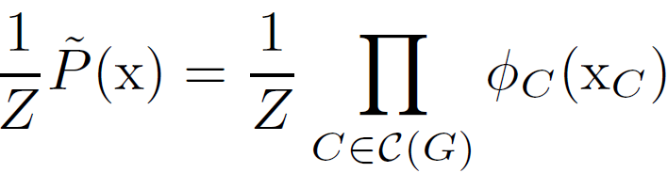
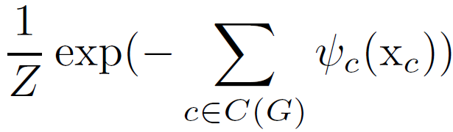

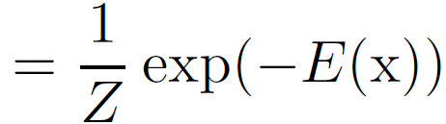
Energy minimization
Potential and energy

Slide 63

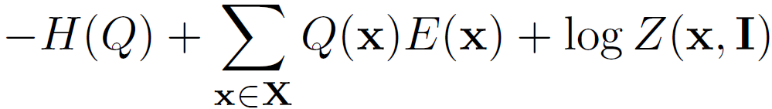
Variational Inference
Entropy
of Q
Expectation of cost
under Q distribution

Slide 64

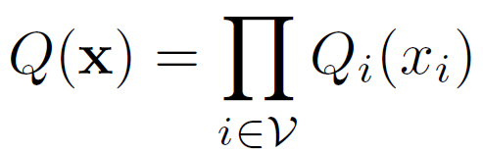
Naïve Mean Field
Family : assume all variables are independent

Slide 65



Max posterior marginal (MPM)
MPM with approximate distribution:
MAP solution / most likely solution
Empirically achieves very high accuracy:

Slide 66
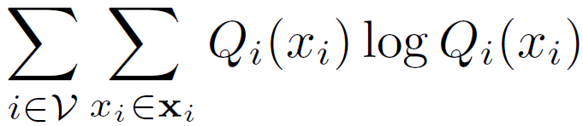
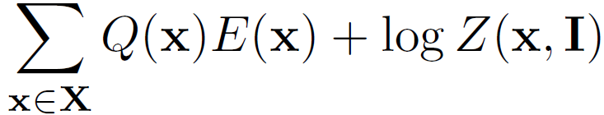

Variational Inference
Shannon’s entropy decomposes

Slide 67
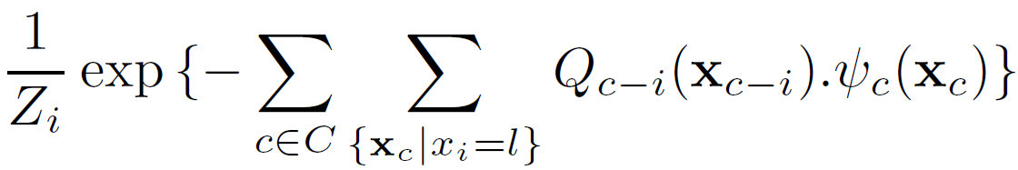

Mean-field algorithm
Iterative algorithm
Iterate till convergence
  Update marginals of each variable in each iteration

Slide 68
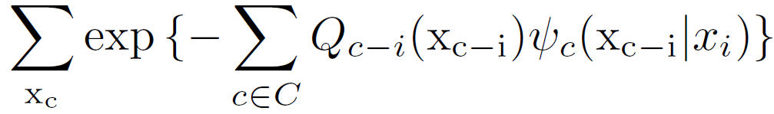

Variational Inference
Stationary point solution
Marginal update in mean-field
Normalizing constant:

Slide 69
Variational Inference
Marginal for variable i taking label l

Slide 70
Variational Inference
Marginal for variable i taking label l
An assignment of all variables in clique c

Slide 71
Variational Inference
Marginal for variable i taking label l
An assignment of all variables in clique c
An assignment of all variables apart from $x_{i}$

Slide 72
Variational Inference
Marginal for variable i taking label l
An assignment of all variables in clique c
An assignment of all variables apart from $x_{i}$
Marginal distribution of all variables in c apart from $x_{i}$

Slide 73
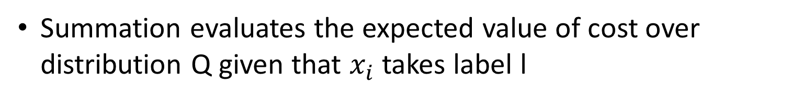
Variational Inference
Marginal for variable i taking label l
An assignment of all variables in clique c
An assignment of all variables apart from $x_{i}$
Marginal distribution of all variables in c apart from $x_{i}$
Summation evaluates the expected value of cost over distribution Q given that $x_{i}$ takes label l

Slide 74








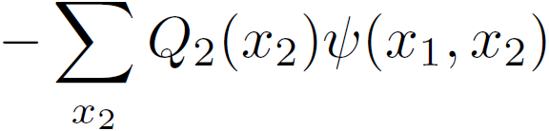
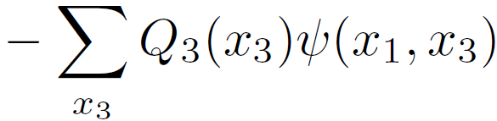
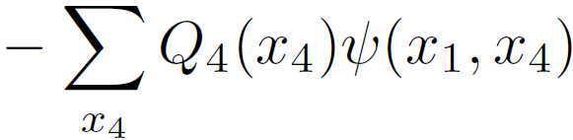
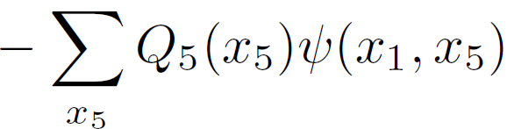
Simple Illustration
Naïve
mean-field approximation

Slide 75
Structured Mean Field
Naïve mean field can lead to poor solution
Structured (higher order) mean-field

Slide 76
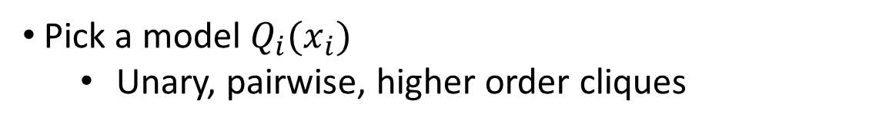
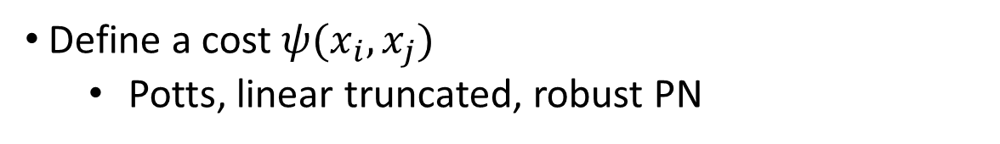
How to make a mean-field algorithm
Pick a model $Q_{i}(x_{i})$
  Unary, pairwise, higher order cliques
Define a cost $ψ(x_{i},x_{j})$
  Potts, linear truncated, robust PN
Calculate the marginal
  Calculate the expectation of cost defined

Slide 77
How to make a mean-field algorithm
Use this plug-in strategy in many different models
  Grid pairwise CRF
  Dense pairwise CRF
  Higher order model
  Co-occurrence model
  Latent variable model
  Product label space

Slide 78
Chapter 3
Monte Carlo Methods

Slide 79
Overview
Monte Carlo basics
Rejection and Importance sampling
Markov chain Monte Carlo
Metropolis-Hastings and Gibbs sampling
Slice sampling
Hamiltonian Monte Carlo
From Slides by Ryan Adams - University of Toronto

Slide 80




Computing Expectations
We often like to use probabilistic models for data.
What is the mean of the posterior?
From Slides by Ryan Adams - University of Toronto

Slide 81


Computing Expectations
What is the predictive distribution?
What is the marginal (integrated) likelihood?
From Slides by Ryan Adams - University of Toronto

Slide 82


Computing Expectations
Sometimes we prefer latent variable models.
Sometimes these joint models are intractable.
Maximize the marginal probability of data
From Slides by Ryan Adams - University of Toronto

Slide 83

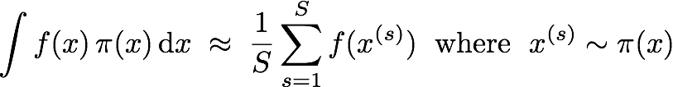
The Monte Carlo Principle
Each of these examples has a shared form:
Any such expectation can be computed from samples:
From Slides by Ryan Adams - University of Toronto

Slide 84

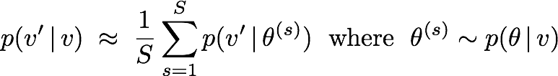
The Monte Carlo Principle
Example: Computing a Bayesian predictive distribution
We get a predictive mixture distribution:
From Slides by Ryan Adams - University of Toronto

Slide 85
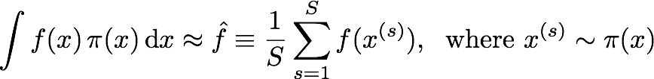




Properties of MC Estimators
Monte Carlo estimates are unbiased.
The variance of the estimator shrinks as
The “error” of the estimator shrinks as
From Slides by Ryan Adams - University of Toronto

Slide 86

Why Monte Carlo?
“Monte Carlo is an extremely bad method; it should be used only when all alternative methods are worse.”
Alan Sokal
Monte Carlo methods in statistical mechanics, 1996
The error is only shrinking as ?!?!? Isn’t that bad?
Heck, Simpson’s Rule gives !!!
How many dimensions do you have?
From Slides by Ryan Adams - University of Toronto

Slide 87

Why Monte Carlo?
If we have a generative model, we can fantasize data.
This helps us understand the properties of our model and know what we’re learning from the true data.
From Slides by Ryan Adams - University of Toronto

Slide 88











Generating Fantasy Data
From Slides by Ryan Adams - University of Toronto

Slide 89

Sampling Basics
We need samples from . How to get them?
Most generally, your pseudo-random number generator is going to give you a sequence of integers from large range.
These you can easily turn into floats in [0,1].
Probably you just call rand() in Matlab or Numpy.
Your is probably more interesting than this.
From Slides by Ryan Adams - University of Toronto

Slide 90






Inversion Sampling
From Slides by Ryan Adams - University of Toronto

Slide 91
Inversion Sampling
Good News:
Straightforward way to take your uniform (0,1) variate and turn it into something complicated.
Bad News:
We still had to do an integral.
Doesn’t generalize easily to multiple dimensions.
The distribution had to be normalized.
From Slides by Ryan Adams - University of Toronto

Slide 92

The Big Picture
So, if generating samples is just as difficult as integration, what’s the point of all this Monte Carlo stuff?
This entire tutorial is about the following idea:
Take samples from some simpler distribution and turn them into samples from the complicated thing that we’re actually interested in, .
In general, I will assume that we only know to within a constant and that we cannot integrate it.
From Slides by Ryan Adams - University of Toronto

Slide 93








Rejection Sampling
One useful observation is that samples uniformly drawn from the volume beneath a (not necessarily normalized) PDF will have the correct marginal distribution.
From Slides by Ryan Adams - University of Toronto

Slide 94




Rejection Sampling
How to get samples from the area? This is the first example, of sample from a simple to get samples from a complicated .
From Slides by Ryan Adams - University of Toronto

Slide 95



Rejection Sampling
1. Choose and so that
2. Sample
3. Sample
4. If keep , else reject and goto 2.
If you accept, you get an unbiased sample from .
Isn’t it wasteful to throw away all those proposals?
From Slides by Ryan Adams - University of Toronto

Slide 96

Importance Sampling
Recall that we’re really just after an expectation.
We could write the above integral another way:
From Slides by Ryan Adams - University of Toronto

Slide 97


Importance Sampling
We can now write a Monte Carlo estimate that is also an expectation under the “easy” distribution
We don’t get samples from , so no easy visualization of fantasy data, but we do get an unbiased estimator of whatever expectation we’re interested in.
It’s like we’re “correcting” each sample with a weight.
From Slides by Ryan Adams - University of Toronto

Slide 98

Importance Sampling
As a side note, this trick also works with integrals that do not correspond to expectations.
From Slides by Ryan Adams - University of Toronto

Slide 99
Scaling Up
Both rejection and importance sampling depend heavily on having a that is very similar to
In interesting high-dimensional problems, it is very hard to choose a that is “easy” and also resembles the fancy distribution you’re interested in.
The whole point is that you’re trying to use a powerful model to capture, say, the statistics of natural images in a way that isn’t captured by a simple distribution!
From Slides by Ryan Adams - University of Toronto

Slide 100









Exploding Importance Weights
Even without going into high dimensions, we can see how a mismatch between the distributions can cause a few importance weights to grow very large.
From Slides by Ryan Adams - University of Toronto

Slide 101


Scaling Up
In high dimensions, the mismatch between the proposal distribution and the true distribution can really ramp up quickly. Example:
Rejection sampling requires and accepts with probability . For the acceptance rate will be less than one percent.
The variance of the importance sampling weights will grow exponentially with dimension. That means that in high dimensions, the answer will be dominated by only a few of the samples.
From Slides by Ryan Adams - University of Toronto

Slide 102
Summary So Far
We would like to find statistics of our probabilistic models for inference, learning and prediction.
Computation of these quantities often involves difficult integrals or sums.
Monte Carlo approximates these with sample averages.
Rejection sampling provides unbiased samples from a complex distribution.
Importance sampling provides an unbiased estimator of a difficult expectation by “correcting” another expectation.
Neither of these methods scale well in high dimensions.
From Slides by Ryan Adams - University of Toronto

Slide 103






Revisiting Independence
It’s hard to find the mass of an unknown density!
From Slides by Ryan Adams - University of Toronto

Slide 104
Revisiting Independence
Why should we immediately forget that we discovered a place with high density? Can we use that information?
Storing this information will mean that the sequence now has correlations in it. Does this matter?
Can we do this in a principled way so that we get good estimates of the expectations we’re interested in?
Markov chain Monte Carlo
From Slides by Ryan Adams - University of Toronto

Slide 105
Markov chain Monte Carlo
As in rejection and importance sampling, in MCMC we have some kind of “easy” distribution that we use to compute something about our “hard” distribution .
The difference is that we’re going to use the easy distribution to update our current state, rather than to draw a new one from scratch.
If the update depends only on the current state, then it is Markovian. Sequentially making these random updates will correspond to simulating a Markov chain.
From Slides by Ryan Adams - University of Toronto

Slide 106


Markov chain Monte Carlo
We define a Markov transition operator .
The trick is: if we choose the transition operator carefully, the marginal distribution over the state at any given instant can have our distribution .
If the marginal distribution is correct, then our estimator for the expectation is unbiased.
From Slides by Ryan Adams - University of Toronto

Slide 107










Markov chain Monte Carlo
From Slides by Ryan Adams - University of Toronto

Slide 108







A Discrete Transition Operator
is an invariant distribution of , i.e.
is the equilibrium distribution of , i.e.
is ergodic, i.e., for all there exists a such that .
From Slides by Ryan Adams - University of Toronto

Slide 109


Detailed Balance
In practice, most MCMC transition operators satisfy detailed balance, which is stronger than invariance.
$$2SO_{2}+O_{2}⇌2SO_{3}$$
From Slides by Ryan Adams - University of Toronto

Slide 110





Metropolis-Hastings
This is the sledgehammer of MCMC. Almost every other method can be seen as a special case of M-H.
Simulate the operator in two steps:
1) Draw a “proposal” from a distribution . This is typically something “easy” like .
2) Accept or reject this move with probability
$$2SO_{2}+O_{2}⇌2SO_{3}$$
The actual transition operator is then
From Slides by Ryan Adams - University of Toronto

Slide 111
Metropolis-Hastings
Things to note:
1) If you reject, the new state is a copy of the current state. Unlike rejection sampling, the rejections count.
2) only needs to be known to a constant.
3) The proposal needs to allow ergodicity.
4) The operator satisfies detailed balance.
From Slides by Ryan Adams - University of Toronto

Slide 112

Metropolis-Hastings
From Slides by Ryan Adams - University of Toronto

Slide 113

Effect of M-H Step Size
From Slides by Ryan Adams - University of Toronto

Slide 114
Effect of M-H Step Size
Huge step size = lots of rejections
From Slides by Ryan Adams - University of Toronto

Slide 115

Effect of M-H Step Size
Tiny step size = slow diffusion
steps
From Slides by Ryan Adams - University of Toronto

Slide 116
Gibbs Sampling
One special case of Metropolis-Hastings is very popular and does not require any choice of step size.
Gibbs sampling is the composition of a sequence of M-H transition operators, each of which acts upon a single component of the state space.
By themselves, these operators are not ergodic, but in aggregate they typically are.
Most commonly, the proposal distribution is taken to be the conditional distribution, given the rest of the state. This causes the acceptance ratio to always be one and is often easy because it is low-dimensional.
From Slides by Ryan Adams - University of Toronto

Slide 117


Gibbs Sampling
From Slides by Ryan Adams - University of Toronto

Slide 118
Gibbs Sampling
Sometimes, it’s really easy: if there are only a small number of possible states, they can be enumerated and normalized easily, e.g. binary hidden units in a restricted Boltzmann machine.
When groups of variables are jointly sampled given everything else, it is called “block-Gibbs” sampling.
Parallelization of Gibbs updates is possible if the conditional independence structure allows it. RBMs are a good example of this also.
From Slides by Ryan Adams - University of Toronto

Slide 119
Summary So Far
We don’t have to start our sampler over every time!
We can use our “easy” distribution to get correlated samples from the “hard” distribution.
Even though correlated, they still have the correct marginal distribution, so we get the right estimator.
Designing an MCMC operator sounds harder than it is.
Metropolis-Hastings can require some tuning.
Gibbs sampling can be an easy version to implement.
From Slides by Ryan Adams - University of Toronto

Slide 120
An MCMC Cartoon
Hamiltonian Monte Carlo
Fast
Gibbs
Slice Sampling
Simple M-H
Slow
Easy
Hard
From Slides by Ryan Adams - University of Toronto

Slide 121
Slice Sampling
An auxiliary variable MCMC method that requires almost no tuning. Remember back to the beginning...
From Slides by Ryan Adams - University of Toronto

Slide 122
Slice Sampling
Define a Markov chain that samples uniformly from the area beneath the curve. This means that we need to introduce a “height” into the MCMC sampler.
From Slides by Ryan Adams - University of Toronto

Slide 123
Slice Sampling
Sampling the height is easy: simulate a random variate uniformly between 0 and the height of your (perhaps unnormalized) density function.
From Slides by Ryan Adams - University of Toronto

Slide 124
Slice Sampling
Sampling the horizontal slice is more complicated. Start with a big “bracket” and rejection sample, shrinking the bracket with rejections. Shrinks exponentially fast!
From Slides by Ryan Adams - University of Toronto

Slide 125
Slice Sampling
Unfortunately, you have to pick an initial bracket size. Exponential shrinkage means you can err on the side of being too large without too much additional cost.
From Slides by Ryan Adams - University of Toronto

Slide 126
Slice Sampling
There are also fancier versions that will automatically grow the bracket if it is too small. Radford Neal’s paper discusses this and many other ideas.
Radford M. Neal, “Slice Sampling”, Annals of Statistics 31, 705-767, 2003.
Iain Murray has Matlab code on the web. I have Python code on the web also. The Matlab statistics toolbox includes a slicesample() function these days.
It is easy and requires almost no tuning. If you’re currently solving a problem with Metropolis-Hastings, you should give this a try. Remember, the “best” M-H step size may vary, even with a single run!
From Slides by Ryan Adams - University of Toronto

Slide 127









Multiple Dimensions
One Approach: Slice sample each dimension, as in Gibbs
From Slides by Ryan Adams - University of Toronto

Slide 128












Multiple Dimensions
Another Approach: Slice sample in random directions
From Slides by Ryan Adams - University of Toronto

Slide 129

Auxiliary Variables
Slice sampling is an example of a very useful trick.
Getting marginal distributions in MCMC is easy: just throw away the things you’re not interested in.
Sometimes it is easy to create an expanded joint distribution that is easier to sample from, but has the marginal distribution that you’re interested in.
In slice sampling, this is the height variable.
From Slides by Ryan Adams - University of Toronto

Slide 130
An MCMC Cartoon
Hamiltonian Monte Carlo
Fast
Gibbs
Slice Sampling
Simple M-H
Slow
Easy
Hard
From Slides by Ryan Adams - University of Toronto

Slide 131



Avoiding Random Walks
All of the MCMC methods I’ve talked about so far have been based on biased random walks.
You need to go about to get a new sample, but you can only take steps around size , so you have to expect it to take about
Hamiltonian Monte Carlo is about turning this into
From Slides by Ryan Adams - University of Toronto

Slide 132

Hamiltonian Monte Carlo
Hamiltonian (also “hybrid”) Monte Carlo does MCMC by sampling from a fictitious dynamical system. It suppresses random walk behaviour via persistent motion.
Think of it as rolling a ball along a surface in such a way that the Markov chain has all of the properties we want.
Call the negative log probability an “energy”.
Think of this as a “gravitational potential energy” for the rolling ball. The ball wants to roll downhill towards low energy (high probability) regions.
From Slides by Ryan Adams - University of Toronto

Slide 133


Hamiltonian Monte Carlo
Now, introduce auxiliary variables (with the same dimensionality as our state space) that we will call “momenta”.
Give these momenta a distribution and call the negative log probability of that the “kinetic energy”. A convenient form is (not surprisingly) the unit-variance Gaussian.
As with other auxiliary variable methods, marginalizing out the momenta gives us back the distribution of interest.
From Slides by Ryan Adams - University of Toronto

Slide 134
Hamiltonian Monte Carlo
We can now simulate Hamiltonian dynamics, i.e., roll the ball around the surface. Even as the energy sloshes between potential and kinetic, the Hamiltonian is constant.
The corresponding joint distribution is invariant to this.
This is not ergodic, of course. This is usually resolved by randomizing the momenta, which is easy because they are independent and Gaussian.
So, HMC consists of two kind of MCMC moves:
1) Randomize the momenta.
2) Simulate the dynamics, starting with these momenta.
From Slides by Ryan Adams - University of Toronto

Slide 135

























Alternating HMC
From Slides by Ryan Adams - University of Toronto

Slide 136
Perturbative HMC
From Slides by Ryan Adams - University of Toronto

Slide 137

HMC Leapfrog Integration
On a real computer, you can’t actually simulate the true Hamiltonian dynamics, because you have to discretize.
To have a valid MCMC algorithm, the simulator needs to be reversible and satisfy the other requirements.
The easiest way to do this is with the “leapfrog method”:
The Hamiltonian is not conserved, so you accept/reject via Metropolis-Hastings on the overall joint distribution.
From Slides by Ryan Adams - University of Toronto

Slide 138
Overall Summary
Monte Carlo allows you to estimate integrals that may be impossible for deterministic numerical methods.
Sampling from arbitrary distributions can be done pretty easily in low dimensions.
MCMC allows us to generate samples in high dimensions.
Metropolis-Hastings and Gibbs sampling are popular, but you should probably consider slice sampling instead.
If you have a difficult high-dimensional problem, Hamiltonian Monte Carlo may be for you.
From Slides by Ryan Adams - University of Toronto

Slide 139
Section 1
DDMCMC

Slide 140
DDMCMC Introduction
What is Image Segmentation?
How to find a good segmentation?
DDMCMC results
Image segmentation in a Bayesian statistical framework
Markov Chain Monte Carlo for exploring the space of all segmentations
Data-Driven methods for exploiting image data and speeding up MCMC
From Slides by Tomasz Malisiewicz
- Advanced Perception

Slide 141
DDMCMC Motivation
Iterative approach: consider many different segmentations and keep the good ones
Few tunable parameters, ex) # of segments encoded into prior
DDMCMC vs Ncuts
From Slides by Tomasz Malisiewicz
- Advanced Perception

Slide 142



Image Segmentation
Berkeley Segmentation Database Image 326038
Berkeley Ncuts K=30
DDMCMC
From Slides by Tomasz Malisiewicz
- Advanced Perception
Notes:
You have to set K for Ncuts. This Ncuts result was generated using the Berkeley Segmentation Engine

Slide 143

Image Segmentation
From Slides by Tomasz Malisiewicz
- Advanced Perception
Notes:
This is the result of using different scales not K-adventurers result.

Slide 144


Image Segmentation
From Slides by Tomasz Malisiewicz
- Advanced Perception

Slide 145







Formulation #1
(and you thought you knew what image segmentation was)
Image Lattice:
Image:
For any point either or
Lattice partition into K disjoint regions:
Region is discrete label map:
Region Boundary is Continuous:
An image partition into
disjoint regions is not
An image segmentation!
Regions Contents Are Key!
From Slides by Tomasz Malisiewicz
- Advanced Perception
Notes:
Regions are treated as discrete label maps (easier for maintaining topology)
Boundaries are treated as continuous (easier for diffusion)

Slide 146




Formulation #2
(and you thought you knew what image segmentation was)
Each Image Region is a realization from a probabilistic model
are parameters of model indexed by
A segmentation is denoted by a vector of hidden variables W; K is number of regions
Bayesian Framework:
Space of all
segmentations
Posterior
Likelihood
Prior
From Slides by Tomasz Malisiewicz
- Advanced Perception
Notes:
We will characterize the space of all segmentations in a future slide

Slide 147










Prior over segmentations
(do you like exponentials?)
# of model
params
-- Want less regions
-- Want round-ish regions
$\sim$ uniform,
-- Want less complex models
-- Want small regions
From Slides by Tomasz Malisiewicz
- Advanced Perception
Notes:
The product in the prior corresponds to the assumption that the prior for each region are independent.
|\Theta_i| is the number of parameters of theta
C is 0.9 (hard-coded)
Gamma is the only free parameter (the only free parameter that they vary)
What is \lambda_0 and \mu and \nu ? (not defined in the paper)

Slide 148





Likelihood for Images
Visual Patterns are independent stochastic processes
is model-type index
is model parameter vector
is image appearance in i-th region
Grayscale
Color
From Slides by Tomasz Malisiewicz
- Advanced Perception

Slide 149


Four Gray-level Models
Uniform Clutter Texture Shading
Gray-level model space:
Gaussian
Intensity
Histogram
FB Response
Histogram
B-Spline
From Slides by Tomasz Malisiewicz
- Advanced Perception

Slide 150

Three Color Models (L*,u*,v*)
Gaussian
Mixture of 2 Gaussians
Bezier Spline
Color model space:
From Slides by Tomasz Malisiewicz
- Advanced Perception

Slide 151
Calibration
Likelihoods are calibrated using empirical study
Calibration required to make likelihoods for different models comparable (necessary for model competition)
Principled?
or
Hack?
From Slides by Tomasz Malisiewicz
- Advanced Perception
Notes:
This is a hack.

Slide 152
What did we just do?
Def. of Segmentation:
Score (probability) of Segmentation:
Likelihood of Image = product of region
likelihoods
Regions defined by k-partition:
From Slides by Tomasz Malisiewicz
- Advanced Perception
Notes:
Summary of Formulation Slides

Slide 153
What do we do with scores?
Search
From Slides by Tomasz Malisiewicz
- Advanced Perception

Slide 154




Search through what?
Anatomy of Solution Space
Space of all k-partitions
General partition space
Space of all segmentations
or
Scene
Space
Partition
space
K Model
spaces
From Slides by Tomasz Malisiewicz
- Advanced Perception
Notes:
Space of all segmentation is the union of all k-segmentations
A k-segmentation is the product of one k-partition space and k spaces for the image models
A model space is made up of cue-spaces

Slide 155
Why MCMC
What is it?
What does it do?
-A clever way of searching through a high-dimensional space
-A general purpose technique of generating samples from a probability
-Iteratively searches through space of all segmentations by constructing
a Markov Chain which converges to stationary distribution
From Slides by Tomasz Malisiewicz
- Advanced Perception

Slide 156
Designing Markov Chains
Three Markov Chain requirements
Ergodic: from an initial segmentation W0, any other state W can be visited in finite time (no greedy algorithms); ensured by jump-diffusion dynamics
Aperiodic: ensured by random dynamics
Detailed Balance: every move is reversible
From Slides by Tomasz Malisiewicz
- Advanced Perception

Slide 157
5 Dynamics
1.) Boundary Diffusion
2.) Model Adaptation
3.) Split Region
4.) Merge Region
5.) Switch Region Model
At each iteration, we choose a dynamic with probability q(1),q(2),q(3),q(4),q(5)
From Slides by Tomasz Malisiewicz
- Advanced Perception

Slide 158


Dynamics 1: Boundary Diffusion
Diffusion* within
Temperature
Decreases over
Time
Brownian Motion
Along
Curve Normal
Boundary
Between
Regions i and j
*Movement within partition space
From Slides by Tomasz Malisiewicz
- Advanced Perception
Notes:
The motion of {x(s),y(s)} follows steepest ascent equation of log(p(W | I)) plus brownian motion
Brownian Motion is a Normal distribution

Slide 159

Dynamics 2: Model Adaptation
Fit the parameters* of a region by steepest ascent
*Movement within cue space
From Slides by Tomasz Malisiewicz
- Advanced Perception
Notes:
How is this not greedy? It appears to be greedy.

Slide 160



Dynamics 3-4: Split and Merge
Remaining
Variables
Are
unchanged
Split one region into two
Probability of
Proposed Split
Conditional Probability
of how likely chain
proposes to move
to W’ from W
Data-Driven Speedup
From Slides by Tomasz Malisiewicz
- Advanced Perception
Notes:
q(3) is just the probability of choosing dynamics 3

Slide 161
Dynamics 3-4: Split and Merge
Remaining
Variables
Are
unchanged
Merge two Regions
Data-Driven Speedup
Probability of
Proposed Merge
From Slides by Tomasz Malisiewicz
- Advanced Perception
Notes:
q(3) is just the probability of choosing dynamics 3

Slide 162


Dynamics 5: Model Switching
Change models
Proposal Probabilities
Data-Driven Speedup
From Slides by Tomasz Malisiewicz
- Advanced Perception
Notes:
q(5) is just the probability of choosing dynamics 5

Slide 163
Motivation of DD
Region Splitting: How to decide where to split a region?
Model Switching: Once we switch to a new model, what parameters do we jump to?
vs
Model Adaptation Required some initial parameter vector
From Slides by Tomasz Malisiewicz
- Advanced Perception
Notes:
Page 18 stuff

Slide 164
Data Driven Methods
Focus on boundaries and model parameters derived from data: compute these before MCMC starts
Cue Particles: Clustering in Model Space
K-partition Particles: Edge Detection
Particles Encode Probabilities Parzen Window Style
From Slides by Tomasz Malisiewicz
- Advanced Perception

Slide 165

Cue Particles In Action
Clustering in Color Space
From Slides by Tomasz Malisiewicz
- Advanced Perception
Notes:
This figure shows a few color clusters in (L,u,v) color space. The size of the ball represents the weights of each particle. Each cluster has an associated saliency map

Slide 166


Cue Particles
Extract Feature at each point in image
m weighted cue particles are the output of a clustering algorithm
Model Index
Probability that
Feature belongs
To cluster
Saliency Map
From Slides by Tomasz Malisiewicz
- Advanced Perception
Notes:
\omega_{i}^{l} are the weights of each particle
EM(mixture of gaussians) and the mean-shift algorithm both return weighted particles
Each feature F_{v}^{l} is classified to cluster \Theta_{i}^{l} with probability S_{i,v}^{l}
Each cue particle has an associated saliency map

Slide 167

K-partition Particles in Action
Edge detection gives us a good idea of where we expect a boundary to be located
From Slides by Tomasz Malisiewicz
- Advanced Perception

Slide 168






K-partition Particles
Edge detection and tracing at 3 scales
Partition Map consists of “meta-regions”
Meta-regions are used to construct regions
is the set of all k-partitions based on
From Slides by Tomasz Malisiewicz
- Advanced Perception
Notes:
s=3
“metaregions” are not really superpixels since they were formed by using only edge detection results
Superpixels are generally created from combining color information with boundary information. So superpixels can be though of as
a hybrid color/edge particle.

Slide 169




K-partition Particles
is the set of all k-partitions based on
Each in is a k-partition particle in partition space
From Slides by Tomasz Malisiewicz
- Advanced Perception

Slide 170

Particles or
Parzen Window* Locations?
What is this particle business about?
A particle is just the position of a parzen-window which is used for density estimation
*Parzen Windowing also known as:
Kernel Density Estimation, Non-parametric density
estimation
1D particles
From Slides by Tomasz Malisiewicz
- Advanced Perception

Slide 171






Nonparametric Probability Densities in Cue Spaces
Weighted cue particles encode nonparametric probability density in
G(x) is a parzen-window centered at 0
is computed once for each image
is computed at run-time
From Slides by Tomasz Malisiewicz
- Advanced Perception
Notes:
Using a Gaussian Window with non-finite support is necessary to have an ergodic markov chain
Using a delta-Window with point-wise support would be equivalent to greedy-ish clustering?

Slide 172


Nonparametric Probability Densities in Partition Spaces
Each k-partition particle has uniform weight and encodes nonparametric probability density in partition space
Using all scales
From Slides by Tomasz Malisiewicz
- Advanced Perception

Slide 173
Section 2
Swendsen-Wang Cuts

Slide 174

Swendsen-Wang for Ising / Potts Models
Swedsen-Wang (1987) is an extremely smart idea that flips a patch at a time.
Each edge in the lattice e=<s,t> is associated a probability q=e^{-β}.
1. If s and t have different labels at the current state, e is turned off.
If s and t have the same label, e is turned off with probability q.
Thus each object is broken into a number of connected components (subgraphs).
2. One or many components are chosen at random.
3. The collective label is changed randomly to any of the labels.
From Slides by Adrian Barbu
- Siemens Corporate Research
Notes:
The SW algorithm has been originally designed for the Ising and Potts models to address the slow performance of the Gibbs sampler.
Each edge of the lattice is associated a probability q=e^-beta, where beta is the parameter of the Potts model.
Then at each step, the SW algorithm performs the following actions:
It turns off all edges between nodes with different labels.
Each of the remaining edges is turned off with probability q. Observe that if the prior parameter beta is large, then most edges will remain on.
After turning all edge on or off, the connected components of this random graph are computed and one or many such components are chosen at random.
The collective label of the chosen components is randomly changed to any of the labels.
By the way the components were constructed, we are guaranteed that in each component, all nodes have the same color.

Slide 175
The Swendsen-Wang Algorithm
Pros
  Computationally efficient in sampling the Ising/Potts models
Cons:
  Limited to Ising / Potts models and factorized distributions
  Not informed by data, slows down in the presence of an external field (data term)
Swendsen Wang Cuts
  Generalizes Swendsen-Wang to arbitrary posterior probabilities
  Improves the clustering step by using the image data
From Slides by Adrian Barbu
- Siemens Corporate Research
Notes:
The Swendsen-Wang algorithm is an improvement over the Gibbs sampler.
For the Ising and Potts models, it is found to be very efficient.
However, it has limited applicability to the Ising/Potts model, or more general to factorized distributions.
Another drawback comes from the fact that it does not use the data information to construct the clusters.
Because of this, it slows down drastically in the presence of an external field, fact observed experimentally for the Ising/Potts models.
My work addresses these problems by generalizing the SW algorithm to arbitrary posterior probabilities.
At the same time, the new formulation can use the image data in constructing the edge probabilities and obtain considerable speedup, even in the presence of a data term in the energy.

Slide 176


SW Cuts: the Acceptance Probability
Theorem (Metropolis-Hastings) For any proposal probability q(A→B) and probability p(A), if the Markov chain moves by taking samples from q(A → B) which are accepted with probability
then the Markov chain is reversible with respect to p and has stationary distribution p.
Theorem (Barbu,Zhu ‘03). The acceptance probability for the Swendsen-Wang Cuts algorithm is
From Slides by Adrian Barbu
- Siemens Corporate Research
Notes:
To incorporate these proposed clusters into our probabilistic setting, we will make use of the famous Metropolis-Hastings theorem.
This theorem allows the use of almost any type of a proposal probability q(A to B) to take the system from the current state A to a new state B.
To guarantee that we sample from the given probability p, each such proposed move must be accepted with probability alpha.
In the original SW algorithm, the edge weights had a specific form which together with the specific form of the posterior probability resulted in alpha =1.
The main contribution of my work is to compute the acceptance probability alpha for the SW algorithm using arbitrary edge weights and arbitrary posterior probability p.
The acceptance probability has the following simple and explicit formula.

Slide 177

The Swendsen-Wang Cuts Algorithm
Swendsen-Wang Cuts: SWC
Input: G_{o}=<V, E_{o}>, discriminative probabilities q_{e}, e ∈E_{o},
and generative posterior probability p(W|I).
Output: Samples W~p(W|I).
1. Initialize a graph partition
2. Repeat, for current state A= π
The initial graph G_{o}
3. Repeat for each subgraph G_{l}=<V_{l}, E_{l}>, l=1,2,...,n in A
4. For e ∈E_{l} turn e=“on” with probability q_{e.}
5. Partition G_{l} into n_{l} connected components:
g_{li}=<V_{li}, E_{li}>, i=1,...,n_{l}
6. Collect all the connected components in
CP={V_{li}: l=1,...,n, i=1,...,n_{l}}.
7. Select a connected component V₀∈CP at random
8. Propose to reassign V₀ to a subgraph G_{l’},
l' follows a probability q(l'|V₀,A)
CP
9. Accept the move with probability α(A→B).
State A
State B
From Slides by Adrian Barbu
- Siemens Corporate Research
Notes:
To summarize, the SW Cuts algorithm proceeds as follows.

Slide 178
Advantages of the SW Cuts Algorithm
Our algorithm bridges the gap between the specialized and generic algorithms:
  Generally applicable – allows usage of complex models beyond the scope of the specialized algorithms
  Computationally efficient – performance comparable with the specialized algorithms
  Reversible and ergodic – theoretically guaranteed to eventually find the global optimum
From Slides by Adrian Barbu
- Siemens Corporate Research

Slide 179

Hierarchical Image-Motion Segmentation
Three-level representation:
  Level 2: Intensity regions are grouped into
  moving objects O_{i} with motion parameters θ_{i}
  Level 1: Atomic regions are grouped into
  intensity regions R_{ij} of coherent motion
  with intensity models H_{ij}
  Level 0: Pixels are grouped into atomic regions
  r_{ijk} of relatively constant motion and intensity
    motion parameters (u_{ijk},v_{ijk})
    intensity histogram h_{ijk}
From Slides by Adrian Barbu
- Siemens Corporate Research
Notes:
Before the atomic regions were fixed.
Here the atomic regions are computed on the fly.

Slide 180


Multi-Grid SWC
Select an attention window Λ ½ G.
Cluster the vertices within Λ and select a connected component R
Swap the label of R
Accept the swap with probability , using as boundary condition.
From Slides by Adrian Barbu
- Siemens Corporate Research

Slide 181
Multi-Level SWC
Select a level s, usually in an increasing order.
Cluster the vertices in G^{(s)} and select a connected component R
Swap the label of R
Accept the swap with probability, using the lower levels, denoted by X^{(<s)}, as boundary conditions.
From Slides by Adrian Barbu
- Siemens Corporate Research

Slide 182





Hierarchical Image-Motion Segmentation
Modeling occlusion
  Accreted (disoccluded) pixels
  Motion pixels
Bayesian formulation
Accreted pixels
Motion pixels explained by motion
Intensity segmentation factor with generative and histogram models.
From Slides by Adrian Barbu
- Siemens Corporate Research

Slide 183



Hierarchical Image-Motion Segmentation
The prior has factors for
  Smoothness of motion
  Main motion for each object
  Boundary length
  Number of labels
From Slides by Adrian Barbu
- Siemens Corporate Research

Slide 184








Designing the Edge Weights
Level 0:
  Pixel similarity
  Common motion
Level 1:
Histogram H_{i}
Histogram H_{j}
Level 2:
Motion histogram M_{i}
Motion histogram M_{j}
From Slides by Adrian Barbu
- Siemens Corporate Research

Slide 185






Experiments
Input sequence
Image Segmentation
Motion Segmentation
Input sequence
Image Segmentation
Motion Segmentation
From Slides by Adrian Barbu
- Siemens Corporate Research

Slide 186





Experiments
Input sequence
Image Segmentation
Motion Segmentation
Input sequence
Image Segmentation
Motion Segmentation
From Slides by Adrian Barbu
- Siemens Corporate Research

Slide 187
Section 3
Composite Cluster Sampling

Slide 188


Problem Formulation
Input: two graphs$(G^{S},G^{T})$
Output: layered matching configuration
Liang Lin, Xiaobai Liu, Song-Chun Zhu. “Layered Graph Matching with Composite Cluster Sampling”. TPAMI 2010.

Slide 189

Problem Formulation
Input: source graph $G^{S}$ and target graph $G^{T}$
Output: layered matching configuration $W$
1. Construct candidate graph.
2. Sample composite clusters.
a. Generate composite cluster.
b. Re-assign color to the composite cluster.
c. Convert to a new state.

Slide 190


Construct candidate graph - vertices
1. Start $u$ with a linelet, find the set $V(u)$ of matching candidates.
2. Grow $u$, reduce the matching candidates.
3. Repeat 1 and 2 until only less than k matching candidates.

Slide 191




Construct Candidate Graph - Vertices
Let a matching pair $(u_{i}, v_{i})$ be a vertices $c_{i}$ in the candidate graph.

Slide 192

Construct Candidate Graph - Vertices
Establish the negative and positive edges and calculate their edge probabilities between vertices.

Slide 193


Construct Candidate graph - Edges
$e= <c_{i},c_{j}>$ as a negative edge in two cases:
1. two candidates are mutually exclusive: $u_{i}=u_{j}$.
2. the two candidates overlap: $v_{i} ∩v_{j}≠ ∅$.

Slide 194



Construct Candidate Graph - Edges
$e= <c_{i},c_{j}>$ as a positive edge: the similarity transformation to align $c_{i}$ and $c_{j}$.

Slide 195

Construct Candidate Graph

Slide 196

Generate Composite Cluster
CCP: Candidates connected by the positive “on” edges form a CCP. (blue lines)
Composite Cluster: A few CCPs connected by negative “on” edges form a composite cluster.(red lines)

Slide 197

Generate Composite Cluster

Slide 198

Re-assign Color
Primitives connected by positive edges receive the same color. The ones connected by negative edges receive different color.
Randomly assign color.

Slide 199


Accept New State
Employ MCMC, the reversible jump between A and B.
Let $q(A→B)$ be the proposal probability for moving from state A to state B.
The acceptance rate of the move from A to B is
proposal probability ratio
posterior probability ratio

Slide 200


Accept New State
Proposal probability ratio:
Assuming uniform
$q(V_{cc}|A)$: the probability of generating $V_{cc}$ at state A.
$q(coloring(V_{cc})=B\left(V_{cc}\right)|V_{cc},A)$: the probability of recoloring the CCPs to state B.

Slide 201



Accept New State
Ratio of generating $V_{cc}$:

Slide 202

Accept New State
Prior ratio
Likelihood ratio
$$\frac{p(W=B|G^{S},G^{T}) }{p(W=A|G^{S},G^{T}) }∝\frac{p\left(W=B\right) ⋅p(G^{S},G^{T}|W=B)}{p\left(W=A\right) ⋅p(G^{S},G^{T}|W=A)}$$
Prior:
$p\left(W\right) ∝\exp\left\{−α_{K}K−α_{N}N\right\}⋅p(𝓛)$,
$p\left(𝓛\right)$ is a Potts model for the label $𝓛$ to punish inconsistent assignments.
Likelihood:
$$p\left(G^{S},G^{T} | W\right)=\prod_{k=1}^{K}{p(g_{k}, g_{k}^{′}|Ψ_{k}, Φ_{k})}$$
$∝\prod_{k=1}^{K}{\exp\left\{−E\left(g_{k},g_{k}^{′}\right)\right\}}$,
the computation of the posterior probability ratio only involves the recoloring of candidates in $V_{cc}$.
Posterior probability ratio:

Slide 203

Composite Cluster Sampling Algorithm

Slide 204

Thanks

