Slide 1
2012
Primal Sketch & Video Primal Sketch – Methods to Parse Images & Videos
Yuanlu Xu, SYSU, China
merayxu@gmail.com
2012.4.7

Slide 2
Episode 1
Backgrounds, Intuitions, and Frameworks

Slide 3
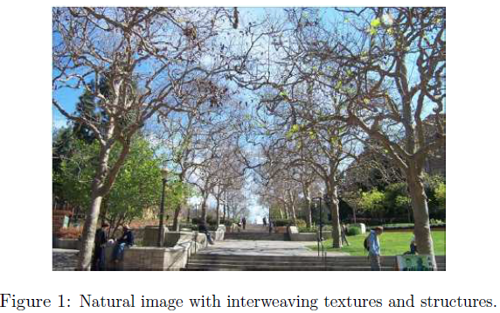
Background of image modeling
texton (token) vs. texture (Julesz, Marr)
Julesz:
Texton -> bars, edges, terminators
Texture -> sharing common statistics on certain features
Marr:
model parsimonious, enough to reconstruct

Slide 4
Background of image modeling
Texton modeling -- over-complete dictionary theory: wavelets, Fourier, ridgelets, image pyramids, and sparse coding.
Texture modeling -- Markov random field (MRF): FRAME.

Slide 5
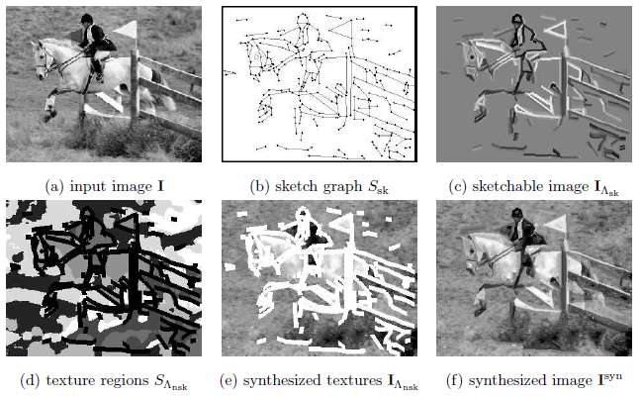
Intuition of Primal Sketch
Primal Sketch:
Sketchable vs. non-sketchable
Sketchable: primitive dictionary
Non-sketchable: simplified FRAME model

Slide 6
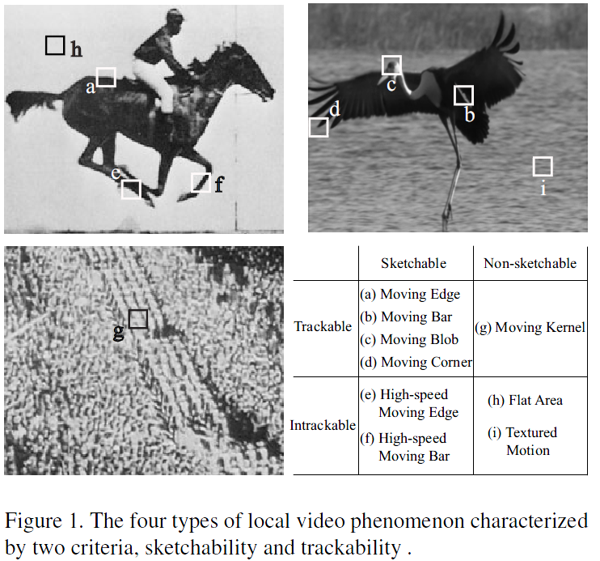
Background of video modeling
4 types of regions
Trackable motion: kernel tracking, contour tracking, key-point tracking
Intrackable motion (textured motion): dynamic texture (DT), STAR, ARMA, LDS

Slide 7
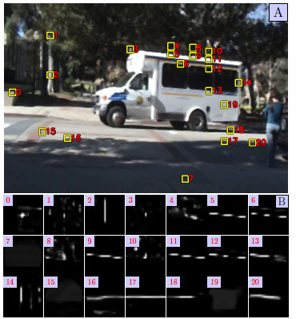
Background of video modeling
Intrackability: Characterizing Video Statistics and Pursuing Video Representations
Haifeng Gong, Song-Chun Zhu

Slide 8
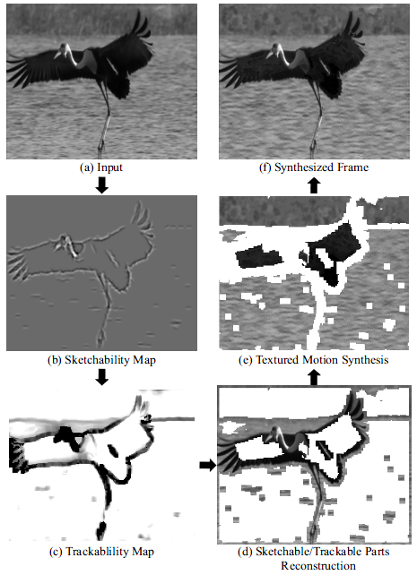
Intuition of Video Primal Sketch
Category 4 regions into two classes: implicit regions, explicit region.
Explicit region:
sketchable and trackable, sketchable and non-trackable, non-sketchable and trackable
Modeling with sparse coding
Implicit region:
Non-sketchable and non-trackable
Modeling with ST-FRAME

Slide 9
The Framework of Primal Sketch
Region of Primitives
Sketch Graph
Synthesized Primitives
Sketch Pursuit
Input Image
Synthesized Image
Region of Texture
Texture Clustering and Modeling
Synthesized Texture

Slide 10
The Framework of Video Primal Sketch
Input Video
Dictionary
Synthesized Primitives
Explicit Region
Sparse Coding
Synthesized Frame
Input Frame
Sketchability & Trackability Map
Previous Two Frames
Synthesized Texture
Implicit Region
ST-FRAME

Slide 11
Episode 2
Texture Modeling

Slide 12
The Framework of Primal Sketch
Region of Primitives
Sketch Graph
Synthesized Primitives
Input Image
Synthesized Image
Region of Texture
Texture Clustering and Modeling
Synthesized Texture

Slide 13
The Review of Video Primal Sketch
Input Video
Dictionary
Synthesized Primitives
Explicit Region
Sparse Coding
Synthesized Frame
Input Frame
Sketchability & Trackability Map
Previous Two Frames
Synthesized Texture
Implicit Region
ST-FRAME

Slide 14
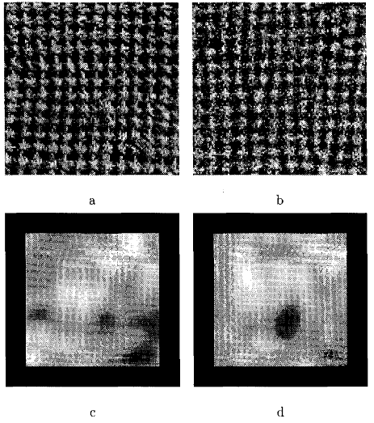
FRAME - Overview
Filters, Random Fields and Maximum Entropy (FRAME): Towards a Unified Theory for Texture Modeling
Songchun Zhu, Yingnian Wu, David Mumford IJCV 1998
Texture: a set of images sharing common statistics on certain features.

Slide 15
FRAME - Minimax Entropy Principle
f(I): underlying probability of a texture,
p(I): estimate probability distribution of f(I) from an textured image.

Slide 16
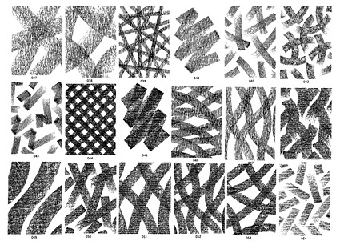
FRAME - Minimax Entropy Principle

Slide 17
FRAME - Minimax Entropy Principle

Slide 18
FRAME - Minimax Entropy Principle

Slide 19
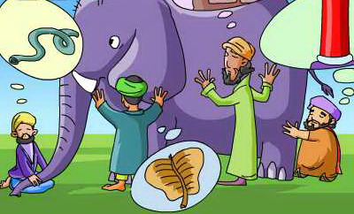
FRAME - Minimax Entropy Principle

Slide 20
FRAME - Minimax Entropy Principle

Slide 21
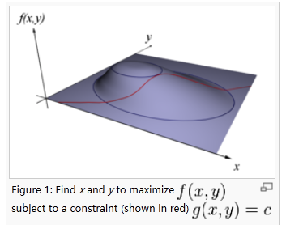
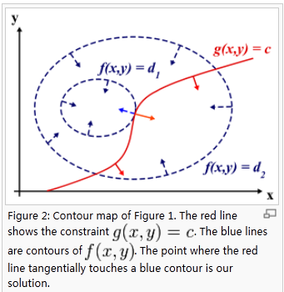
FRAME - Minimax Entropy Principle

Slide 22
FRAME - Minimax Entropy Principle
A point on f is a constrained stationary point if and only if the direction that changes f violates at least one of the constraints.

Slide 23
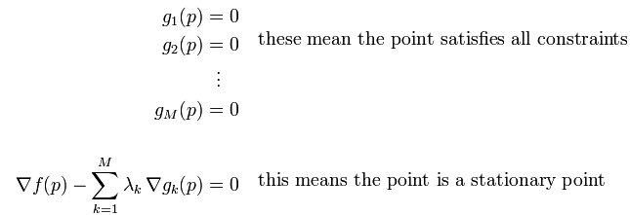
FRAME - Minimax Entropy Principle
To satisfy multiple constraints we can state that at the stationary points, the direction that changes f is in the “violation space” created by the constraints acting jointly.
That is, a stationary point satisfies:

Slide 24
FRAME - Minimax Entropy Principle

Slide 25
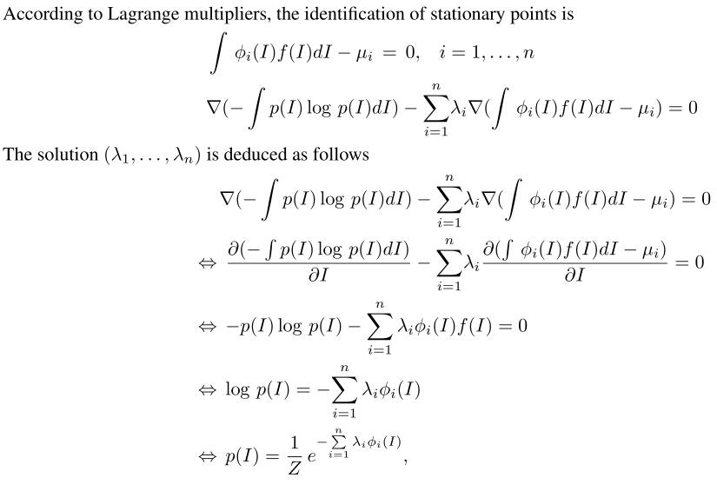
FRAME - Minimax Entropy Principle

Slide 26
FRAME - Minimax Entropy Principle
Function Z has the following nice properties:
Property 2 tells us the Hessian matrix of function log Z is the covariance matrix of log Z and is positive definite. Therefore, Z is log concave. It is easy to prove log p(x) is convex, either. Given a set of consistent constraints, the solution for is unique.

Slide 27
FRAME - Minimax Entropy Principle
Considering a closed form solution is not available in general, we seek numerical solutions by solving the following equations iteratively.
Gradient Descent

Slide 28
FRAME - Minimax Entropy Principle

Slide 29
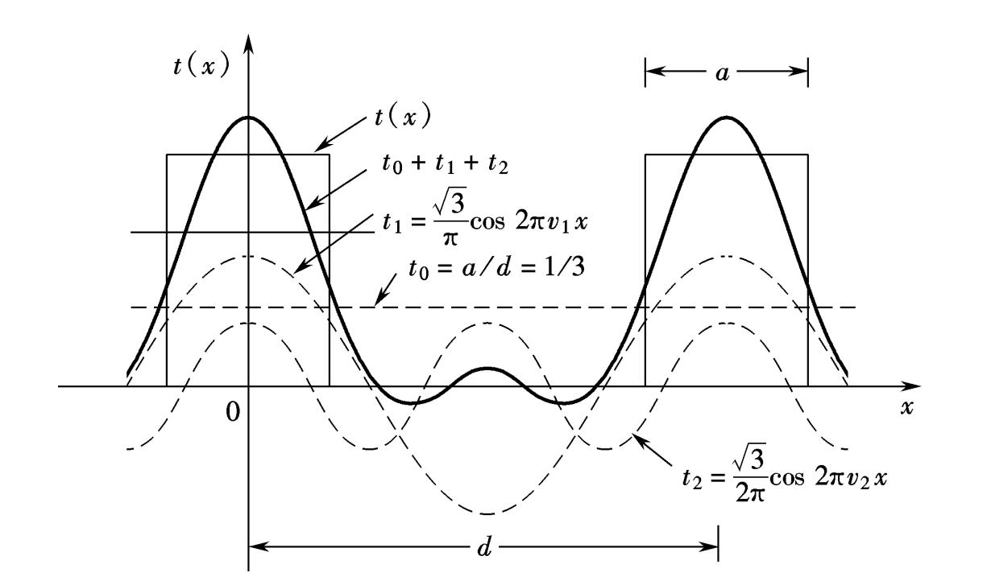
FRAME – Deriving the FRAME Model
Fourier transformation

Slide 30
FRAME – Deriving the FRAME Model

Slide 31
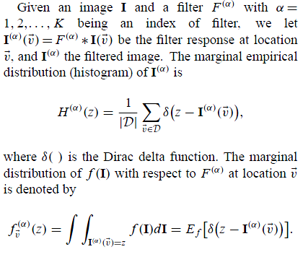
FRAME – Deriving the FRAME Model
The Dirac delta can be loosely thought of as a function on the real line which is zero everywhere except at the origin,
where it is infinite,
and which is also constrained to satisfy the identity

Slide 32
FRAME – Deriving the FRAME Model

Slide 33
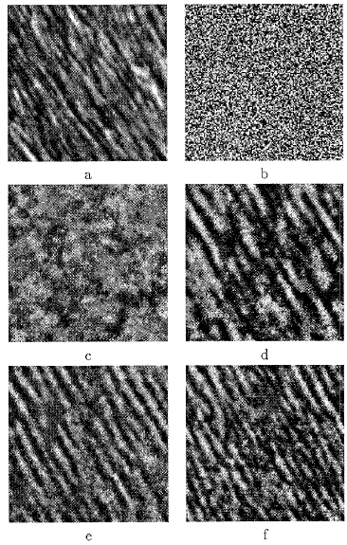
FRAME – Deriving the FRAME Model
Plugging the above equation into the constraints of
Maximum Entropy distribution, we get

Slide 34
FRAME – Choice of Filters
k is the number of filters selected to model f(I) and pk(I) the best estimate of f(I) given k filters

Slide 35
FRAME – Choice of Filters

Slide 36
FRAME – Choice of Filters
Constructing a filter bank B using five kinds of filters

Slide 37
FRAME – Synthesizing Texture
Gibbs sampling or a Gibbs sampler is an algorithm to generate a sequence of samples from the joint probability distribution of two or more random variables.
The purpose of such a sequence:
approximate the joint distribution;
approximate the marginal distribution of one of the variables, or some subset of the variables;
compute an integral (such as the expected value of one of the variables).

Slide 38
FRAME – Synthesizing Texture

Slide 39
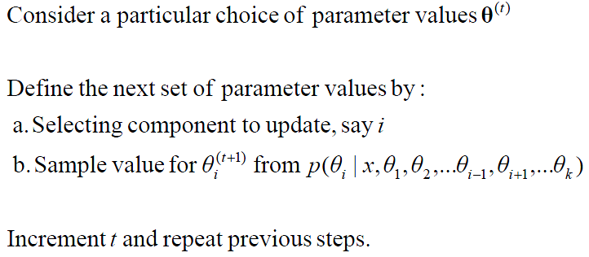
FRAME – Synthesizing Texture

Slide 40
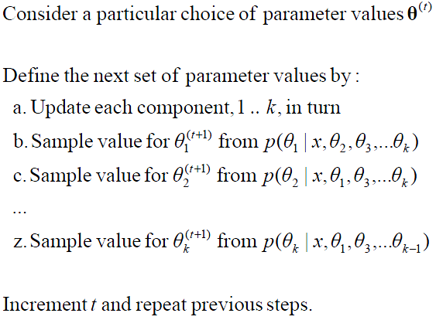
FRAME – Synthesizing Texture

Slide 41
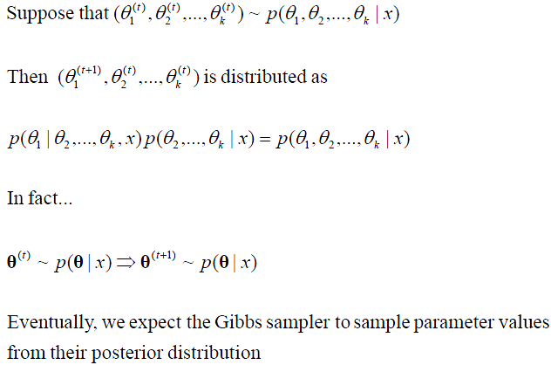
FRAME – Synthesizing Texture
is not a function of θ1 and thus is the same for all values
of θ1

Slide 42
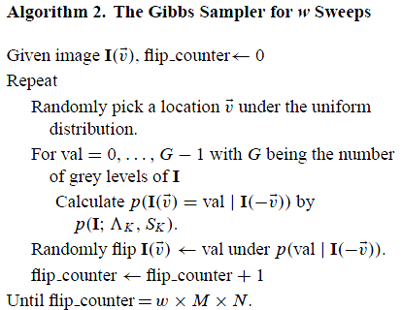
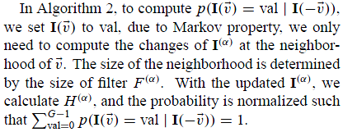
FRAME – Synthesizing Texture

Slide 43
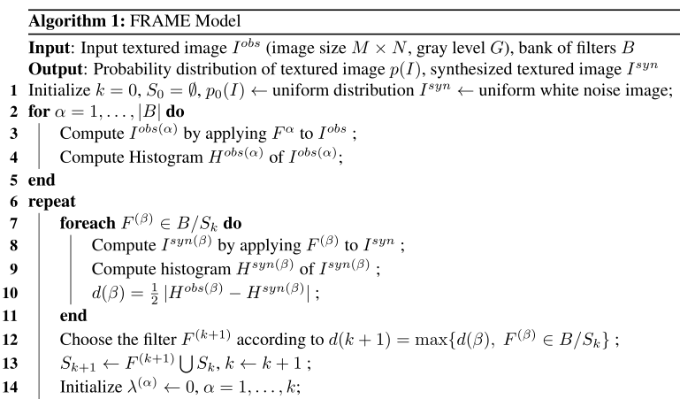
FRAME – Detailed Framework

Slide 44
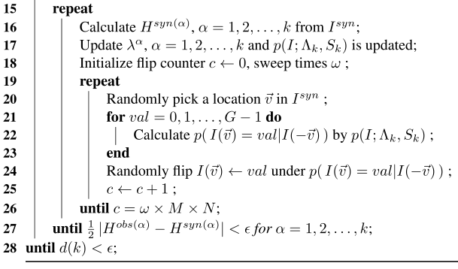
FRAME – Detailed Framework

Slide 45
Simplified Version in Primal Sketch
To segment the whole texture region into small ones, the clustering process is maximizing a posterior, with the assumption that each sub-region obeying a multivariate Gaussian distribution:

Slide 46
Simplified Version in Primal Sketch

Slide 47
Simplified Version in Primal Sketch

Slide 48
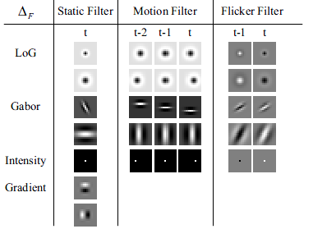
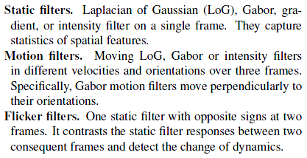
Adapted Version in Video Primal Sketch (ST-FRAME)

Slide 49
Episode 3
Texton Modeling

Slide 50
The Framework of Primal Sketch
Region of Primitives
Sketch Graph
Synthesized Primitives
Input Image
Synthesized Image
Region of Texture
Texture Clustering and Modeling
Synthesized Texture

Slide 51
The Review of Video Primal Sketch
Input Video
Dictionary
Synthesized Primitives
Explicit Region
Sparse Coding
Synthesized Frame
Input Frame
Sketchability & Trackability Map
Previous Two Frames
Synthesized Texture
Implicit Region
ST-FRAME

Slide 52
Sparse Coding
The image coding theory assumes that I is the weighted sum
of a number of image bases Bi indexed by i for its position, scale, orientation etc. Thus one obtains a “generative model”,

Slide 53
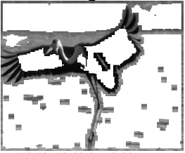
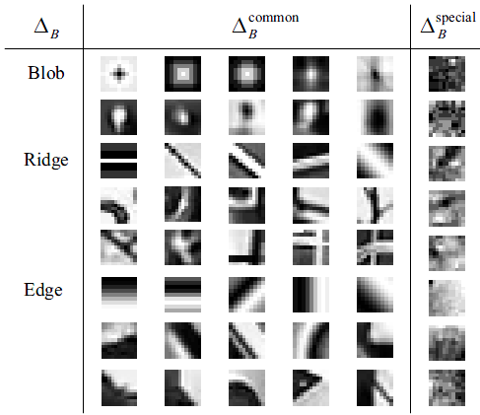
Sparse Coding
Sparse Coding:
Definition: modeling data vectors as sparse linear combinations of basis elements.

Slide 54
Sparse Coding
Classical Dictionary Learning:
Given a finite training set of signals , optimize the
empirical cost function:
where is the dictionary, each column representing a basis vector, and
is a loss function measuring the reconstruction residual.

Slide 55
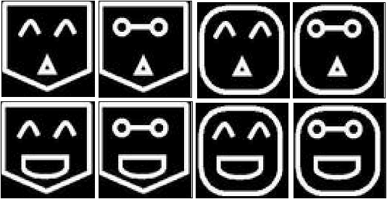
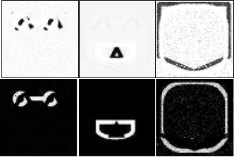
Sparse Coding
Intuitive Explanation of Sparse Coding:
Given n samples with dimension of each sample m, usually n >> m, constructing an over-complete dictionary D with k bases, k >= m, each sample only uses a few bases in D.

Slide 56
Sparse Coding
Key:
minimize
L1 – Norm Penalty
L0 – Norm Penalty : Aharon et al. (2006)

Slide 57
Sparse Coding
Problems of using L1 – norm penalty:
L1 – norm is not equivalent to sparsity.

Slide 58
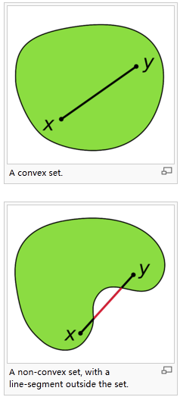
Sparse Coding
To prevent D from being arbitrarily large (which would lead to arbitrarily small values of

Slide 59
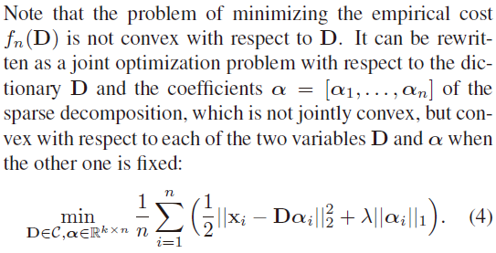
Sparse Coding

Slide 60
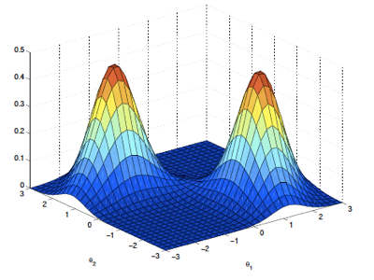
Sparse Coding
To solve this problem, an expectation-maximum (EM) like algorithm is employed.
Alternate between the two variables, minimizing over one while keeping the other one fixed.

Slide 61
Sparse Coding
Extend the empirical cost to the expected cost:
Bottou and Bousquet (2008)
where the expectation is taken relative to the (unknown) probability distribution p(x) of the data.

Slide 62
Sparse Coding
Calculating dictionary in classical sparse coding
First order stochastic gradient descent: Aharon and Elad (2008)
of the (unknown) distribution p(x).

Slide 63
Sparse Coding
Online Dictionary Learning for Sparse Coding
ICML 2009
Julien Mairal
Francis Bach
Jean Ponce
Guillermo Sapiro
Characteristic: Online Dictionary Learning (Incremental Learning)

Slide 64
Sparse Coding
Online Dictionary Learning:
Based on stochastic approximations.
Processing one sample at a time.
Not requiring explicit learning rate tuning.
Classical first-order stochastic
gradient descent
Good initialization of .
minimizes a sequentially quadratic local approximations of the expected cost.

Slide 65
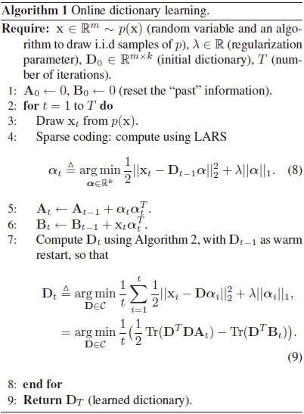
Sparse Coding
Sparse Coding Step:
Dictionary Update Step:

Slide 66
Sparse Coding
Motivation:

Slide 67
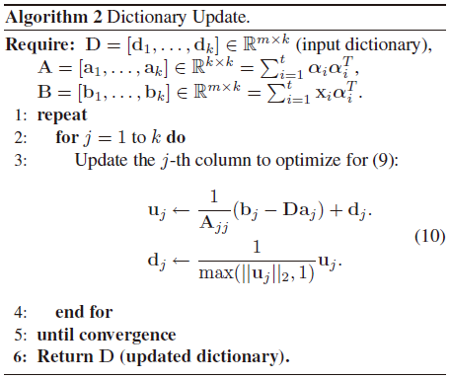
Sparse Coding
Due to the convexity of
dictionary D convergence to a global optimum is guaranteed.

Slide 68
Sparse Coding
Key:

Slide 69
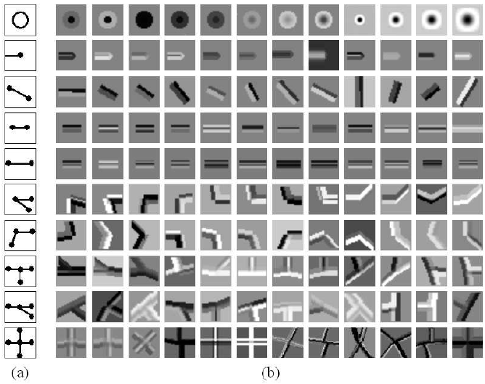
Adapted Version in Primitive Modeling
The dictionary of image primitives designed for the sketch graph Ssk consists of eight types of primitives in increasing degree of connection:
0. blob.
1. terminators, edge, ridge.
2. multi-ridge, corner.
3. junction.
4. cross.

Slide 70
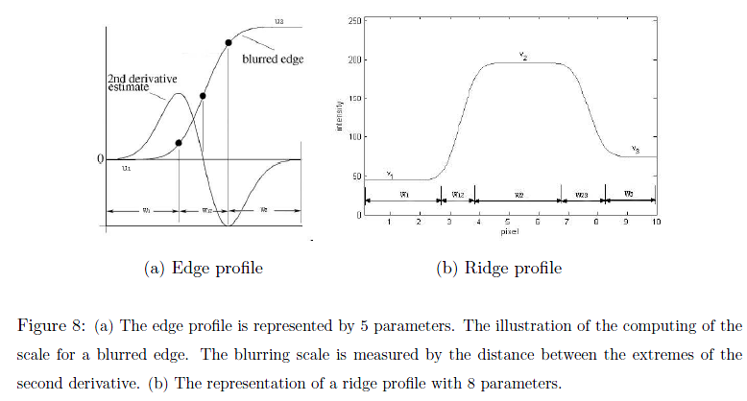
Adapted Version in Primitive Modeling
These primitives have a center landmark and l = 0 ~ 4 axes (arms) for connecting with other primitives. For arms, the photometric property is represented by the intensity profiles.

Slide 71
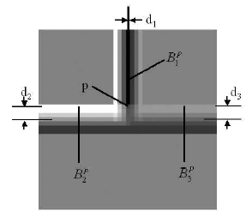
Adapted Version in Primitive Modeling
For the center of a primitive, considering the arms may overlap with each other, a pixel p with L arms overlapped is modeled by:

Slide 72
Adapted Version in Primitive Modeling
divide the set of vertices V into 5 subsets according to their degrees of connection,
According to Gestalt laws, the closure and continuity are preferred in the perceptual organization. Thus we penalize terminators, edges, ridge.

Slide 73
Adapted Version in Explicit Region Modeling

Slide 74
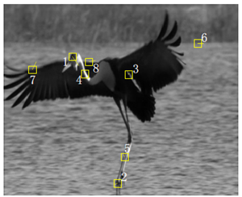
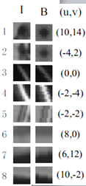
Adapted Version in Explicit Region Modeling
A primitive

Slide 75
Adapted Version in Explicit Region Modeling
a minority of noisy bricks are trackable over time but not sketchable; thus we cannot find specific shared primitives to represent them.
Trackable and Sketchable Regions
Trackable and Non-sketchable Regions

Slide 76
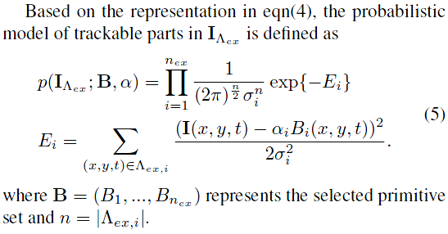
Adapted Version in Explicit Region Modeling

Slide 77
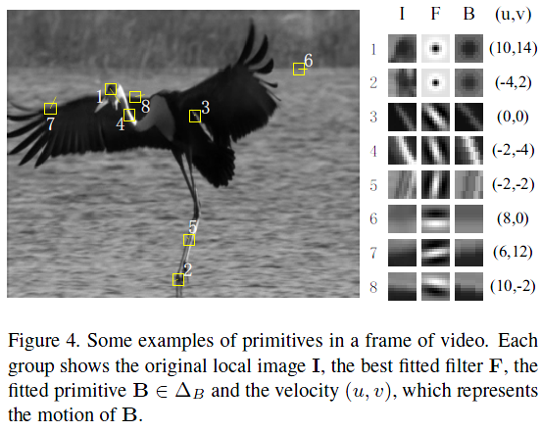
Adapted Version in Explicit Region Modeling
In order to alleviate computational complexity, α are calculated by filter responses.
The fitted filter F gives a raw sketch of the trackable patch and extracts information. such as type and orientation, for generating the primitive.

Slide 78
Episode 4
Inference Algorithm

Slide 79
Sketch Pursuit for Primal Sketch

Slide 80
Sketch Pursuit for Primal Sketch
The selected image primitives is indexed by k = 1, 2, …, K,

Slide 81
Sketch Pursuit for Primal Sketch
The sketch graph is a layer of hidden representation which has to be inferred from the image,

Slide 82
Sketch Pursuit for Primal Sketch
Probability model for the primal sketch representation:
Sparse Coding Residual Error
FRAME Residual Error
Dictionary Coding Length
FRAME Coding Length

Slide 83
Sketch Pursuit for Primal Sketch
The Sketch Pursuit Algorithm consists of two phases:
Phase 1: Deterministic pursuit of the sketch graph Ssk in a procedure similar to matching pursuit. It sequentially add new strokes (primitives of edges/ridges) that are most prominent.
Phase 2: Refine the sketch graph Ssk to achieve better Gestalt organization by reversible graph operators, in a process of maximizing a posterior probability (MAP).
Coarse to Fine

Slide 84
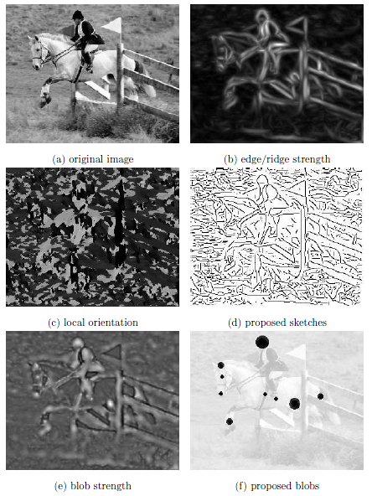
Sketch Pursuit for Primal Sketch
Phase 1
Blob-Edge-Ridge (BER) Detector for a proposal map
Acting as a prior for sketch pursuit algorithm.

Slide 85
Sketch Pursuit for Primal Sketch
Phase 1
This operation is called creation and defined as graph operator O1. The reverse operation O’1 proposes to remove one stroke.

Slide 86
Sketch Pursuit for Primal Sketch
Phase 1
This operation is called growing and defined as graph operator O2. This operator can be applied iteratively until no proposal is accepted. Then a curve is obtained.

Slide 87
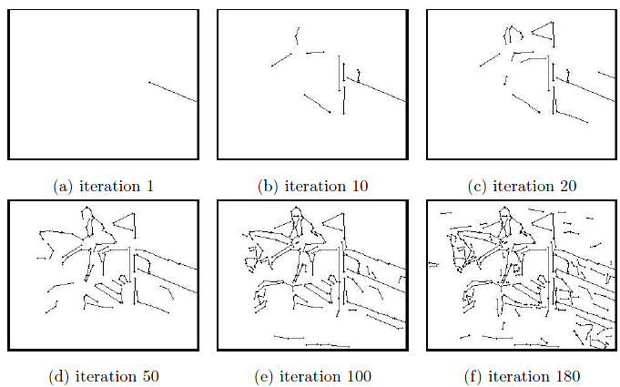
Sketch Pursuit for Primal Sketch
Phase 1
The sketch pursuit phase I applies operators O1 and O2 iteratively until no more strokes are accepted.
Phase I provides an initialization state for sketch pursuit phase II.

Slide 88
Sketch Pursuit for Primal Sketch
Probability model for the primal sketch representation:
Sparse Coding Residual Error
FRAME Residual Error
Dictionary Coding Length
FRAME Coding Length

Slide 89
Sketch Pursuit for Primal Sketch
Phase 1
Using a simplified primal sketch model
Sparse Coding Residual Error
Simplify FRAME Residual Error as a local Gaussian distribution.

Slide 90
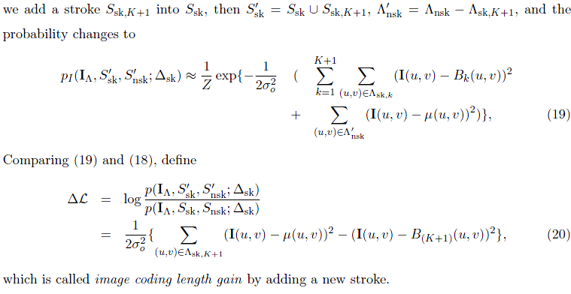
Sketch Pursuit for Primal Sketch
Phase 1

Slide 91
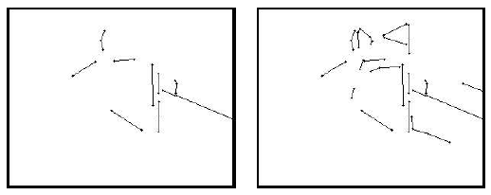
Sketch Pursuit for Primal Sketch
Phase 1
Grow a stroke
Grow a stroke

Slide 92
Sketch Pursuit for Primal Sketch
Phase 2

Slide 93
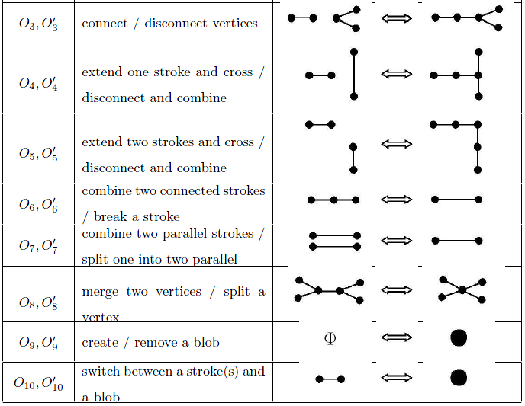
Sketch Pursuit for Primal Sketch
Phase 2
Overall 10 graph operators is proposed facilitate the sketch pursuit process to transverse the sketch graph space.
Simplified Version of DDMCMC

Slide 94
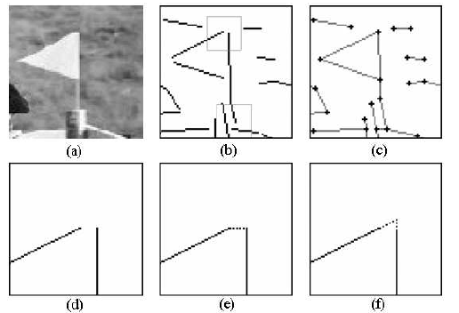
Sketch Pursuit for Primal Sketch
Phase 2
Input image.
Sketch map after Phase 1.
Sketch map after Phase 2.
The zoom-in view of the upper rectangle in b.
Applying O3 – connecting two vertices.
Applying O5 – extending two strokes and cross.

Slide 95
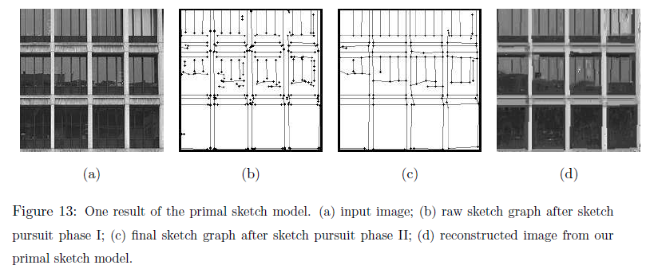
Sketch Pursuit for Primal Sketch
Phase 2

Slide 96
Sketch Pursuit for Primal Sketch
Probability model for the primal sketch representation:
Sparse Coding Residual Error
FRAME Residual Error
Dictionary Coding Length
FRAME Coding Length

Slide 97
Sketch Pursuit for Primal Sketch
Phase 2
Sparse Coding Residual Error
Dictionary Coding Length
Simplify FRAME Residual Error as a local Gaussian distribution.

Slide 98
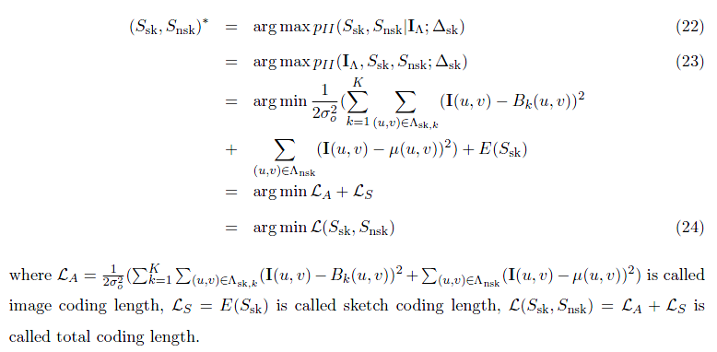
Sketch Pursuit for Primal Sketch
Phase 2

Slide 99
Episode 5
Reviews, Problems, and Vista

Slide 100
Review of Primal Sketch
Region of Primitives
Sketch Graph
Synthesized Primitives
Sketch Pursuit
Input Image
Synthesized Image
Region of Texture
Texture Clustering and Modeling
Synthesized Texture

Slide 101
Review of Video Primal Sketch
Input Video
Dictionary
Synthesized Primitives
Explicit Region
Sparse Coding
Synthesized Frame
Input Frame
Sketchability & Trackability Map
Previous Two Frames
Synthesized Texture
Implicit Region
ST-FRAME

Slide 102
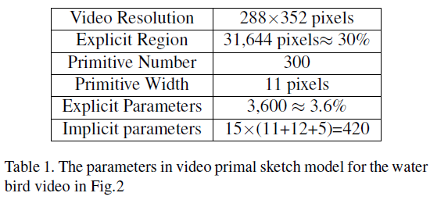
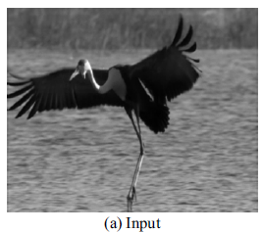
Problem in Video Primal Sketch
Major region: implicit region
Major model parameters: explicit parameters

Slide 103
Problem in Video Primal Sketch
Major error: error from reconstructing explicit regions

Slide 104
Problem in Video Primal Sketch
Modeling trackable and non-sketchable region with Sparse Coding or FRAME ?
Special dictionary for trackable and non-sketchable region.

Slide 105
Problem in Video Primal Sketch

Slide 106
A Philosophy Problem
Probability model for the primal sketch representation:
Simplified as

Slide 107
A Philosophy Problem
Probability model for the video primal sketch representation:
inconsistent energy measurement!

Slide 108
A Philosophy Problem
Philosophy View - Contrary vs. Uniform
S. C. Zhu “Eternal Debate”
1. The central problems of primal sketch & video primal sketch:
The great complexity caused by mixing two totally irrelevant model together.
The Collapse of Classical Physics
a. 相对论排除了绝对时空观的牛顿幻觉，
b. 量子论排除了可控测量过程中的牛顿迷梦，c. 混沌论则排除了拉普拉斯可预见性的狂想.
2. Reviewing two method in a dialectic way.
The problem caused by metaphysics: constrained observation, huge gap between two categories.

Slide 109
Vista
3. The philosophical purpose of image / video segmentation:
Magnifying the difference among different parts of the image / video.
4. Complement method to ameliorate these two modeling method
Intuition: particle wave duality, texture & texton, coexist for each atom in image / video, observation decides which state dominates.

Slide 110
Vista
5. Schrödinger Equation / Uncertain Principle:
The particle position we observe is the integral of a probability wave.
6. The new intuition of video modeling
Texton texture duality: (1). Integral of a single probability wave – trackable, sketchable motion, (2). Integral of the composition of several probability wave – textured motion

Slide 111
QUESTIONS?

