Slide 1
CS145 Discussion
Week 9
Yunsheng, Shengming
03/08/2019

Slide 2
Today’s Discussion
Announcement
Roadmap
GSP
PrefixSpan
DTW
Naive Bayes
Project Help
Q & A

Slide 3
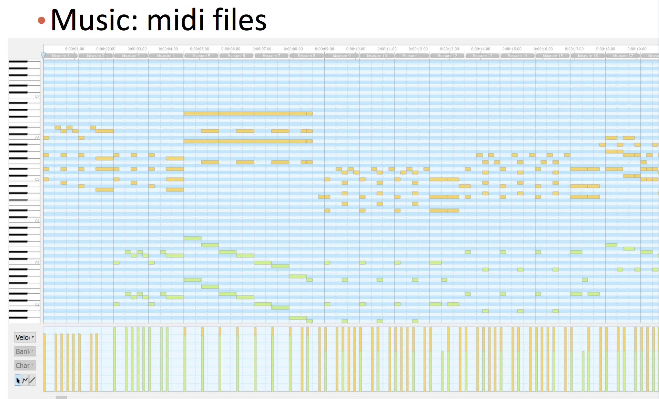
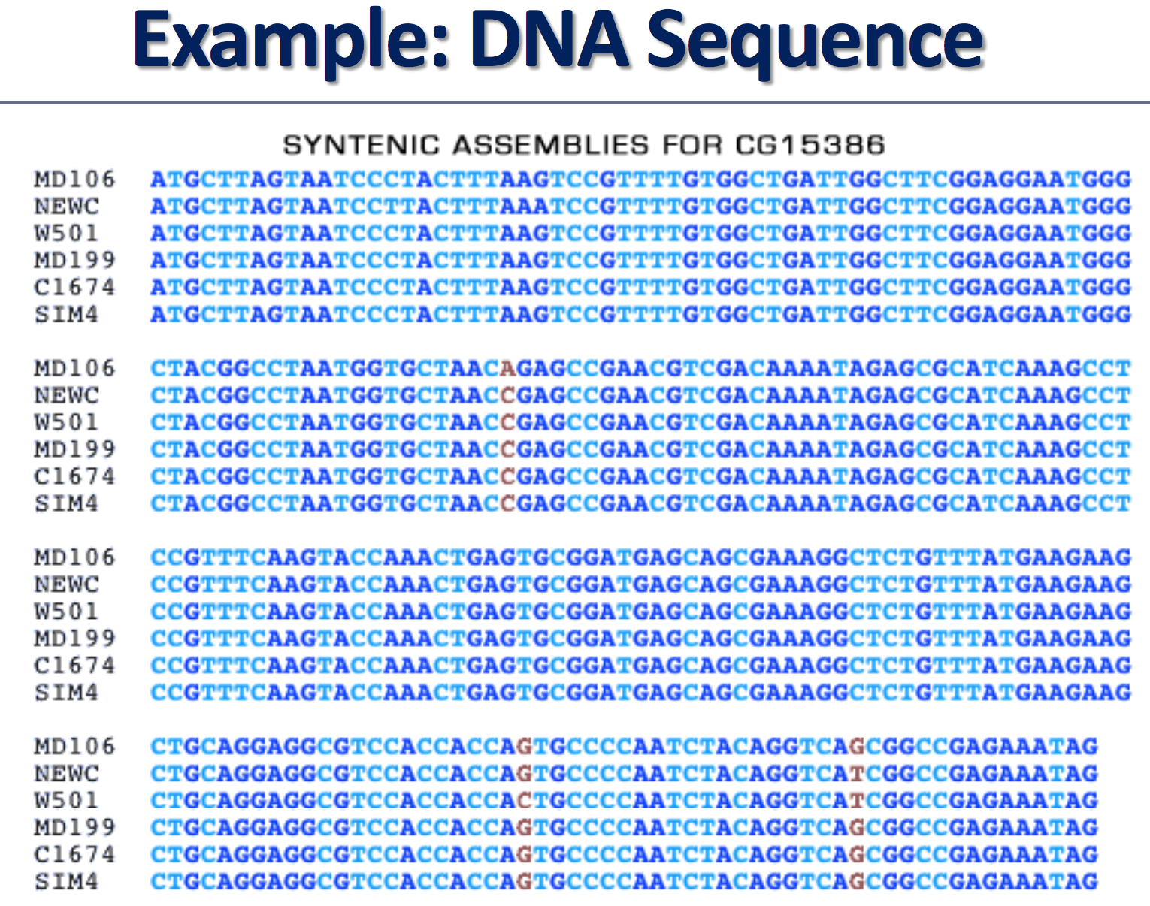
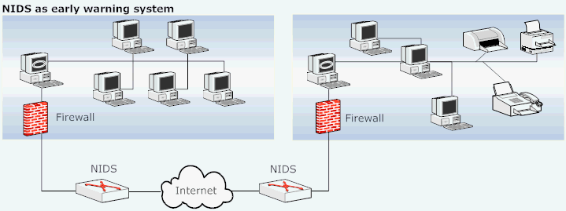
Sequential Pattern Mining: Applications
https://www.cse.wustl.edu/~jain/cse571-07/ftp/ids/index.html#sec2

Slide 4
GSP
https://www.slideshare.net/Krish_ver2/53-mining-sequential-patterns

Slide 5
GSP
https://www.slideshare.net/Krish_ver2/53-mining-sequential-patterns

Slide 6
GSP
https://www.slideshare.net/Krish_ver2/53-mining-sequential-patterns

Slide 7
GSP
https://www.slideshare.net/Krish_ver2/53-mining-sequential-patterns

Slide 8
GSP
https://www.slideshare.net/Krish_ver2/53-mining-sequential-patterns

Slide 9
GSP
https://www.slideshare.net/Krish_ver2/53-mining-sequential-patterns

Slide 10
GSP
https://www.slideshare.net/Krish_ver2/53-mining-sequential-patterns

Slide 11
GSP
https://www.slideshare.net/Krish_ver2/53-mining-sequential-patterns

Slide 12
GSP
https://www.slideshare.net/Krish_ver2/53-mining-sequential-patterns

Slide 13
PrefixSpan
https://fenix.tecnico.ulisboa.pt/downloadFile/1407993358847907/licao_8.pdf

Slide 14
PrefixSpan
https://fenix.tecnico.ulisboa.pt/downloadFile/1407993358847907/licao_8.pdf

Slide 15
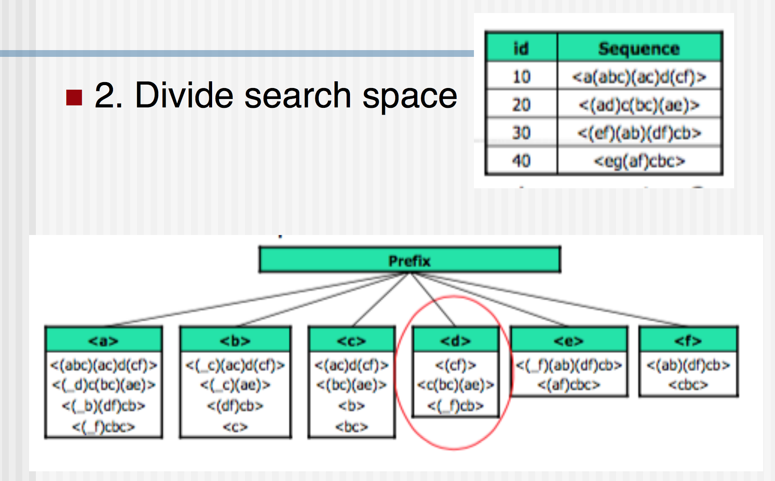
PrefixSpan
https://fenix.tecnico.ulisboa.pt/downloadFile/1407993358847907/licao_8.pdf

Slide 16
PrefixSpan
https://fenix.tecnico.ulisboa.pt/downloadFile/1407993358847907/licao_8.pdf

Slide 17
PrefixSpan
https://fenix.tecnico.ulisboa.pt/downloadFile/1407993358847907/licao_8.pdf

Slide 18
PrefixSpan
https://fenix.tecnico.ulisboa.pt/downloadFile/1407993358847907/licao_8.pdf

Slide 19
PrefixSpan
https://fenix.tecnico.ulisboa.pt/downloadFile/1407993358847907/licao_8.pdf

Slide 20
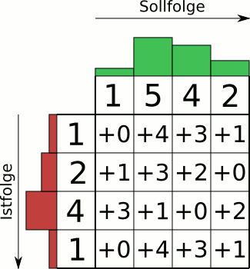
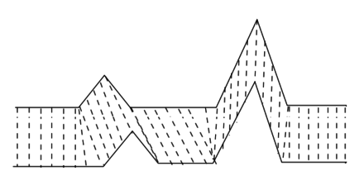
DTW
https://en.wikipedia.org/wiki/Dynamic_time_warping
https://commons.wikimedia.org/wiki/File:Animation_Dynamic_Time_Warping.gif

Slide 21
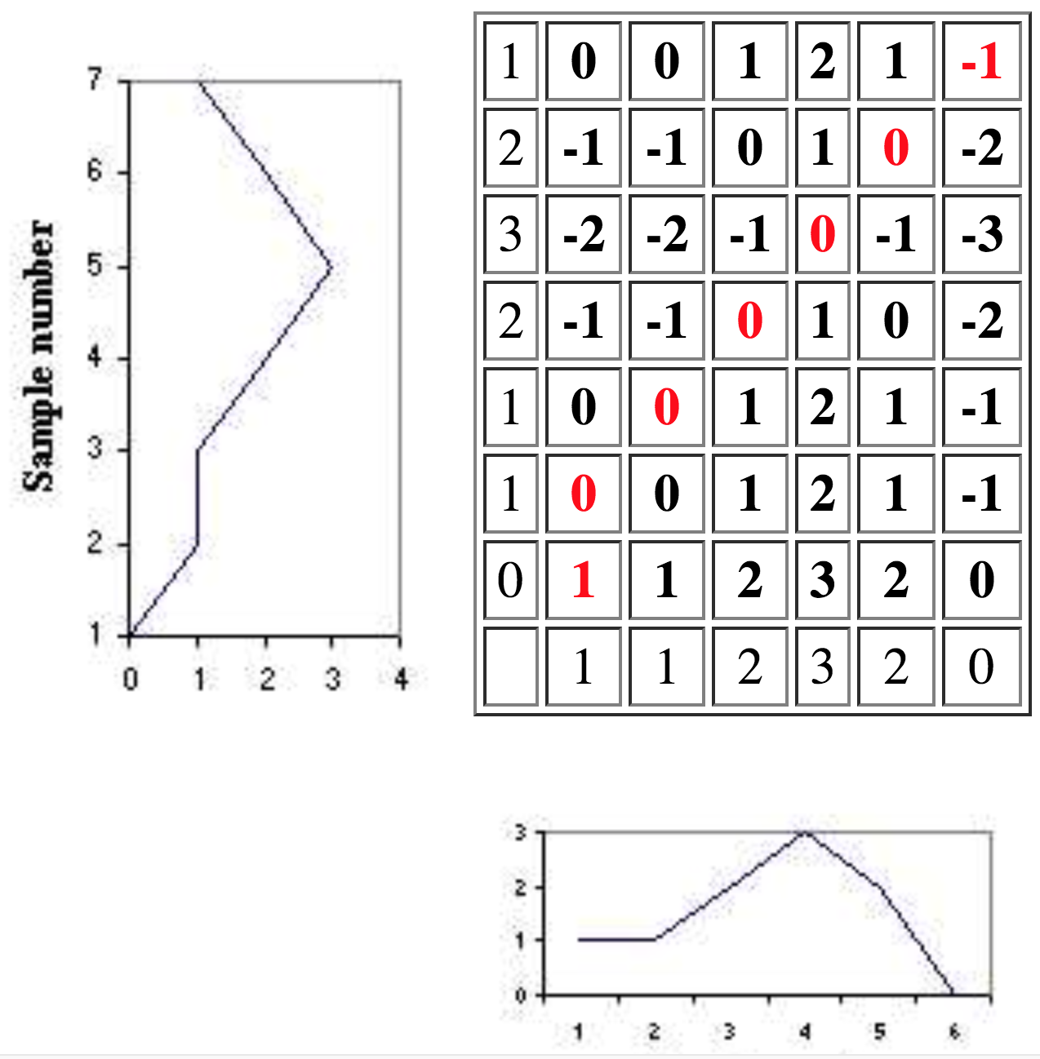
DTW
http://www.phon.ox.ac.uk/jcoleman/old_SLP/Lecture_5/DTW_explanation.html

Slide 22
DTW
http://www.phon.ox.ac.uk/jcoleman/old_SLP/Lecture_5/DTW_explanation.html

Slide 23
DTW
0
0
1
2
1
1
1
1
0
1
1
2
2
2
1
0
1
3
1
1
0
1
0
2
0
0
1
2
1
1
0
0
1
2
1
1
1
2
3
2
0
http://www.phon.ox.ac.uk/jcoleman/old_SLP/Lecture_5/DTW_explanation.html

Slide 24
DTW
5
5
3
4
3
5
5
5
2
2
3
4
4
4
2
1
2
5
2
2
1
2
2
4
1
1
2
4
5
6
1
1
2
4
5
6
2
4
7
9
9
http://www.phon.ox.ac.uk/jcoleman/old_SLP/Lecture_5/DTW_explanation.html

Slide 25
DTW
5
5
3
4
3
5
5
5
2
2
3
4
4
4
2
1
2
5
2
2
1
2
2
4
1
1
2
4
5
6
1
1
2
4
5
6
2
4
7
9
9
http://www.phon.ox.ac.uk/jcoleman/old_SLP/Lecture_5/DTW_explanation.html

Slide 26
DTW
5
5
3
4
3
5
5
5
2
2
3
4
4
4
2
1
2
5
2
2
1
2
2
4
1
1
2
4
5
6
1
1
2
4
5
6
2
4
7
9
9
http://www.phon.ox.ac.uk/jcoleman/old_SLP/Lecture_5/DTW_explanation.html

Slide 27
DTW
5
5
3
4
3
5
5
5
2
2
3
4
4
4
2
1
2
5
2
2
1
2
2
4
1
1
2
4
5
6
1
1
2
4
5
6
2
4
7
9
9
http://www.phon.ox.ac.uk/jcoleman/old_SLP/Lecture_5/DTW_explanation.html

Slide 28
DTW
5
5
3
4
3
5
5
5
2
2
3
4
4
4
2
1
2
5
2
2
1
2
2
4
1
1
2
4
5
6
1
1
2
4
5
6
2
4
7
9
9
http://www.phon.ox.ac.uk/jcoleman/old_SLP/Lecture_5/DTW_explanation.html

Slide 29
DTW
5
5
3
4
3
5
5
5
2
2
3
4
4
4
2
1
2
5
2
2
1
2
2
4
1
1
2
4
5
6
1
1
2
4
5
6
2
4
7
9
9
http://www.phon.ox.ac.uk/jcoleman/old_SLP/Lecture_5/DTW_explanation.html

Slide 30
DTW
5
5
3
4
3
5
5
5
2
2
3
4
4
4
2
1
2
5
2
2
1
2
2
4
1
1
2
4
5
6
1
1
2
4
5
6
2
4
7
9
9
http://www.phon.ox.ac.uk/jcoleman/old_SLP/Lecture_5/DTW_explanation.html

Slide 31
DTW
http://www.phon.ox.ac.uk/jcoleman/old_SLP/Lecture_5/DTW_explanation.html

Slide 32
Thank you!
Q & A

